Slide 1


Discovery Informatique – Session de formation
FORMATION QAD REPORTING FRAMEWORK
Novembre 2018
Présenté par :
Faiçal ABBASSI
Ingénieur Consultant technico-fonctionnel
faical.abbassi@discovery.com.tn
Bureau : (+216) 71 942 765 , poste 124
Cell : (+216) 98 760 337

Slide 2
Présentation
QAD Reporting Framework est un outil QAD pour gérer et générer :
  Des reporting
  Des documents de gestion

Slide 3
Présentation
depuis QAD 2009, sur la Standard Edition et Enterprise Edition
Module “Gratuit” si en Contrat de Maintenance actif
Echantillons inclus (Samples)
Directement connecté à la base de données de QAD.

Slide 4
Pourquoi faire?
Rapports plus beaux, y compris les logos, des changements de police, codes barres, mise en évidence d’éléments, totaux, etc.
Optimisation de l’espace dans un rapport
Simplification de la mise en page
Utilisation d’un Browse ou Query comme base/input pour l’exécution du rapport.

Slide 5
Pourquoi faire?
Sauvegarde des critères de recherche pour simplifier l’input
Générer des rapports en format pdf ou Excel
Planification automatique de rapports

Slide 6
Ce qui est inclus
Modèles standard
  Basés sur des Browses
  Orientation : Portrait/Paysage
  Présentation : Etiquettes, Colonnes
  Formats : A4, Letter, …
Echantillons fournis :
  Documents commerciaux : Offres, Commandes, BL, Factures
  Ordres d’achat
  Ordres de fabrication

Slide 7
Terminologie
Rapport (Report) : est une collection des données désirées, comme définies à la ressource d’état (Report Resource) et organisées selon le format désiré comme défini à la définition d’état (Report Definition)
Ressource d’état (Report Resource) : représente un objet unique et multi-domaines qui contient les définitions, la source de données, la metadata, les filtres, et les paramètres du rapport.

Slide 8
Terminologie
Définition d’état (Report Definition) : est un fichier XML qui peut être édité dans le Concepteur de ressource d’état et qui contient toute l’information définissant les ralations entre les données, le layout et le formatage personnalisé de l’état.
Modèle d’état (Report Template): est une définition d’état spécifique contenant certains aspects pour le formatage d’états. Il est défini puis hérité par un ou plusieurs états. Le modèle permet d’appliquer des mises à jour à l’ensemble des états qui l’héritent.

Slide 9
Architecture Reporting Framework
Report
Layout
Definition
Pre-Render
Engine
Report
Render
Engine
Report
Applies Template
Translates Labels
Data
Source
Progress Program
Browse
Financial API

Slide 10
Architecture Reporting Framework
Report
Layout
Definition
Pre-Render
Engine
Report
Render
Engine
Report
Applies Template
Translates Labels
Data
Source
Progress Program
Browse
Financial API

Slide 11
Architecture Reporting Framework
Report
Render
Engine
Prend en entrée la source de données (data source) et la définition de mise en page de l’état (report layout definition).
En sortie de ce processus : visualisateur de document, fichier PDF, fichier Excel, ou envoi vers imprimante.

Slide 12
Architecture Reporting Framework
Report
Render
Engine
  Composant tiers
  Solution .NET, exécutée sous Windows seulement
Le processus de création de l’état prend place sur la machine qui exécute l’état. Si c’est le PC client ayant QAD .NET qui exécute le rapport, l’exécution se fait alors côté client (contribue à répartir la charge de traitement sur les machines clientes)

Slide 13
Architecture Reporting Framework
Report
Layout
Definition
Pre-Render
Engine
Report
Render
Engine
Report
Applies Template
Translates Labels
Data
Source
Progress Program
Browse
Financial API

Slide 14
Architecture Reporting Framework
  Avant de créer un rapport, déter-miner d’où viennent les données. QAD Reporting Framework supporte 3 types de sources de données :
      Browse
        Créé avec « MAINT des consultations » (36.20.13)
        Codage non nécessaire
      Proxy générique (Programme Progress)
        Solution la plus complète et la plus flexible
        Nécessite dév. Progress
      QAD EE Financials API
Data
Source
Progress Program
Browse
Financial API
Notes:
Depending on which type of data source you use, you may need to perform some additional implementation steps.
NOTE: It is even possible to create a new data source type to connect to other stores of data. This would require writing a .NET implementation of the IDataSourceProvider interface.
Rolling up your sleeves and writing Progress code is your most powerful method to create data sources. (Most powerful, but not necessarily quicker or more convenient.) If data is in a browse or Financials query, that’s easier, but the power of 4GL is available.

Slide 15
Architecture Reporting Framework
Report
Layout
Definition
Pre-Render
Engine
Report
Render
Engine
Report
Applies Template
Translates Labels
Data
Source
Progress Program
Browse
Financial API

Slide 16
Architecture Reporting Framework
  Definit quels éléments seront affichés et où seront-t-ils affichés dans la page
  Enregistré en tant que fichier XML
  Créé/édité par le Concepteur d’état
  Concepteur d’état : éditeur graphique
  Outil d’import/export :
    Utile pour le contrôle de version, le déploiement
Report
Layout
Definition
Notes:
Depending on which type of data source you use, you may need to perform some additional implementation steps.
NOTE: It is even possible to create a new data source type to connect to other stores of data. This would require writing a .NET implementation of the IDataSourceProvider interface.
Rolling up your sleeves and writing Progress code is your most powerful method to create data sources. (Most powerful, but not necessarily quicker or more convenient.) If data is in a browse or Financials query, that’s easier, but the power of 4GL is available.

Slide 17
Report
Layout
Definition
Pre-Render
Engine
Report
Render
Engine
Report
Applies Template
Translates Labels
.NET UI Viewer
PDF, PDF read-only
TIFF
RTF
Excel
Plain text
User can send to printer
Data
Source
Progress Program
Browse
Financial API

Slide 18
Architecture Reporting Framework
Report
  Les rapports peuvent être rendus en formats différents:
    Document (visualisateur .NET UI) : affiché dans la fenêtre de visualisation
    Fichier PDF
    Fichier PDF en lecture seule
    Image TIFF
    Fichier Excel
    Fichier RTF
    Texte brut
Notes:
Depending on which type of data source you use, you may need to perform some additional implementation steps.
NOTE: It is even possible to create a new data source type to connect to other stores of data. This would require writing a .NET implementation of the IDataSourceProvider interface.
Rolling up your sleeves and writing Progress code is your most powerful method to create data sources. (Most powerful, but not necessarily quicker or more convenient.) If data is in a browse or Financials query, that’s easier, but the power of 4GL is available.

Slide 19
Sources de données
Browse
  Crée à partir de ‘Browse Maintenance’ (36.4.8.13)
  Pas de programmation requise
Programme Progress (“Proxy”)
  Option la plus puissante et flexible
  Nécessite d’effectuer de la programmation avancée
API Query Finance (seulement pour la version EE)

Slide 20
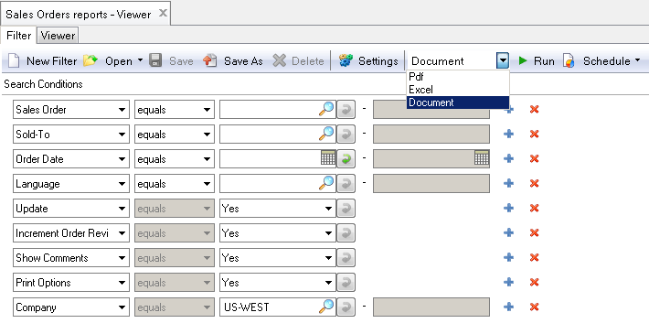
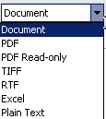
Exécution d’un rapport
Mise en batch du rapport
Gestion des filtres : création, sauvegarde, chargement
Type de sortie : PDF, Excel, …
Paramétrage des formats de dates, décimaux et emplacement des critères de recherche

Slide 21
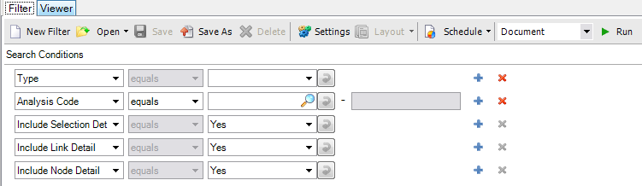
Exécution d’un rapport
La zone de filtre permet de spécifier les critères de recherche afin de filtrer les données de l’état.
Enregitrer les critères de recherche afin de les réutiliser

Slide 22
Exécution d’un rapport
Conditions de recherche
Ouvrir > Plus… (filtres sauvegardés)
Enregistrer, Enregistrer sous…
Supprimer
Paramètres (Général, Date, Décimal)
Présentation (disponible si la ressource d’état a plusieurs définitions d’état)
Types de sorties
Exécuter

Slide 23
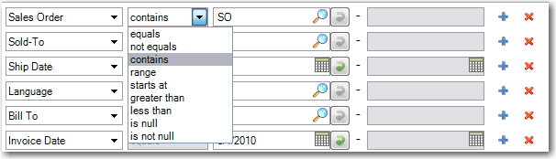
Exécution d’un rapport
Conditions de recherche :
  Égal
  N’est pas égal à
  Contient
  Gamme
  Démarre à
  Plus grand que
  Inférieur à
  Est nul(le)
  N’est pas nul(le)
Ajout/sauvegarde de conditions

Slide 24
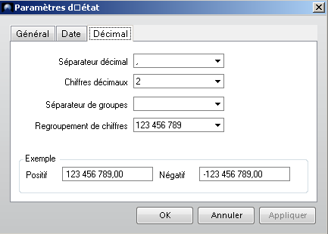
Exécution d’un rapport
Paramètres d’état :
  Général
    Critères de sélection : les faire apparaître sur le document final? Si oui, en début ou en fin d’édition
  Date
    Format d’affichage de la date
  Décimal
    Format, séparateur,…
Paramétrage hors filtres

Slide 25
Exécution d’un rapport
Notez-Bien :
  Report Framework est capable non seulement de lire les données dans la base, mais également de la modifier. Exemple : marquer un document comme ayant déjà été imprimé.
  De manière générale, n’importe quelle donnée est modifiable.
  Il n’est pas possible de modifier des données lorsque le Report est bâti sur un browse.

Slide 26
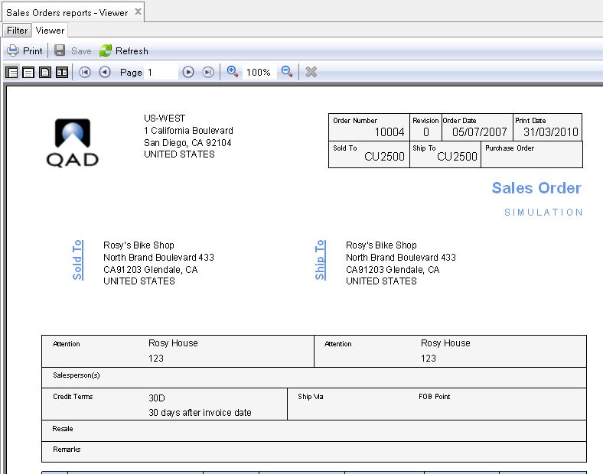
Exécution d’un rapport
Exemple de sortie (Sales Ordrer) :

Slide 27
Maintenance ressource état
(36.4.21.1)
N.B. : Si ce menu semble ne pas marcher, vérifier ces paramètres dans « MAINT des paramètres généraux » (36.2.13)
  +----------------------------- Generalized Codes ------------------------------+
  | Field Name: rptres_category |
  | Value: C1 |
  | |
  | Comments: Report |
  +------------------------------------------------------------------------------+
  +----------------------------- Generalized Codes ------------------------------+
  | Field Name: rptres_datasource_type |
  | Value: 1 |
  | |
  | Comments: Browse |
  +------------------------------------------------------------------------------+
  +----------------------------- Generalized Codes ------------------------------+
  | Field Name: rptres_datasource_type |
  | Value: 2 |
  | |
  | Comments: Proxy |
  +------------------------------------------------------------------------------+
  +----------------------------- Generalized Codes --------------------------+
  | Field Name: rptres_datasource_type |
  | Value: 3 |
  | |
  | Comments: FinancialAPI |
  +--------------------------------------------------------------------------+
  +----------------------------- Generalized Codes --------------------------+
  | Field Name: rptres_datasource_type |
  | Value: 4 |
  | |
  | Comments: Cognos |
  +--------------------------------------------------------------------------+
Notes:
Open Report Resource Maintenance and enter the following fields. Open Report Resource Maintenance and enter the following fields. Click Next or press Enter to move to the next frame or field; click Back to return to the previous field.
Report Code
Specify a code that identifies a report resource.
QAD-provided built-in reports, report resources and templates all begin with “QAD_”. Do not create or modify reports, report resources, or templates with this prefix. Otherwise, your customized changes will get overwritten during system upgrades from QAD.
Category
Select one of the following report resource types for different report providers: Report for QAD .NET-based reporting and Dashboard for Cognos dashboard reports.
Cognos dashboard reports are currently not implemented.
Data Source Type
Specify a data source type that indicates how the report retrieves its data:
Browse: The report uses browses as its data source. Both classic browses (created in Browse Maintenance) and Financials browses (created in the Financials CBF tool) are supported.
Proxy: The report accesses the database through the generic proxy program.
Financials API: The report retrieves data through the QAD Financials API.
Data Source Ref
Provide the reference information for retrieving data through the data source provider.
For classic QAD ERP browses maintained in Browse Maintenance, enter <BrowseServerType>:<QueryID>; for example, QAD.Browse.MfgProBrowseServer:so009. <BrowseServerType> is optional. If it is not specified, the data source reference defaults to the QAD ERP browse server. In this case, so009 is equivalent to QAD.Browse.MfgProBrowseServer:so009.
For Financials browses created in the Financials CBF tool, enter the following:
BaseAdapters.CBAdapters.QadBrowseAdapter:<BusinessComponent>.<QueryMethod>
Here is an example using this naming syntax:
BaseAdapters.CBAdapters.QadBrowseAdapter:BJournalEntry.SelectPosting
For the generic proxy data source, specify a data source proxy program file name; for example, myReport.p.
For the Financials API data source, specify a Financials reporting component name followed by a method name; for example, BGLReport.GLList, where BGLReport is a component name and GLList is a method name.
Description
Provide a description of the report resource.
Default Definition
Specify the default report definition for the report resource. When you open a report resource in Report Viewer or Report Designer, this report definition is loaded by default.

Slide 28
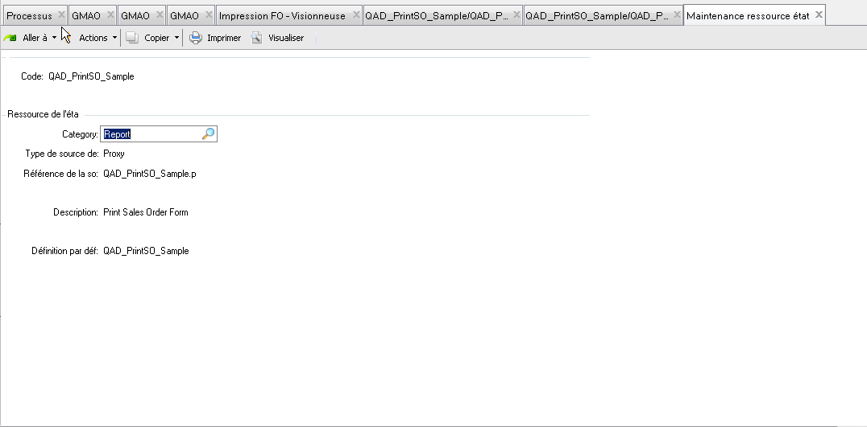
Maintenance ressource état
(36.4.21.1)
Notes:
Open Report Resource Maintenance and enter the following fields. Open Report Resource Maintenance and enter the following fields. Click Next or press Enter to move to the next frame or field; click Back to return to the previous field.
Report Code
Specify a code that identifies a report resource.
QAD-provided built-in reports, report resources and templates all begin with “QAD_”. Do not create or modify reports, report resources, or templates with this prefix. Otherwise, your customized changes will get overwritten during system upgrades from QAD.
Category
Select one of the following report resource types for different report providers: Report for QAD .NET-based reporting and Dashboard for Cognos dashboard reports.
Cognos dashboard reports are currently not implemented.
Data Source Type
Specify a data source type that indicates how the report retrieves its data:
Browse: The report uses browses as its data source. Both classic browses (created in Browse Maintenance) and Financials browses (created in the Financials CBF tool) are supported.
Proxy: The report accesses the database through the generic proxy program.
Financials API: The report retrieves data through the QAD Financials API.
Data Source Ref
Provide the reference information for retrieving data through the data source provider.
For classic QAD ERP browses maintained in Browse Maintenance, enter <BrowseServerType>:<QueryID>; for example, QAD.Browse.MfgProBrowseServer:so009. <BrowseServerType> is optional. If it is not specified, the data source reference defaults to the QAD ERP browse server. In this case, so009 is equivalent to QAD.Browse.MfgProBrowseServer:so009.
For Financials browses created in the Financials CBF tool, enter the following:
BaseAdapters.CBAdapters.QadBrowseAdapter:<BusinessComponent>.<QueryMethod>
Here is an example using this naming syntax:
BaseAdapters.CBAdapters.QadBrowseAdapter:BJournalEntry.SelectPosting
For the generic proxy data source, specify a data source proxy program file name; for example, myReport.p.
For the Financials API data source, specify a Financials reporting component name followed by a method name; for example, BGLReport.GLList, where BGLReport is a component name and GLList is a method name.
Description
Provide a description of the report resource.
Default Definition
Specify the default report definition for the report resource. When you open a report resource in Report Viewer or Report Designer, this report definition is loaded by default.

Slide 29
Maintenance ressource état
Report Code
  Unique. Le préfixe « QAD_ » correspond aux rapports standards
Report Category => Toujours ‘Report’
Data source type => Browse, Proxy, ou API Finance (EE)
Data source ref
  ID du browse (Browse opérationnel). Exemple : so001 (idem QAD.Browse.MfgProBrowseServer:so001)
  Ref du browse (Browse Finance). Exemple : BaseAdapters.CBAdapters.QadBrowseAdapter:BJournalEntry.SelectPosting
  Nom de programme (Proxy). Exemple : QAD_PrintPO.p
  Nom de l’objet Query (API Finance). Exemple : BGLReport.GLList
Notes:
Open Report Resource Maintenance and enter the following fields. Open Report Resource Maintenance and enter the following fields. Click Next or press Enter to move to the next frame or field; click Back to return to the previous field.
Report Code
Specify a code that identifies a report resource.
QAD-provided built-in reports, report resources and templates all begin with “QAD_”. Do not create or modify reports, report resources, or templates with this prefix. Otherwise, your customized changes will get overwritten during system upgrades from QAD.
Category
Select one of the following report resource types for different report providers: Report for QAD .NET-based reporting and Dashboard for Cognos dashboard reports.
Cognos dashboard reports are currently not implemented.
Data Source Type
Specify a data source type that indicates how the report retrieves its data:
Browse: The report uses browses as its data source. Both classic browses (created in Browse Maintenance) and Financials browses (created in the Financials CBF tool) are supported.
Proxy: The report accesses the database through the generic proxy program.
Financials API: The report retrieves data through the QAD Financials API.
Data Source Ref
Provide the reference information for retrieving data through the data source provider.
For classic QAD ERP browses maintained in Browse Maintenance, enter <BrowseServerType>:<QueryID>; for example, QAD.Browse.MfgProBrowseServer:so009. <BrowseServerType> is optional. If it is not specified, the data source reference defaults to the QAD ERP browse server. In this case, so009 is equivalent to QAD.Browse.MfgProBrowseServer:so009.
For Financials browses created in the Financials CBF tool, enter the following:
BaseAdapters.CBAdapters.QadBrowseAdapter:<BusinessComponent>.<QueryMethod>
Here is an example using this naming syntax:
BaseAdapters.CBAdapters.QadBrowseAdapter:BJournalEntry.SelectPosting
For the generic proxy data source, specify a data source proxy program file name; for example, myReport.p.
For the Financials API data source, specify a Financials reporting component name followed by a method name; for example, BGLReport.GLList, where BGLReport is a component name and GLList is a method name.
Description
Provide a description of the report resource.
Default Definition
Specify the default report definition for the report resource. When you open a report resource in Report Viewer or Report Designer, this report definition is loaded by default.

Slide 30
Maintenance ressource état
Remarque : Une source de donné peut être utilisée dans autant de Report codes que l’on veut.
Ne jamais modifier directement sur les ressources « QAD_ », faire d’abord une copie et changer de préfixe. Risque d’écrasement lors d’une mise à jour de QAD.
Notes:
Open Report Resource Maintenance and enter the following fields. Open Report Resource Maintenance and enter the following fields. Click Next or press Enter to move to the next frame or field; click Back to return to the previous field.
Report Code
Specify a code that identifies a report resource.
QAD-provided built-in reports, report resources and templates all begin with “QAD_”. Do not create or modify reports, report resources, or templates with this prefix. Otherwise, your customized changes will get overwritten during system upgrades from QAD.
Category
Select one of the following report resource types for different report providers: Report for QAD .NET-based reporting and Dashboard for Cognos dashboard reports.
Cognos dashboard reports are currently not implemented.
Data Source Type
Specify a data source type that indicates how the report retrieves its data:
Browse: The report uses browses as its data source. Both classic browses (created in Browse Maintenance) and Financials browses (created in the Financials CBF tool) are supported.
Proxy: The report accesses the database through the generic proxy program.
Financials API: The report retrieves data through the QAD Financials API.
Data Source Ref
Provide the reference information for retrieving data through the data source provider.
For classic QAD ERP browses maintained in Browse Maintenance, enter <BrowseServerType>:<QueryID>; for example, QAD.Browse.MfgProBrowseServer:so009. <BrowseServerType> is optional. If it is not specified, the data source reference defaults to the QAD ERP browse server. In this case, so009 is equivalent to QAD.Browse.MfgProBrowseServer:so009.
For Financials browses created in the Financials CBF tool, enter the following:
BaseAdapters.CBAdapters.QadBrowseAdapter:<BusinessComponent>.<QueryMethod>
Here is an example using this naming syntax:
BaseAdapters.CBAdapters.QadBrowseAdapter:BJournalEntry.SelectPosting
For the generic proxy data source, specify a data source proxy program file name; for example, myReport.p.
For the Financials API data source, specify a Financials reporting component name followed by a method name; for example, BGLReport.GLList, where BGLReport is a component name and GLList is a method name.
Description
Provide a description of the report resource.
Default Definition
Specify the default report definition for the report resource. When you open a report resource in Report Viewer or Report Designer, this report definition is loaded by default.

Slide 31
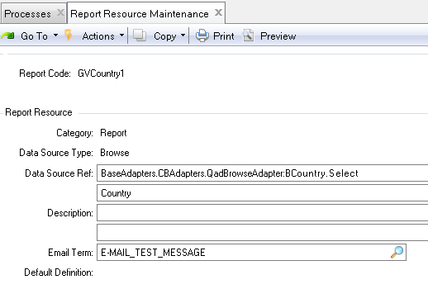
Report Resource Maintenance
Browse Finance
Processus de création d’un rapport depuis un browse Finance
Disparu dans les versions récentes

Slide 32
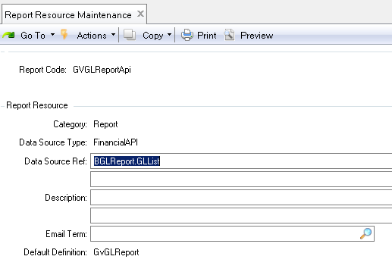
Report Resource Maintenance
API Report Finance
Processus de création d’un rapport depuis une API Report Finance
Disparu dans les versions récentes

Slide 33
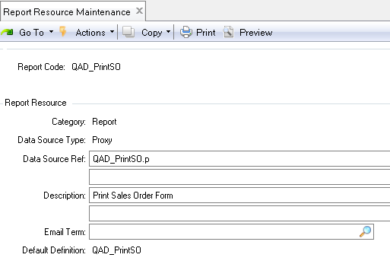
Report Resource Maintenance
Proxy
Processus de création d’un rapport depuis programme Proxy
Disparu dans les versions récentes

Slide 34
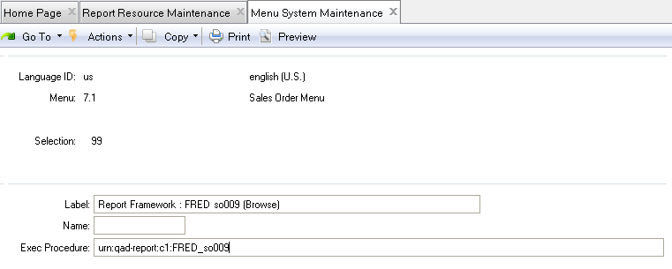
Ajout au menu d’un rapport QAD RF
Le ‘Report code’ doit avoir au moins une définition de ‘Mise en Page’ dans le « Report resource designer »
  Si plusieurs définitions, c’est celle par défaut qui sera exécutée quand le point de menu sera lancé
Utilisation du ‘Menu System Maintenance’ pourra servir d’alias lors de l’appel au report p(36.4.4)
  ‘Exec procedure’ correspond à ce type d’URN
    Urn:qad-report:c1:ReportCode
  On peut renseigner le champ « Name », qui a un lien qadsh.

Slide 35
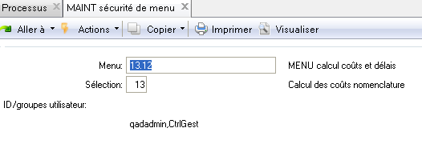
Ajout au menu d’un rapport QAD RF
Gestion de la sécurité
  SE : Menu Security Maintenance (36.3.10)

Slide 36
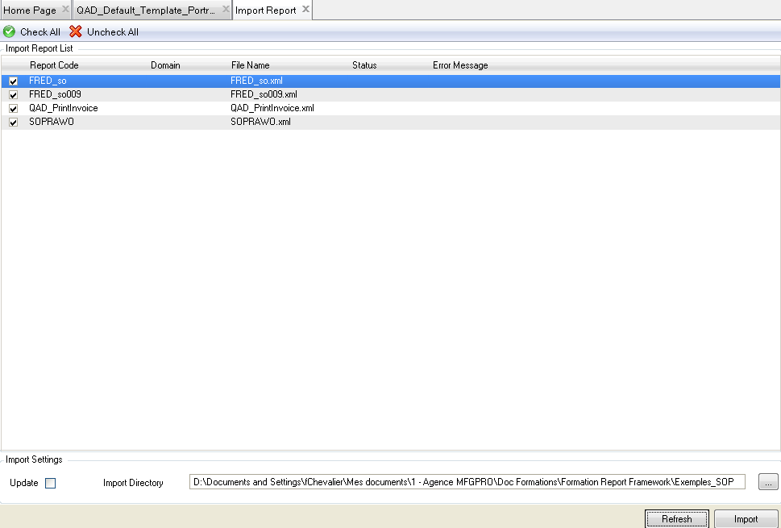
Import / Export
Report Resource Import (36.4.21.21)
  Import de la définition du rapport du fichier XML vers la base de donnée

Slide 37
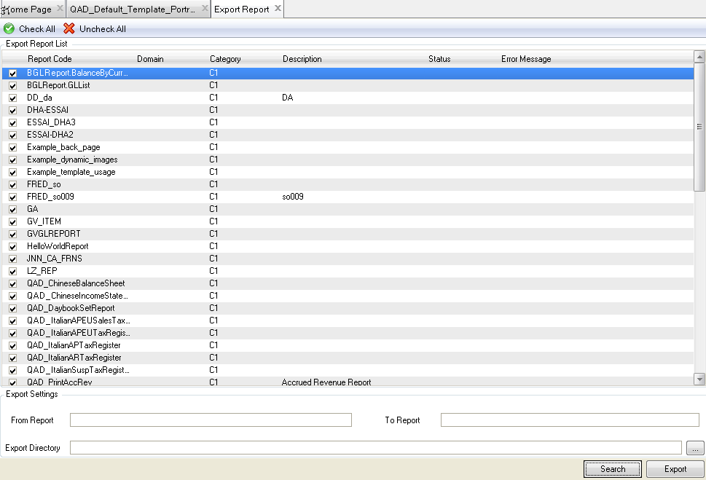
Import / Export
Report Resource Export (36.4.21.22)
  Export de la définition du rapport depuis la base de donnée vers un fichier XML (1 fichier XML par ressource, même si plusieurs définitions)
Sélection des rapports à exporter

Slide 38
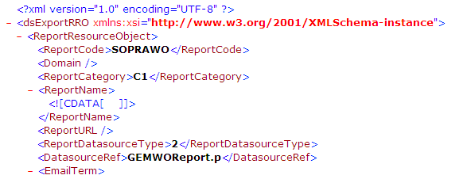
Import / Export
Fichier XML
  Contient toutes les informations de la ressource
  Contient toutes les définitions de la mise en page
    Champs utilisés
    Cadres
    Scripts VB
    Logos
    …
  Ne contient pas
    Le programme Proxy (.p) est séparé et devra être copié séparément
    Les xml de sélection (*.meta.xml)
    Le paramétrage de la disposition par défaut (manager dans 36.4.21.30)
    Les mises au menu / permissions

Slide 39
Report Resource Designer

Slide 40

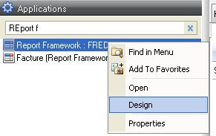
Utilisation du ‘Designer’
36.4.21.30
Editeur de type WYSIWYG (Ce que vous voyez est ce que vous obtenez)
Utilisable seulement pour les utilisateurs qui sont dans les groupes ‘rptDsgn’ et ‘rptAdmin’
  User Groups Maintenance (36.3.4) (SE)
  Role Permissions Maintain (36.3.6.5) (EE)
2 possibilités
  Menu ‘Report Resource Designer’ (36.4.21.30)
  Clic-droit sur un rapport « branché » au menu (Design)

Slide 41
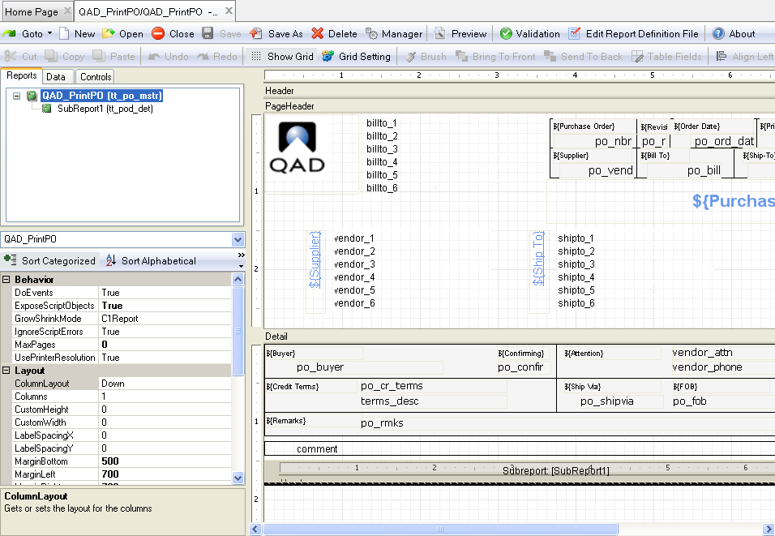
Utilisation du ‘Designer’
36.4.21.30

Slide 42

Utilisation du ‘Designer’
About :
Version du ‘Designer’
Barre d’outils
Preview :
Pour tester le rapport. Attention, cela peut entrainer des modifications de données !
New, Open, Close, Save, Save as, Delete
Test du la cohérence du code (vb)
Actions
Manager :
Choix de la définition par défaut
Edit Report Definition File :
Edition du fichier XML (idem Export XML)
Retour au 36.4.21.1

Slide 43
Utilisation du ‘Designer’
Gestion des champs (alignements, etc..)
Barre d’outils (2)
Modification du Z-order
Fonctions classiques d’édition
Paramétrage / Affichage de la grille
Copier le style
Lorsque plusieurs champs sont sélectionnés, ils sont mis côte à côte à la même hauteur
Options d’alignement riches, pratiques et plutôt bien faites
PAS DE ZOOM !
  QAD n’a pas prévu d’inclure cette fonctionnalité !!!
  Prévoir un grand écran pour le développement
  pour un alignement propre, aller directement modifier la position de l’objet dans ses propriétés.

Slide 44
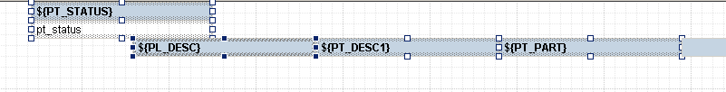
Utilisation du ‘Designer’
Barre d’outils (2)
Lors d’un sélection multiple, le dernier élément sélectionné a un status différent des autres (dans l’exemple ci-dessus, c’est le cas de ${PL_DESC}) On distingue cet élément par la couleur différente des carrés qui entourent le champ en question
Lorsqu’on applique une modification de style à une sélection de plusieurs éléments, c’est cet élément particulier qui sera pris comme référence (exemple : mettre tous les champs à la même hauteur de ligne)

Slide 45
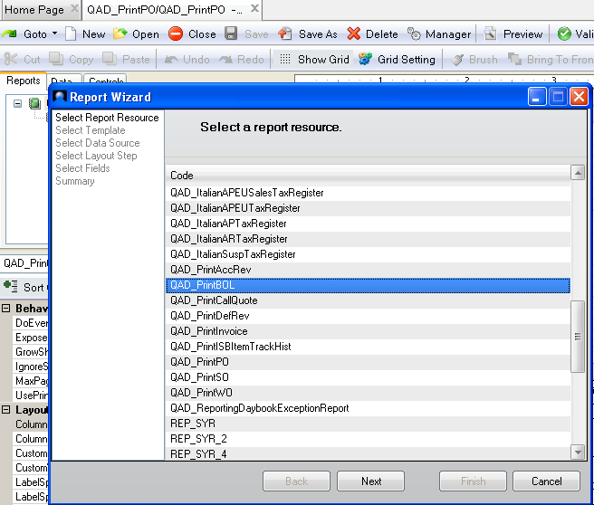
Utilisation du ‘Designer’
Nouveau rapport : Choix de la ressource

Slide 46
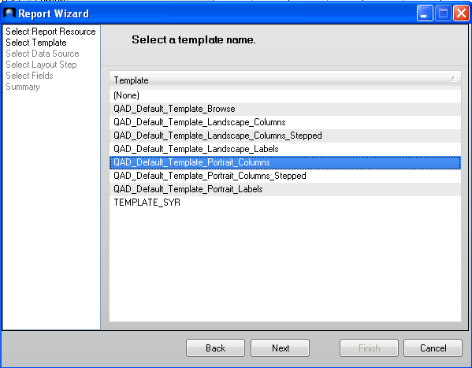
Utilisation du ‘Designer’
Nouveau rapport : Choix du ‘Template’ (non obligatoire)

Slide 47
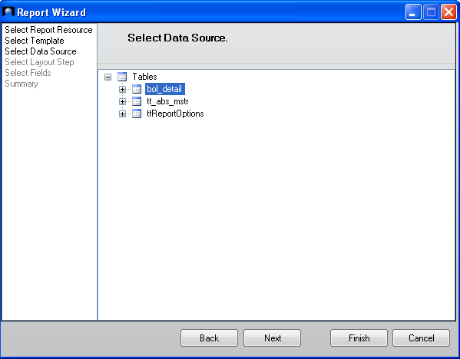
Utilisation du ‘Designer’
Nouveau rapport : Sélection de la source (1 seul niveau par rapport)
Dépendant du ‘DataSet’

Slide 48
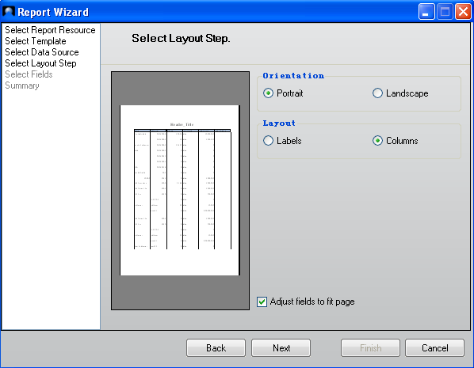
Utilisation du ‘Designer’
Nouveau rapport : Type de présentation

Slide 49
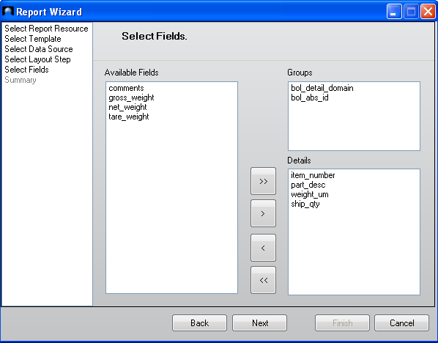
Utilisation du ‘Designer’
Nouveau rapport : Choix des champs à afficher et de ruptures
Tri des champs
(Rupture)
Champs
affichés

Slide 50
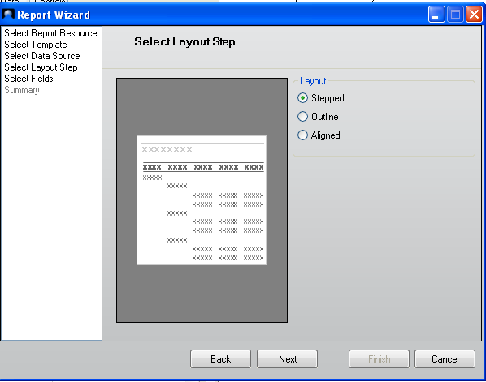
Utilisation du ‘Designer’
Nouveau rapport : Type de présentation (Défini par QAD)

Slide 51
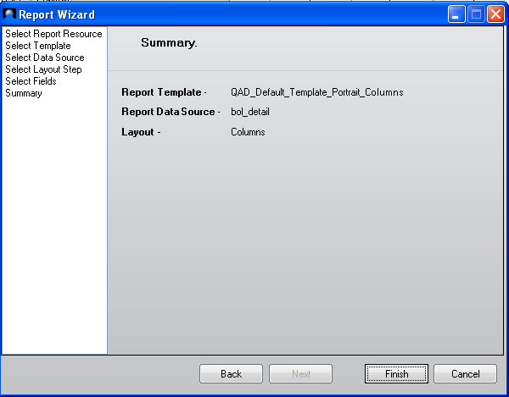
Utilisation du ‘Designer’
Nouveau rapport : Résumé
Après cette étape, impossible de revenir en arrière sur la présentation générale proposée

Slide 52
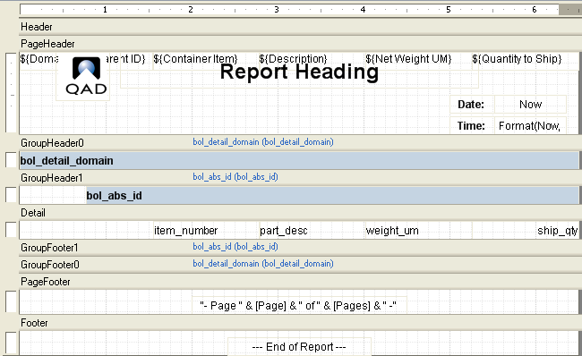
Utilisation du ‘Designer’
Nouveau rapport : Rapport généré

Slide 53
Utilisation du ‘Designer’
Sections
Header
  Affiché une fois au début du rapport
Page Header
  Affiché au début de chaque page
Group Header
  Affiché au début de chaque groupe d'enregistrement
Detail
  Affiché à chaque enregistrement
Group Footer
  Affiché à la fin de chaque groupe d'enregistrement
PageFooter
  Affiché à la fin de chaque page
Footer
  Affiché une fois à la fin du rapport

Slide 54
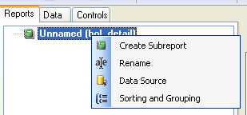
Utilisation du ‘Designer’
Onglet « Report » : Re-Paramétrage du rapport
Nom du rapport
Data Source
Tri / Regroupement
Création de sous-rapport

Slide 55
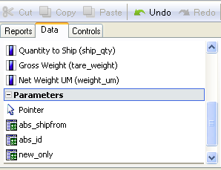
Utilisation du ‘Designer’
Onglet « Data »
Utilisé pour choisir le type de donnée à créer
  Fields : Liste des champs disponibles à partir de la source de donnée (DataSet)
  Parameters : Liste des valeurs des critères de sélection
  Report Settings : Liste des valeurs des paramétrages ‘système’
Utilisation
  1) Cliquer sur le champ désiré dans l’onglet « Data »
  2) Cliquer et « drag & drop » dans la section désirée pour créer un rectangle qui définira la position du champ

Slide 56
Utilisation du ‘Designer’
Onglet « Controls »
Permet de choisir le type de « contrôle » à créer
Utilisation
  1) Cliquer sur le champ désiré dans l’onglet « Controls »
  2) Cliquer et « drag & drop » dans la section désirée pour créer un rectangle qui définira la position du champ
Liste des objets
  Pointer : retour à l’outil « Pointeur de souris »
  Label : Texte statique (possibilité de champ traduit)
  Calculated Field : Expression en script VB
  Common Field : Champ prédéfini (Date, heure, page)
  Unbound Picture : Image, logo
  Line, rectangle : Objet géométrique
  Page Break : Saut de page
  Chart : Gestion de graphique simple par rapport aux données du DataSet
  Barcode : Code à barres (attention, certains codes-barre ne prennent pas en charge les caractères minuscules : penser à utilier la fonction VB de mise en majuscule)

Slide 57
Utilisation du ‘Designer’
Astuces de développement
L’utilisation du clavier est possible pour beaucoup de manipulations
  Touche TAB => aller sur l’objet suivant
  CTRL + TAB => objet précédent
  Flèches directionnelles : déplacement de l’objet ou des objets dans le cas d’un sélection multiple
  CTRL + Flèches directionnelles : déplacement fin
  MAJ + Flèches directionnelles : redimensionnement de la zone (coin supérieur gauche fixe)
  MAJ + CTRL + Flèches directionnelles : redimensionnement fin
  F2 : modification du contenu de la zone
  CTRL + C / V / X => copier / coller / couper
  … d’autres à découvrir

Slide 58
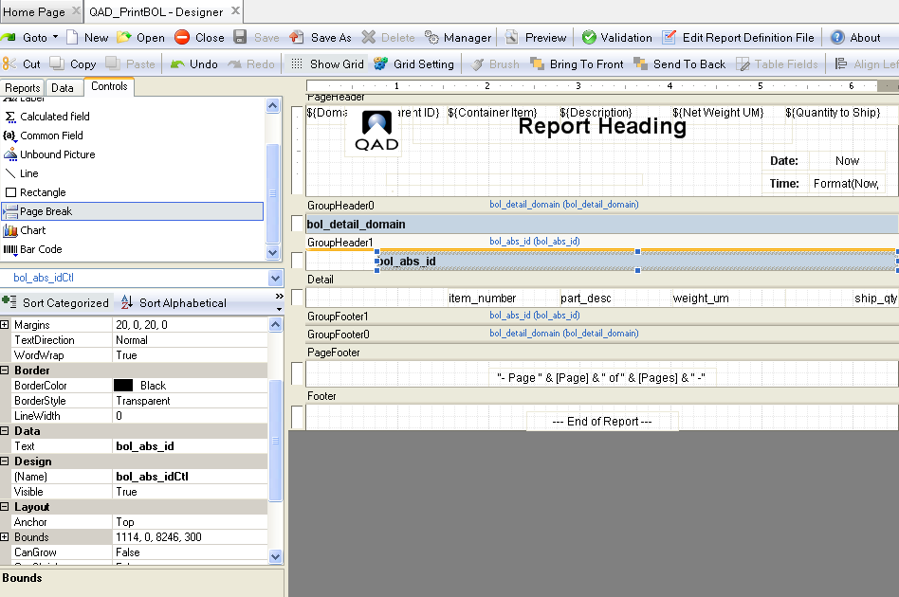
Utilisation du ‘Designer’
Propriétés des objets
Voir détail dans ‘Reporting Framework User Guide’

Slide 59
Utilisation du ‘Designer’
Traduction des libellés
Traduction selon la langue de l’utilisateur (sys_language)
Jusqu’à la version QAD 2009.1
  Label « Long » issu du module de traduction (36.4.17.1)
  ${TERM_KEY}
Depuis la version QAD 2010 (2.9 .Net UI)
  Choix du label
    ${TERM_KEY} : Libellé le plus LONG possible (idem mode MFG)
    ${TERM_KEY}S : Libellé COURT
    ${TERM_KEY}M : Libellé MEDIUM
    ${TERM_KEY}L : Libellé LONG
    ${TERM_KEY}! : Libellé EMPILE
Depuis la version QAD 2011
    ${TERM_KEY}V : pour les valeurs logiques ou les listes de valeur, donne la valeur

Slide 60
Utilisation du ‘Designer’
Traduction des nombres en lettres
Depuis la version QAD 2010
  ${Nom_du_champ}N
  La donnée doit être un ‘entier’
Exemple
  Valeur = 273
  Affichage de “two hundred seventy three » si langue « US »
Utilise la langue de l’utilisateur connecté à la .NET UI
  Limitations : Ne fonctionne pas pour les langues Chinois, Polonais, Coréen. (Polonais pris en charge depuis la 2011, et de manière générale, le produit étant en constante évolution, ne pas hésiter à tester / faire jouer le support)
  Pour le Japonais, pas de symbole, seulement des lettres

Slide 61
Utilisation du ‘Designer’
Sous-rapport
Utilisable uniquement dans un DataSet qui a plusieurs tables
Règles
  Un rapport peut seulement accéder à un seule table
  S’il y a plusieurs tables dans le DataSet, on doit faire plusieurs rapports, chacun accédant à une table différente. Notion de « sous-rapport »
Utilisation
  1) Dans l’onglet « Reports », prendre « Create Subreport »
  2) Choisir la table, les champs, etc…
  3) Créer le sous-rapport dans la section désirée (clic + drag)
  4) Indiquer le champ qui ‘relie’ les 2 tables (Link Subreport)
  5) Visualiser/ modifier le sous-rapport souhaité en cliquant sur « Edit Subreport »
Notes:
Possibilit é de faire des sous etats

Slide 62
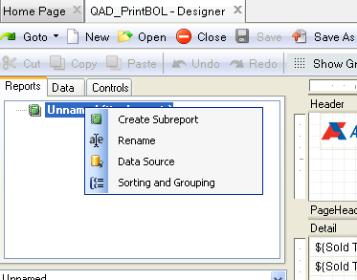
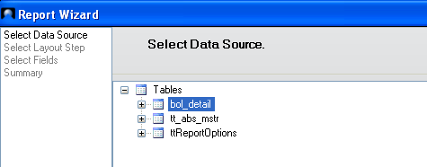
Utilisation du ‘Designer’
Sous-rapport

Slide 63
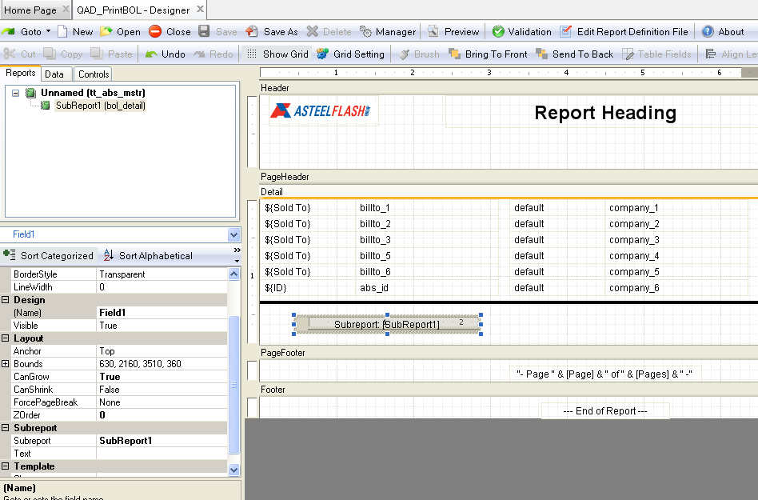
Utilisation du ‘Designer’
Sous-rapport

Slide 64
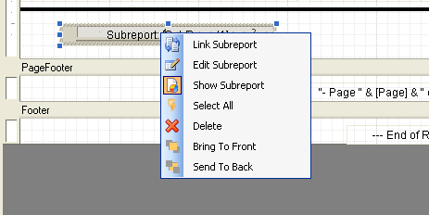
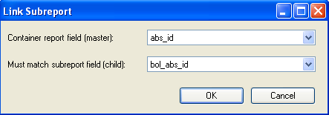
Utilisation du ‘Designer’
Sous-rapport
Attention, la jointure ne peut se faire que sur un seul champ de chaque table !

Slide 65
Utilisation du ‘Designer’
Sous-rapport
Habituellement placé dans la section « Detail » du rapport ‘Parent’
  Le sous-rapport est exécuté une fois par enregistrement
  Les lignes du sous-rapport correspondent à la relation entre le rapport et le sous-rapport
Généralement, les sections ‘Page Header’ et ‘Page Footer’ ne sont pas utilisées dans le sous-rapport
Les variables des scripts VB du rapport peuvent être utilisées dans le sous-rapport
  Seulement si la propriété « ExposeScriptObjects » = vrai
Mise en page autorisée
  Un sous-rapport peut appeler un autre sous-rapport
  Un rapport peut contenir plusieurs sous-rapports
  Pas de limite (nombre de niveaux) de cette arborescence
  En pratique, il peut être judicieux de limiter le nombre de table au minimum et gérer les rupture par des groupements.

Slide 66
Utilisation du ‘Designer’
Scripts VB
Principe
  Un script VB peut être placé dans des points d’entrée de chaque section des rapports
  Le Script VB se déclenche lorsque l'événement correspondant se produit
  Accès aux propriétés des champs et des sections
    Exemple : header.visible= false
    Exemple : soldto_attnLbl.ForeColor= rgb(255,0,0)
Règles de base
  Utiliser au minimum le script VB (facilité de maintenance), TAG des modifs.
  Pour rendre plus dynamique le rapport
Utilisation des champs calculés (Calculated Fields)
  Lié aux champs de la source de donnée
  Fonctions intégrées (sum(), …), variables (Page, Pages, …)
  Gestion des pages par document : GroupPage(N° du groupe) et GroupPages(N° du groupe)

Slide 67
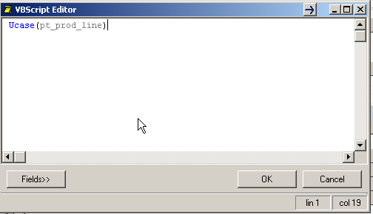

Utilisation du ‘Designer’
Scripts VB
Utilisation des champs calculés (Calculated Fields)
  On peut éditer directement la valeur d’un champ de base pour en faire un champ calculé. On peut soit taper directement la formule dans la zone de valeur de la propriété, soit cliquer sur le bouton […] qui ouvre l’éditeur VB, soit double-cliquer sur la zone directement dans l’éditeur, soit faire F2 si la zone est sélectionnée.

Slide 68
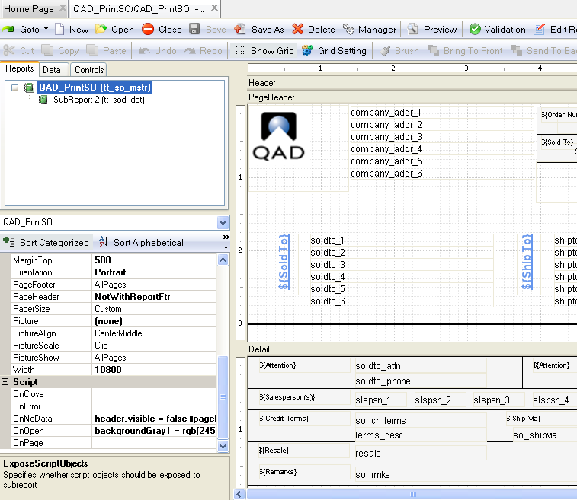
Utilisation du ‘Designer’
Scripts VB

Slide 69
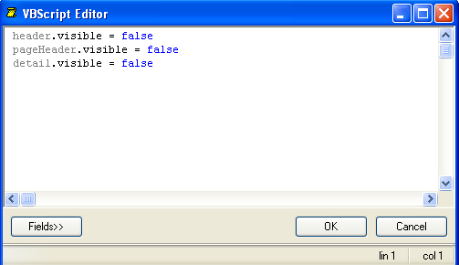
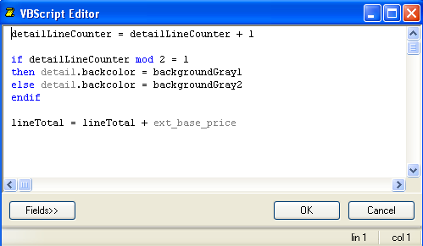
Utilisation du ‘Designer’
Scripts VB
Forum Visual Basic
  http://www.w3schools.com/vbscript/

Slide 70
Utilisation du ‘Designer’
Scripts VB : Exemples
Filtrer des données en fonction de la valeur d’un champ du dataSet
  Section ‘Detail’ , évènement ‘OnFormat’
    if ucase(pt_mstr_pt_part_type) = "FINGOOD" then
    Detail.Visible= false
    else
    Detail.Visible= true
    endif
Changer la couleur d’un champ fonction de la valeur du champ
  Section ‘Detail’, évènement ‘OnPrint’
    if (pt_price>= 100) then
    'color the field text RED
    [pt_priceCtl].ForeColor= "#FF0000"
    else
    'color the field text BLACK
    [pt_priceCtl].ForeColor= "#000000"
    Endif
Attention à l’initialisation / réinitialisation des variables ! Bien penser à gérer le « else » pour revenir à l’aspect normal.

Slide 71
Utilisation du ‘Designer’
Scripts VB : Autres langages
.NET Script Objects permet d’outrepasser la logique du Vbscript. Il est possible, avec les versions récentes, d’écrire des classes personnalisées en C# (ou tout autre langage .NET) et d’exposer leurs méthodes publiques, de telle sorte qu’elle puissent être invoquées par le Vbscript lors de l’exécution du rapport. C’est une possibilité puissante qui autorise le contournement de la plupart des limitations des versions antérieures

Slide 72
‘Template’ Designer

Slide 73
Template Designer
Introduction
Utilisé pour créer / modifier les ‘Templates’ des rapports
Un ‘Report Template’ permet un héritage des propriétés dans un ou plusieurs rapports
  Identique à CSS pour le Design des pages WEB
  Héritage des propriétés telles que les polices, les couleurs et l'alignement
  Les champs peuvent être héritées (par exemple, l’en-tête de page, logo, …)
Permet des changements en masse seulement (sur de nombreux rapports) en changeant ou modifiant le ‘Template’
Très utile pour la standardisation des documents (charte graphique d’une société)

Slide 74
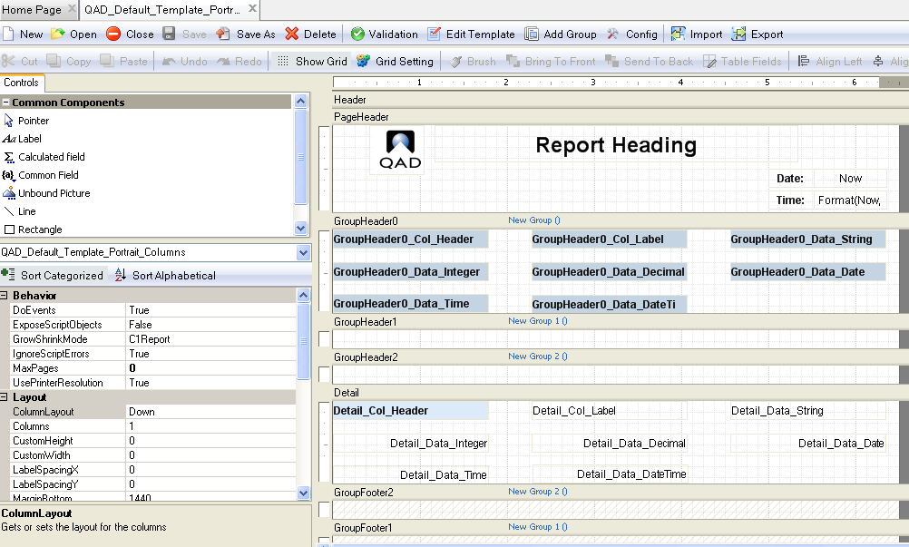

Template Designer
36.4.21.31
Ne jamais modifier les templates “QAD_”, faire une copie.
(Risque d’écrasement lors d’une mise à jour de QAD

Slide 75
Template Designer
36.4.21.31
Le ‘Template’ définit des « Classes » qui peuvent être appliquées aux objets des rapports
Classe ‘section’ : Héritée par les sections du rapport
  La plupart des propriétés de la ‘section’
    BackColor, Visible, CanGrow, CanShrink, ForcePageBreak, KeepTogether, Repeat, OnFormat, OnPrint
  Tous les champs de la ‘section’
    Seulement pour Header, PageHeader, PageFooter, Footer
Classe ‘Champ’ : Héritée par les champs du rapport
  La plupart des propriétés du champ
    dont les propriétés dépendent du type de champ (Font, BackColor, ForeColor, Height, …)
Depuis QAD2010 (.NET UI 2.9)
  Les propriétés du rapport peuvent être héritées du ‘template’

Slide 76
Template Designer
36.4.21.31
Utilisable seulement pour les utilisateurs qui sont dans les groupes ‘rptDsgn’ et ‘rptAdmin’
  User Groups Maintain (36.3.4) (SE)
  Role Permissions Maintain (36.3.6.5) (EE)
Identique au ‘Designer’ mais à quelques différences près
  Comportement de la section ‘Detail’
    Les champs de la section ‘Detail’ ne sont pas transmis au rapport
    Les champs ‘Detail’ sont seulement utilisés pour définir la classe ‘Champ’
Import / Export des ‘Templates’
  Identique à l’Import/Export des rapports

Slide 77
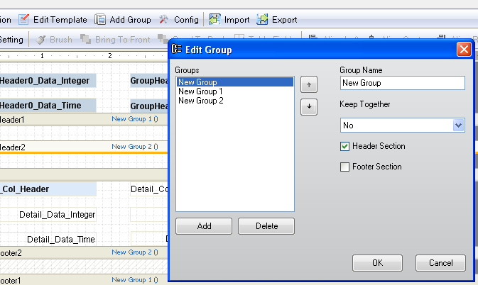
Template Designer
36.4.21.31
Ajout de section
Groupes
Sous-groupes

Slide 78
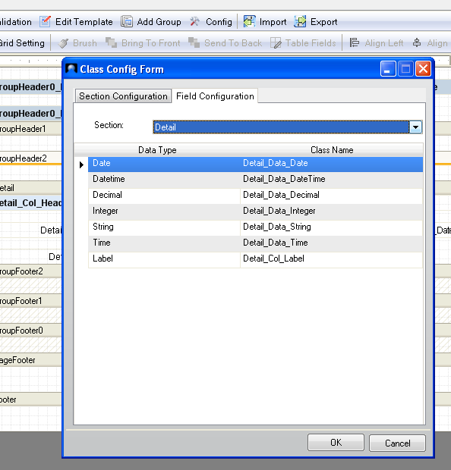
Template Designer
36.4.21.31
Paramétrage des champs des « sections »
Champs associés à chaque type de donnée
(par section)

Slide 79
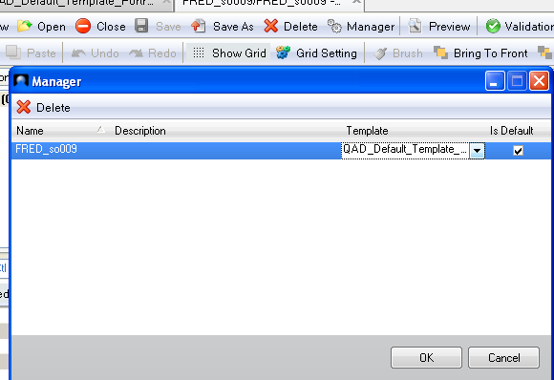
Template
Application du ‘Template’ à un rapport
Spécifier le ‘Template’ à utiliser
  Lors de la création du rapport (Boutons ‘New’)
  Puis ensuite, en utilisant le bouton ‘Manager’
Propriétés ‘classe’
  Utilisable au niveau ‘Section’ et ‘Champ’ pour associer l’élément du ‘Template’ permettant d’hériter des propriétés de ce dernier
  Association automatique par défaut
  Si la valeur est vide, pas de lien avec le ‘Template’

Slide 80
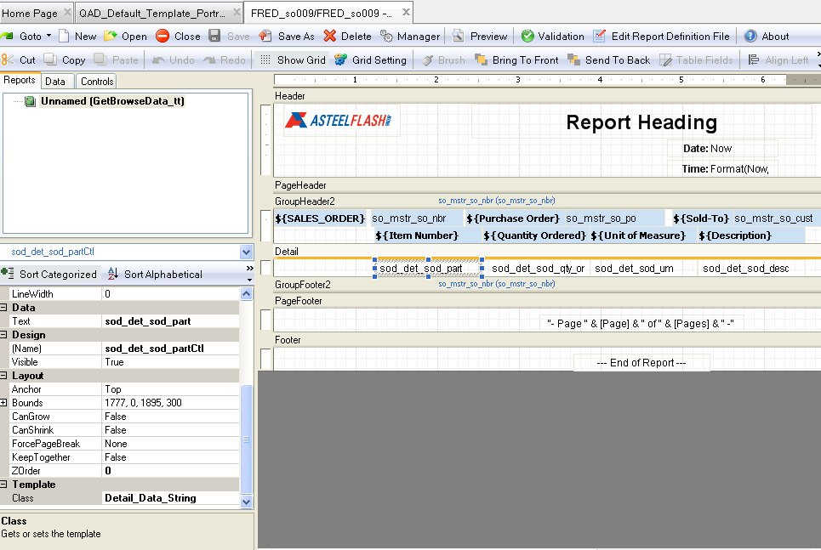
Template
Application du ‘Template’ à un rapport

Slide 81
Template
‘Template’ de tous les Browses
QAD_Default_Template_Browse
Permet d’avoir une personnalisation des browses qui seront aux couleurs de votre société (Logos, …)
Disponible depuis la version QAD 2009.1
Penser à sauvegarder / exporter en XML le ‘Template’ d’origine QAD, afin de pouvoir revenir en arrière
Penser également à sauvegarder votre nouveau ‘Template’ afin que celui-ci ne puisse être ‘écrasé’ lors d’une mise à jour QAD

Slide 82
Programme PROGRESS pour ‘Proxy’

Slide 83
Programme PROGRESS pour ‘Proxy’
Introduction
Programme exécuté par le serveur tiers de l’application .NET UI
Deux types de requête supportés
  Requête Metadata
    Informations sur les tables et champs du DataSet
    Attributs de chaque champ (format, label, etc…)
  Requête Data
    Gestion de la requête sur la base de données associée à la gestion des filtres de sélection
Géré par les programmes génériques
  RunReport.p
  GetReportMeta.p

Slide 84
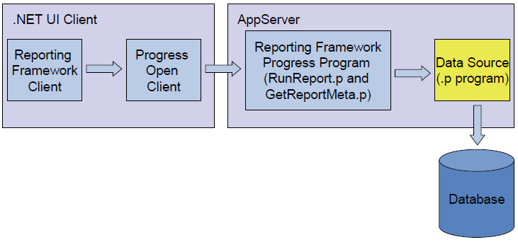
Programme PROGRESS pour ‘Proxy’
Introduction

Slide 85
Programme PROGRESS pour ‘Proxy’
Introduction
4 parties dans le programme ‘proxy’
  1) Définition du DataSet
    Une ou plusieurs tables temporaires qui définissent la structure de données du rapport
    Les tables temporaires peuvent être reliées (Table maître / détail)
  2) Nettoyage des tables temporaires
  3) Définition du MetaData
    Attributs de chaque champ du DataSet (Label, format, type, …)
  4) Lecture des données afin de remplir le DataSet en tenant compte des filtres de sélection

Slide 86
Programme PROGRESS pour ‘Proxy’
Structure d’ un programme ‘Proxy’ (Page 1)
{mfdeclre.i}
{gplabel.i}
{com/qad/shell/report/dsReportRequest.i}
{com/qad/shell/report/ReportConstants.i}
/* Report data set definition block */
/* TODO Insert your data set code here */ (1)
/* Main Block */
define input parameter runReport as logical.
define input parameter reportHandle as handle.
define input parameter dataset for dsReportRequest.
define output parameter dataset-handle phReportResults.
{com/qad/shell/report/reporting.i}
define variable bufferName as character no-undo.
/* Empty temp-table block */
/* TODO empty the temp-table(s) */ (2)

Slide 87
Programme PROGRESS pour ‘Proxy’
Structure d’ un programme ‘Proxy’ (Page 2)
for first ttReportRequest no-lock:
run FillMetaData.
if runReport then do:
run RunReport
(output dataset-handle phReportResults).
end.
end.
/* Metadata definition block */
procedure FillMetaData:
/* TODO Insert your metadata code here */ (3)
end procedure.
/* Data retrieval logic block */
procedure RunReport:
define output parameter dataset-handle phReportResults.
/* TODO Insert your data retrieval code here */ (4)
phReportResults = dataset dsReportResults:handle.
end procedure.
Notes:
3- propriété des champs
4- remplir dataset

Slide 88
Programme PROGRESS pour ‘Proxy’
Définition du DataSet (1) (Exemple)
/* Report data set definition block */
define temp-table ttSalesHeader
field so_nbr like so_mstr.so_nbr
field so_cust like so_mstr.so_cust
field so_ord_date like so_mstr.so_ord_date
field sales_order_slspsn1 like so_mstr.so_slspsn[1]
field sales_order_slspsn2 like so_mstr.so_slspsn[2]
field sales_order_slspsn3 like so_mstr.so_slspsn[3]
field sales_order_slspsn4 like so_mstr.so_slspsn[4]
index SalesHeaderIdx is primary so_nbr
.
define temp-table ttSoLine
field sales_order_number like so_mstr.so_nbr
field sales_detail_line like sod_det.sod_line
field sales_detail_item like sod_det.sod_part
field sales_detail_qty_ord like sod_det.sod_qty_ord
field sales_detail_unit_measure like sod_det.sod_um
field sales_detail_due_date like sod_det.sod_due_date
index SoLineIdx is primary sales_order_number
sales_detail_line.
.
define dataset dsReportResults for ttSalesHeader, ttSoLine
data-relation drLine for ttSalesHeader, ttSoLine
relation-fields (so_nbr, sales_order_number)
.
Attention:
  Si vous voulez vous servir du champ comme critère de sélection, vous DEVEZ utiliser le même nom dans la table temporaire que dans la base QAD (cas de createFieldForDBField)
  Il faut qu’un dataset nommé dsReportResults soit défini pour les temp-table, même s’il n’y a pas de relation
  Les index spécifiés pour les temp-tables peuvent servir à définir des contraintes et imposer un ordre de tri par défaut.
Notes:
Si linking par plusieurs champs: + relation-fields (so_nbr, sales_order_number),(so_domain, sales_order_domain)
define temp-table ttSalesHeader no-undo

Slide 89
Programme PROGRESS pour ‘Proxy’
Nettoyage des tables temporaires du DataSet (2) (Exemple)
/* Empty temp-table block */
empty temp-table ttSalesHeader no-error.
empty temp-table ttSoLine no-error.

Slide 90
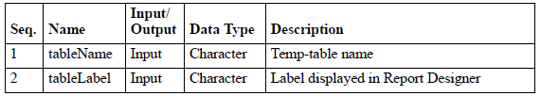
Programme PROGRESS pour ‘Proxy’
Définition du MetaData (3) : Méthode « Historique »
Définition des tables (pour chaque table)
  CreateBufferHeader
  bufferName = "ttSalesHeader".
  run CreateBufferHeader in reportHandle (bufferName, "Sales Orders").
Définition de chaque champ
  CreateField
    Détail des propriétés d’un champ
  CreateFieldForDBField
    Détail des propriétés d’un champ associé à la base de donnée QAD (idem « like »)
  CreateFieldLikeDBField
    Idem CreateFieldForDBField mais dans ce cas le nom du champ du DataSet pourra être différent du nom de la base de données
Notes:
Créer la métadata de la table
Puis créer la métadata pour chaque champ
CreateField : généralement utilisé pour les champs calculés.
CreateFieldForDBField: quand on charge les champs de la base
CreateFieldLikeDBField: depuis la base mais on a besoin de changer le nom : exmple : métadata pour le champ: field sales_order_number like so_mstr.so_nbr

Slide 91
Programme PROGRESS pour ‘Proxy’
Définition du MetaData (CreateField)
  run CreateField in reportHandle
  (bufferName,
  "hello",
  "Hello",
  "character",
  "x(40)",
  “gplu239.p", : la loupe
  false,
  false,
  true,
  false,
  false,
  false,
  false,
  "",
  "Equals",
  "Constant",
  "",
  "Constant"
  ).
Notes:
Définir les propriétés du métadata.

Slide 92
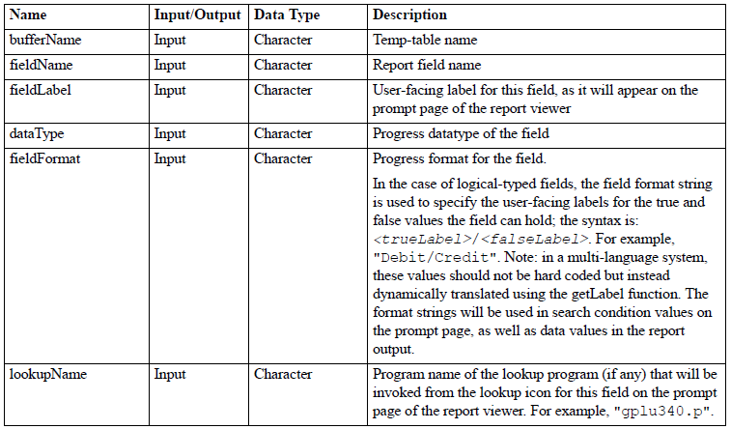
Programme PROGRESS pour ‘Proxy’
Définition du MetaData (CreateField)

Slide 93
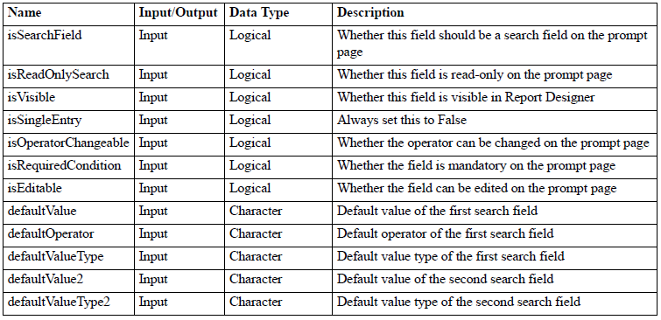
Programme PROGRESS pour ‘Proxy’
Définition du MetaData (CreateField)

Slide 94
Programme PROGRESS pour ‘Proxy’
Définition du MetaData (CreateFieldForDBField)
run CreateFieldForDBField in reportHandle
(bufferName, tt
"pt_mstr", table
"pt_part", champ
true,
false,
true,
false,
true,
false,
true,
"",
{&ParameterOperator_Equals},
{&ParameterValueType_Constant},
"",
{&ParameterValueType_Constant})
.

Slide 95
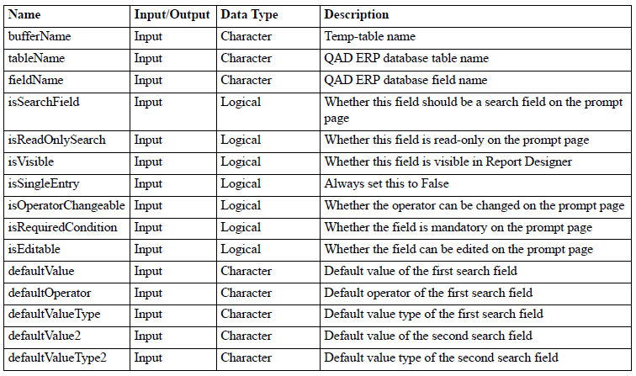
Programme PROGRESS pour ‘Proxy’
Définition du MetaData (CreateFieldForDBField)

Slide 96
Programme PROGRESS pour ‘Proxy’
Définition du MetaData (CreateFieldLikeDBField)
/* Create field for ttSalesHeader */
run CreateFieldLikeDBField in reportHandle
(bufferName, // tt
"numero_commande", // nom du champ de ma tt
"so_mstr",
"so_nbr",
true,
false,
true,
false,
true,
false,
true,
"",
{&ParameterOperator_Equals},
{&ParameterValueType_Constant},
"",
{&ParameterValueType_Constant}).

Slide 97
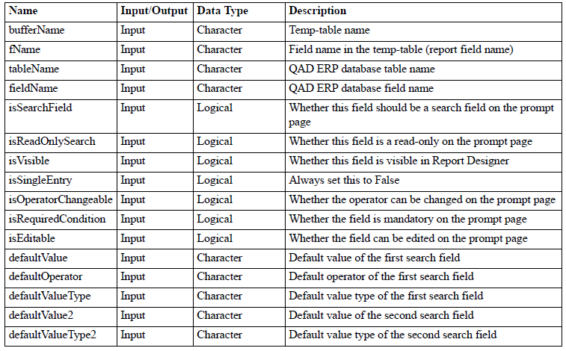
Programme PROGRESS pour ‘Proxy’
Définition du MetaData (CreateFieldLikeDBField)

Slide 98
Programme PROGRESS pour ‘Proxy’
Définition du MetaData
Liste de valeurs possibles
  Dans les filtres de sélection
  Dans le document final
Utilisable seulement avec un champ ‘caractère’
Example
define variable statusValueList as character no-undo.
statusValueList= "New,1,In Process,2,Completed,3".
run SetFieldMetaParamin ReportHandle(
bufferName,
"status",
"valueList",
statusValueList)
CreateField doit avoir été appelé avant
Notes:
Dans métadata: on peut ajouter une combo: Liste de valeurs possibles: SetFieldMetaParamin
statusValueList= "New,1,In Process,2,Completed,3". : combo: label = New, 1 = value. Gettermlabel(xx) + ‘,’ + value + …. Pour prendre ne charge les langues. Ou bien voir la page suivante

Slide 99
Programme PROGRESS pour ‘Proxy’
Définition du MetaData
Traduction des libellés
  La plupart des traductions des rapports sont faites dans l’outil de mise en page « Report Resource Designer »
  Mais il peut aussi être intéressant que les données soient traduites directement dans le programme ‘proxy’ (règles de gestion particulières)
    Libellé du champ
    Liste de valeurs
    Libellé d’une donnée « Logical »
    Utilisation de la variable « global_user_lang » pour déterminer le langage de traduction
  Existe depuis la version QAD 2010
    Fonction getLabel()
    Entrée : TERM du 36.4.17.1
    Sortie : libellé long traduit selon « global_user_lang »
    Exemple
        getLabel("SALES_ORDER")

Slide 100
Programme PROGRESS pour ‘Proxy’
Définition du MetaData (3) : Méthode « Moderne »
Plutôt que d’utiliser les méthodes createfield*, il est possible de stocker dans un fichier xml les caractéristiques que l’on veut donner aux critères de recherche. Pour cela,
  Rajouter dans la partie des define de la Main routine
    define variable vhDS as handle no-undo.
  Retirer la ligne :
    run FillMetaData.
  La remplacer par
    vhDS = dataset dsReportResults:handle.
    run FillMetaData in reportHandle(vhDS,"SimpleItemReport.meta.xml").

Slide 101
Programme PROGRESS pour ‘Proxy’
Définition du MetaData (3) : Méthode « Moderne »
Le fichier xml doit être stocké au même endroit que le proxy. Lors de l’utilisation des menus 36.4.21.21 et 36.4.21.22, ce fichier, tout comme le proxy, n’est pas importé/exporté.
Exemple de fichier
<dsReportMetaData>
<ttField>
<BufferName>ttItem</BufferName>
<FieldName>pt_part</FieldName>
<FieldSequence>1</FieldSequence>
<IsSearchField>true</IsSearchField>
</ttField>
<ttField>
<BufferName>ttItem</BufferName>
<FieldName>pt_desc1</FieldName>
<FieldSequence>2</FieldSequence>
<IsSearchField>true</IsSearchField>
</ttField>
……..
</dsReportMetaData>
Xml => l’ordre de codage des balises est quelconque

Slide 102
Programme PROGRESS pour ‘Proxy’
Définition du MetaData (3) : Méthode « Moderne »
Principales balises utilisées

Slide 103
Programme PROGRESS pour ‘Proxy’
Définition du MetaData (3) : Méthode « Moderne »
Principales balises utilisées : exemples

Slide 104
Programme PROGRESS pour ‘Proxy’
Lecture des données
Doit être intégré dans la procédure RunReport
Utilisation d’un Query Dynamique
  Gestion des filtres de sélection
  Utilisation de la fonction FillQueryStringVariable
Gestion de la boucle du Query et remplissage des tables temporaires
Notes:
Lecture des données.

Slide 105
Programme PROGRESS pour ‘Proxy’
Lecture des données
/* Retrieve the data from database */
define variable queryString as character no-undo.
define variable hSOQuery as handle.
define query SOQuery for so_mstr.
hSOQuery = query SOQuery:handle.
queryString = "for each so_mstr no-lock "
+ " where so_mstr.so_domain = " + QUOTER(global_domain).
run FillQueryStringVariable in reportHandle (input "ttSalesHeader", input "so_nbr", input-output queryString).
run FillQueryStringVariable in reportHandle (input "ttSalesHeader", input "so_cust", input-output queryString).
run FillQueryStringVariable in reportHandle (input "ttSalesHeader", input "so_ord_date", input-output queryString).
queryString = queryString + ":".
hSOQuery:query-prepare(queryString).
hSOQuery:query-open().
hSOQuery:get-next().
Notes:
Puis on fait :
Repeat et créet la tt.
Ou for each ,, buffer-copy…

Slide 106
Programme PROGRESS pour ‘Proxy’
QUERY : Fonction « FillQueryStringVariable »
Pour gérer dynamiquement les filtres
Permet de construire la clause « Where »
Si plusieurs appels à la fonction, logique « and »
Fonction FillQueryStringVariable
PROCEDURE FillQueryStringVariable:
define input parameter bufferNameas character no-undo.
define input parameter fieldNameas character no-undo.
define input-output parameter queryStringas character no-undo.

Slide 107
Programme PROGRESS pour ‘Proxy’
QUERY : Clause statique
Ajout d’un filtre statique
  Exemple: Site de la commande = « SITE1 »
    queryString = "for each so_mstr no-lock where so_site= " +
    QUOTER("SITE1").
  Exemple: Ajout une clause « By »
    queryString = queryString + " by so_cust:".

Slide 108
Programme PROGRESS pour ‘Proxy’
Fonction « GetFilterValue »
Connaître la valeur d’un filtre
Fonction GetFilterValue
FUNCTION GetFilterValue returns character
(input ipBufferName as character,
input ipFieldName as character,
input defaultValue as character):
Retourne la valeur du filtre
Exemple
define var orderLineFilterValue as integer no-undo.
orderLineFilterValue= integer(
GetFilterValue("ttReportOptions",
“sod_line",
"1")).

Slide 109
Programme PROGRESS pour ‘Proxy’
QUERY : Gestion de l’itération
repeat while not hSOQuery:query-off-end:
create ttSalesHeader.
assign
ttSalesHeader.so_nbr = so_mstr.so_nbr
ttSalesHeader.so_cust = so_mstr.so_cust
ttSalesHeader.so_ord_date = so_mstr.so_ord_date
ttSalesHeader.sales_order_slspsn1 = so_mstr.so_slspsn[1]
ttSalesHeader.sales_order_slspsn2 = so_mstr.so_slspsn[2]
ttSalesHeader.sales_order_slspsn3 = so_mstr.so_slspsn[3]
ttSalesHeader.sales_order_slspsn4 = so_mstr.so_slspsn[4].
for each sod_det no-lock
where sod_det.sod_nbr = so_mstr.so_nbr
and sod_det.sod_domain = global_domain:
create ttSoLine.
assign
ttSoLine.sales_order_number = sod_det.sod_nbr
ttSoLine.sales_detail_line = sod_det.sod_line
ttSoLine.sales_detail_item = sod_det.sod_part
ttSoLine.sales_detail_qty_ord = sod_det.sod_qty_ord
ttSoLine.sales_detail_unit_measure = sod_det.sod_um
ttSoLine.sales_detail_due_date = sod_det.sod_due_date.
end.
hSOQuery:get-next().
end. /* Repeat query */
hQuery:query-close().
delete object hQuery.

Slide 110
Programme PROGRESS pour ‘Proxy’
Autres Fonction
Report Framework est un outil en grande évolution. D’une version à l’autre, des fonctions sont rajoutées / modifiées.
Deux fichiers source sont particulièrement utiles:
  ReportHelper.p (situé dans le répertoire parent des proxys)
    Contient la plupart des procédures utilisées (createfieldforDb, fillquerystring etc).
    Ainsi, selon la version exact, on pourra trouver ou non la fonction run AddAllConditions in reportHandle("sv_mstr",input-output queryString) qui permet d’ajouter tous les critères dans la query sans avoir à utiliser FillQueryString pour chaque champ.

Slide 111
Programme PROGRESS pour ‘Proxy’
  BusinessReportHelper.p (dans le répertoire des proxys)
    Certaines fonctions classiques sont définies (pour récupérer les commentaires, conversions de devises etc.
    Ajouter {com/qad/shell/report/reports/ReportBusinessHelper.i}
    Juste avant le Run Report :
      run com/qad/shell/report/reports/ReportBusinessHelper.p persistent set reportBussinessHelper.
    Juste après le Run Report
      delete procedure reportBussinessHelper.
Notes:
Persistant : yetel3ou une fois w ya93dou fil mémoire tant que l’app srver matsakkarch. (set persistant)

Slide 112
Programme PROGRESS pour ‘Proxy’
Installation et compilation du programme ‘Proxy’
Répertoire du source
  <desktop source code directory>/com/qad/shell/report/reports
  Exemple
    /mfgpro/qad20091ee/sop091eefor/com/qad/shell/report/reports /
Répertoire de compilation
  Idem
Compilation (Exemple)
  <desktop source code directory> doit être dans le PROPATH
PROPATH = "/mfgpro/qad20091ee/sop091eefor/," + PROPATH.
compile /mfgpro/qad20091ee/sop091eefor/com/qad/shell/report/reports/UserGuideSampleReport_1.p
save into /mfgpro/qad20091ee/sop091eefor/com/qad/shell/report/reports.
Notes:
Ajouter propath.
Le .p et .r dans le meme repertoire.
36.4.21.1 pour ajouter le proxy dans QAD.

Slide 113
Administration de
QAD Report FrameWork

Slide 114
Administration
Groupes / Roles
‘rptAdmin’ et ‘rptDsgn’
  Permet d’accéder aux programmes ‘Report Framework’
  ‘rptAdmin’ pour tous les programmes
  ‘rptDsgn’ pour la conception des rapports (Template, Designer, Resource, …), idéal pour les développeurs
User Groups Maintenance (36.3.4) (SE)
Role Permissions Maintain (36.3.6.5) (EE)

Slide 115
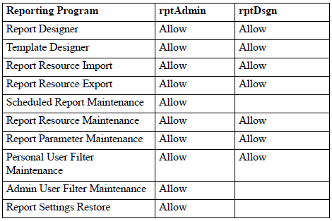
Administration
Groupes / Roles

Slide 116
Scheduled Reports
(Edition batchable)

Slide 117
Scheduled Reports
File d’attente pour exécuter les rapports (Batch ID)
Traité par le serveur
  Processus non-GUI .Net
  Installé en standard avec la version .Net UI (SE et EE)
  Lancement type ‘ligne de commande’ + fichier de config
Le « Planificateur de tâches Windows » (Windows Task Scheduler) utilisé pour lancer périodiquement des lots (par exemple tous les jours, en fin de mois)
Sortie imprimante et / ou fichier sur le serveur Web
Notification optionnelle e-mail, boîte de réception .NET UI

Slide 118

Scheduled Reports
Architecture

Slide 119

Scheduled Reports
Architecture

Slide 120

Scheduled Reports
Statut
Chaque rapport batché contient le statut en cours (rptsr_mstr.rptsr_status)
Statut possible
  NEW : Batch qui a été crée mais n’a jamais été exécuté
  WAITING : Initialisé pour être exécuté dans le traitement en cours
  RUNNING : En cours d’exécution
  COMPLETED : Traitement exécuté sans erreur
  ERROR : Traitement exécuté avec des erreurs
Scheduled Report Browse (36.4.21.6)

Slide 121

Scheduled Reports
Batch ID Maintenance (36.14.1)
Même table (bc_mstr) que pour les éditions batch MFG/PRO
  Table de détail différente : rptsr_mstr (un enregistrement par rapport planifié)

Slide 122
Scheduled Reports
Paramétrage du serveur de « Tâches planifiées Windows »
Possibilité de lancer le serveur selon votre besoin, par Batch ID
  Exemple : La nuit, chaque heure, en fin de mois, etc…
Exécuté sur un serveur Windows
Configuration du serveur par ligne de commande : le fichier de config peut être stocké :
  Sur la machine locale
    QAD.Client.exe […] -param.url:file:///c:/params.pf
  Sur une machine distante
    QAD.Client.exe […] -param.url:http://somehost/rpt/params.pf
Exemple de raccourci pour le lancement ( .bat)
"C:\Program Files\QAD\QAD Enterprise Applications 2009.1 EE STD\QAD.Applications.exe"
-homeserver:http://xr03.renn.fr.sopra:51781/qadhomestd
-config-uri:http://xr03.renn.fr.sopra:51781/qadhomestd/servlet/env
-param.url:file:///d:/QAD/sop091eefor.pf
NB: pas de retour chariot => une seule ligne d’instruction dans le .bat

Slide 123
Scheduled Reports
Paramétrage du serveur de « Tâches planifiées Windows »
Exemple de fichier ‘params.pf’
    -silent
    -config-name:sop091eefor
    -user:mfg
    -password:
    -workspace:QMS-US
    -report-batch:REPORT
    -enable:qad.plugin.services
    -enable:qad.plugin.reports
    -enable:qad.plugin.reportserver
    -report-mode:batch
NB: une ligne par option dans le .pf !

Slide 124



Scheduled Reports
Paramétrage du serveur de « Tâches planifiées Windows »

Slide 125

Scheduled Reports
Création d’un rapport batché

Slide 126

Scheduled Reports
Création d’un rapport batché

Slide 127

Scheduled Reports
Création d’un rapport batché
Scheduled Report Maintenance (36.4.21.5)

Slide 128


Scheduled Reports
Création d’un rapport batché
Scheduled Report Browse (36.4.21.6)
Puis lancement de la « Tache planifiée Windows »

Slide 129

Scheduled Reports
Création d’un rapport batché
Résultat de l’édition (en plus de l’impression sur l’imprimante associée au batch ID)
Scheduled Report History Browse (36.4.21.7)
Lien URL du document généré

Slide 130

Scheduled Reports
Création d’un rapport batché (Résultat)

Slide 131

Scheduled Reports
Paramétrage e-mail SMTP
Dans le fichier client-session.xml
/mfgpro/intranet/tomcat20091ee_2/webapps/qadhomestd/configurations/sop091eefor

Slide 132
Scheduled Reports
Paramétrage masque e-mail
Dans le fichier report-email-template.txt
Répertoire
<TomcatInstallDir>/webapps/qadhome/configurations/<config>/storage/reports/
Exemple:
/mfgpro/intranet/tomcat20091ee_2/webapps/qadhomestd/configurations/sop091eefor/storage/reports
Exemple
[SUBJECT]
Scheduled Report Completed: {$RRO_DESC}
[BODY]
A scheduled report from QAD Enterprise Applications has completed:
Report: {$RRO_DESC} ({$RRO_CODE})
Description: {$SR_DESC}
Link to Report: {$REPORT_FILE_LINK}

Slide 133
Scheduled Reports
Paramétrage imprimante pour batch
L’imprimante doit être accessible par le serveur d’impression, pas nécessairement par les serveurs QAD.
En 36.13.2 Printer Setup maintenance, créer une nouvelle imprimante
  Destination Type = Default
  Device Pathname = UNC du printer, par exemple
    \\cont23\copr62
    ipp://iprint.lyon.fr.sopra/ipp/lyon2_01_prt209_black

Slide 134

Scheduled Reports
Paramétrage imprimante pour batch

