Slide 1


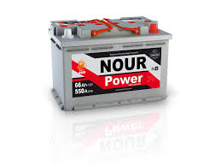
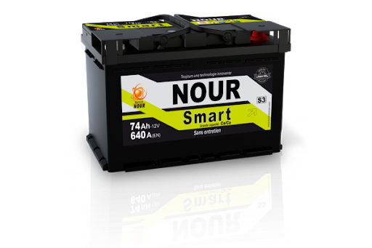
SNA NOUR
Rapport de test HRD
15-04-2022
Achref Riahi

Slide 2
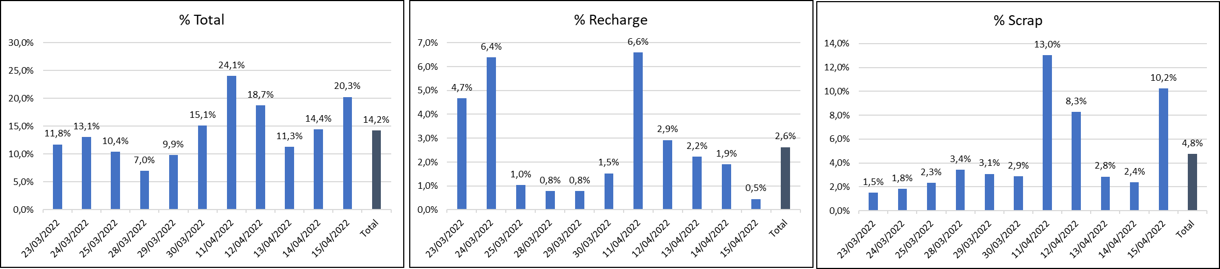
Taux de défauts Journalier
Date | Qté totale testée | Total Qté Nok | % Total | Recharge | Retest | Scrap | % Recharge | % Scrap
23/03/2022 | 1200 | 141 | 11,8% | 56 | 30 | 18 | 4,7% | 1,5%
24/03/2022 | 1206 | 158 | 13,1% | 77 | 22 | 22 | 6,4% | 1,8%
25/03/2022 | 1250 | 130 | 10,4% | 13 | 36 | 29 | 1,0% | 2,3%
28/03/2022 | 1135 | 79 | 7,0% | 9 | 19 | 39 | 0,8% | 3,4%
29/03/2022 | 1267 | 125 | 9,9% | 10 | 19 | 39 | 0,8% | 3,1%
30/03/2022 | 1176 | 178 | 15,1% | 18 | 13 | 34 | 1,5% | 2,9%
11/04/2022 | 1168 | 281 | 24,1% | 77 | 20 | 152 | 6,6% | 13,0%
12/04/2022 | 1436 | 269 | 18,7% | 42 | 67 | 119 | 2,9% | 8,3%
13/04/2022 | 1439 | 163 | 11,3% | 32 | 52 | 41 | 2,2% | 2,8%
14/04/2022 | 1256 | 181 | 14,4% | 24 | 31 | 30 | 1,9% | 2,4%
15/04/2022 | 1328 | 269 | 20,3% | 6 | 64 | 136 | 0,5% | 10,2%
Total | 13861 | 1974 | 14,2% | 364 | 373 | 659 | 2,6% | 4,8%

Slide 3
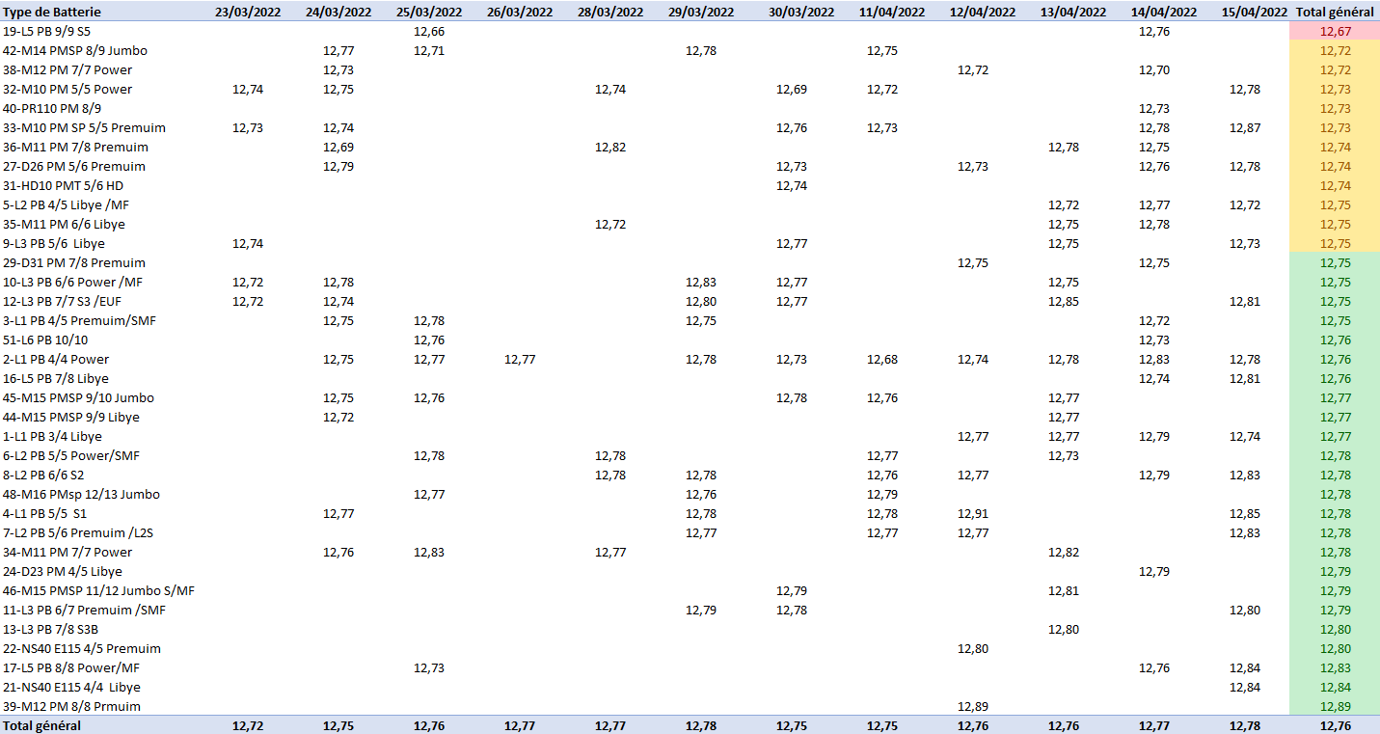
Moyenne des tensions

Slide 4
Bilan Production du 30/03/2022
Taux de défauts par type de batterie
Pareto par type de défaut
Complément de charge
Date | Qté totale | Qté Recharge | % Recharge
32-M10 PM 5/5 Power | 277 | 44 | 16%
45-M15 PMSP 9/10 Jumbo | 62 | 20 | 32%
27-D26 PM 5/6 Premuim | 132 | 17 | 13%
9-L3 PB 5/6 Libye | 421 | 16 | 4%
22-NS40 E115 4/5 Premuim | 100 | 14 | 14%
2-L1 PB 4/4 Power | 557 | 12 | 2%
40-PR110 PM 8/9 | 49 | 9 | 18%
29-D31 PM 7/8 Premuim | 126 | 7 | 6%
38-M12 PM 7/7 Power | 74 | 7 | 9%
8-L2 PB 6/6 S2 | 339 | 5 | 1%
42-M14 PMSP 8/9 Jumbo | 33 | 4 | 12%
5-L2 PB 4/5 Libye /MF | 1236 | 3 | 0%
4-L1 PB 5/5 S1 | 431 | 3 | 1%
16-L5 PB 7/8 Libye | 151 | 3 | 2%
36-M11 PM 7/8 Premuim | 77 | 3 | 4%
1-L1 PB 3/4 Libye | 990 | 2 | 0%
33-M10 PM SP 5/5 Premuim | 154 | 2 | 1%
6-L2 PB 5/5 Power/SMF | 62 | 2 | 3%
48-M16 PMsp 12/13 Jumbo | 59 | 2 | 3%
11-L3 PB 6/7 Premuim /SMF | 341 | 1 | 0%
35-M11 PM 6/6 Libye | 320 | 1 | 0%
7-L2 PB 5/6 Premuim /L2S | 189 | 1 | 1%
21-NS40 E115 4/4 Libye | 92 | 1 | 1%
24-D23 PM 4/5 Libye | 13 | 1 | 8%
3-L1 PB 4/5 Premuim/SMF | 3 | 1 | 33%
Batterie | Qté totale | Qté Nok | %
7-L2 PB 5/6 Premuim /L2S | 189 | 59 | 31,2%
22-NS40 E115 4/5 Premuim | 100 | 56 | 56,0%
21-NS40 E115 4/4 Libye | 92 | 56 | 60,9%
4-L1 PB 5/5 S1 | 431 | 54 | 12,5%
8-L2 PB 6/6 S2 | 339 | 48 | 14,2%
2-L1 PB 4/4 Power | 557 | 45 | 8,1%
1-L1 PB 3/4 Libye | 990 | 27 | 2,7%
5-L2 PB 4/5 Libye /MF | 1236 | 24 | 1,9%
32-M10 PM 5/5 Power | 277 | 22 | 7,9%
48-M16 PMsp 12/13 Jumbo | 59 | 17 | 28,8%
11-L3 PB 6/7 Premuim /SMF | 341 | 12 | 3,5%
35-M11 PM 6/6 Libye | 320 | 11 | 3,4%
13-L3 PB 7/8 S3B | 35 | 8 | 22,9%
33-M10 PM SP 5/5 Premuim | 154 | 7 | 4,5%
44-M15 PMSP 9/9 Libye | 44 | 6 | 13,6%
46-M15 PMSP 11/12 Jumbo S/MF | 15 | 4 | 26,7%
27-D26 PM 5/6 Premuim | 132 | 3 | 2,3%
40-PR110 PM 8/9 | 49 | 3 | 6,1%
29-D31 PM 7/8 Premuim | 126 | 2 | 1,6%
12-L3 PB 7/7 S3 /EUF | 122 | 2 | 1,6%
17-L5 PB 8/8 Power/MF | 89 | 2 | 2,2%
45-M15 PMSP 9/10 Jumbo | 62 | 2 | 3,2%
42-M14 PMSP 8/9 Jumbo | 33 | 2 | 6,1%
10-L3 PB 6/6 Power /MF | 11 | 2 | 18,2%
9-L3 PB 5/6 Libye | 421 | 1 | 0,2%
36-M11 PM 7/8 Premuim | 77 | 1 | 1,3%
19-L5 PB 9/9 S5 | 3 | 1 | 33,3%
51-L6 PB 10/10 | 2 | 1 | 50,0%
Défaut | 11/04 | 12/04 | 13/04 | 14/04 | 15/04
HRDV min | 145 | 89 | 46 | 30 | 124
ΔU bigger than setting | 64 | 111 | 22 | 49 | 112
Icca min | 56 | 70 | 27 | 16 | 79
OCV min | 81 | 58 | 62 | 45 | 55
R internal Max | 20 | 75 | 8 | 6 | 55
Current out of limit | 14 | 8 | 28 | 13 | 31
Icca max |  | 3 | 15 | 55 | 18
Reverse polarity | 4 | 7 | 6 | 6 | 7
OCV max |  | 41 | 4 |  | 6
HRDV max |  | 1 |  | 3 | 3

Slide 5
Points d’amélioration produit process

Slide 6
OCV-Tension

Slide 7
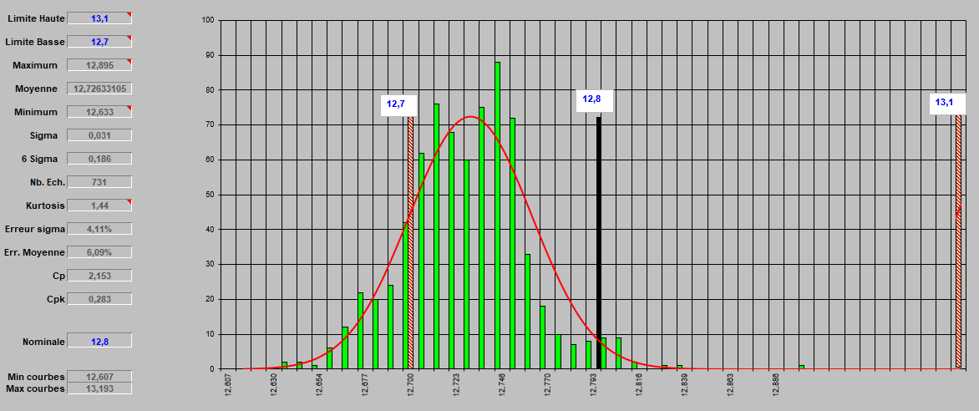
Voltage measurements
M10 PM 5/5 Power and
M10 PM SP 5/5 Premium
Average: 12.72 out of 731 batteries tested
=> The voltage must be increased to 12.80 minimum

Slide 8
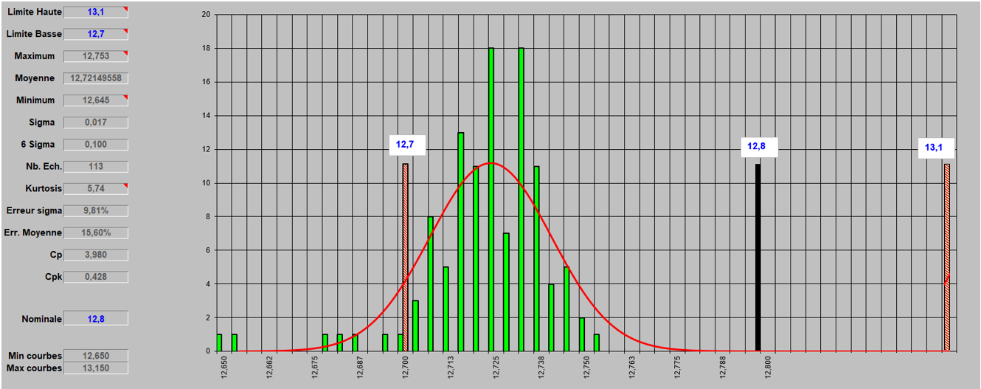
Voltage measurements
M12 PM 7/7 Power
Average: 12.72 out of 113 batteries tested
=> The voltage must be increased to 12.80 minimum

Slide 9
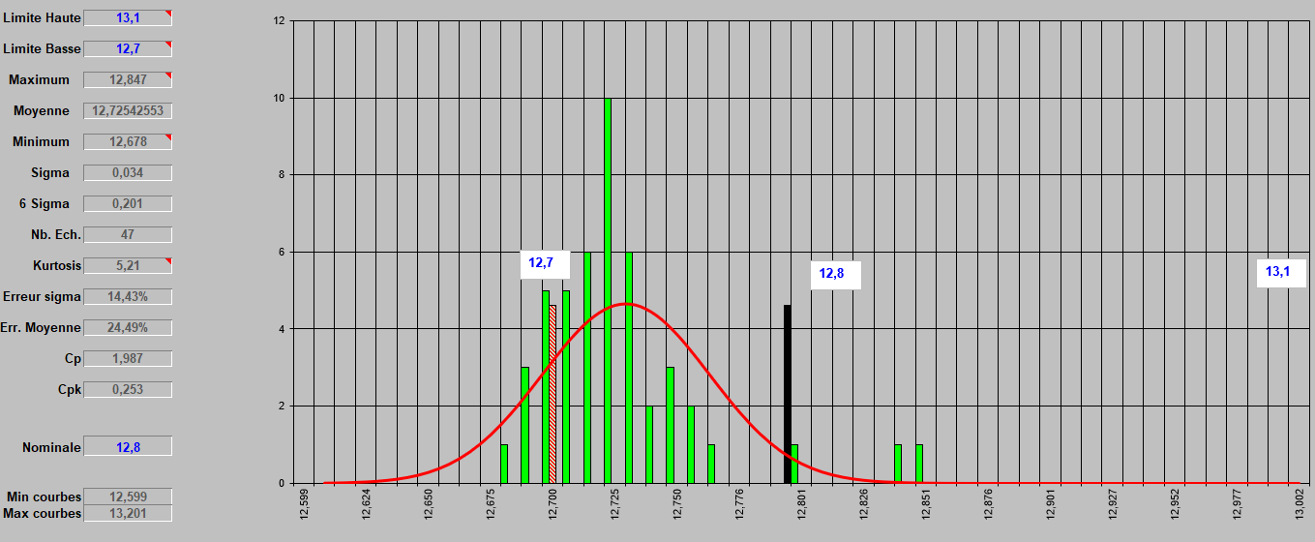
Voltage measurements
PR110 PM 8/9
Average: 12.72 out of 47 batteries tested
=> The voltage must be increased to 12.80 minimum

Slide 10
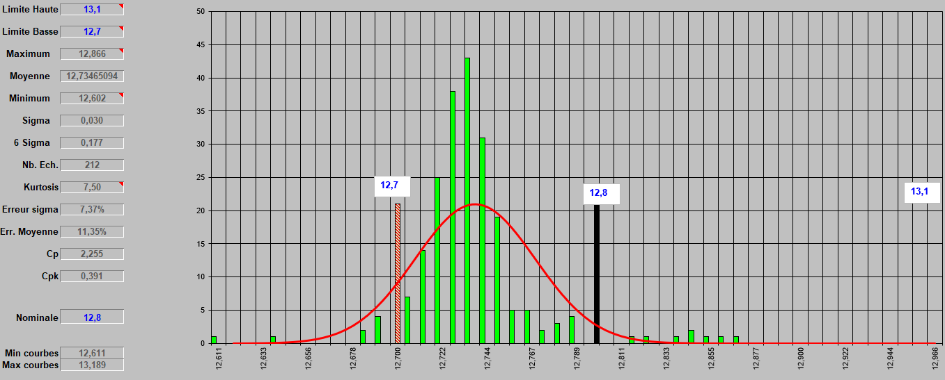
Voltage measurements
M14 PMSP 8/9 Jumbo
Average: 12.72 out of 47 batteries tested
=> The voltage must be increased to 12.80 minimum

Slide 11
Icca-Courant

Slide 12
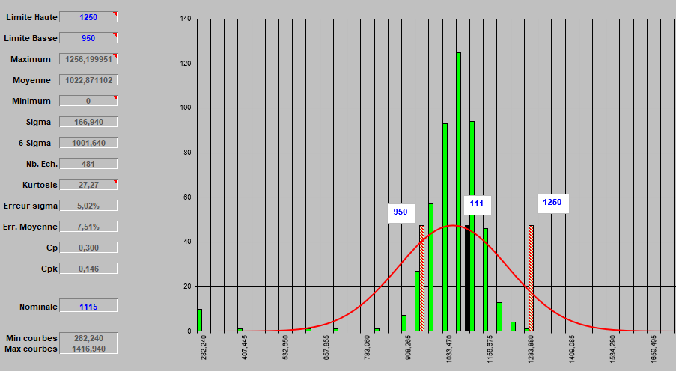
Icca measurements
M15 PMSP 9/10 Jumbo
Average: 1022 out of 481 batteries tested, the average is closer to the lower limit

Slide 13
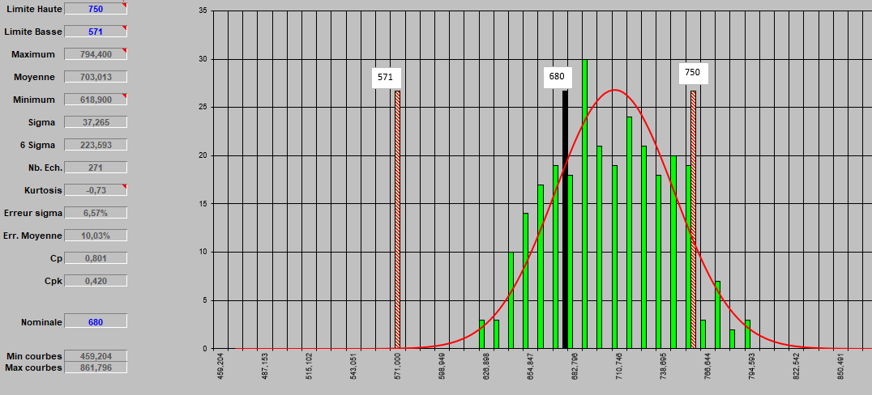
Icca measurements
D26 PM 5/6 Premium
Average: 703 out of 271 batteries tested, the dispersion is closer to the upper limit
=> Shift the upper limit to 850: recommendation from Evgeni

Slide 14
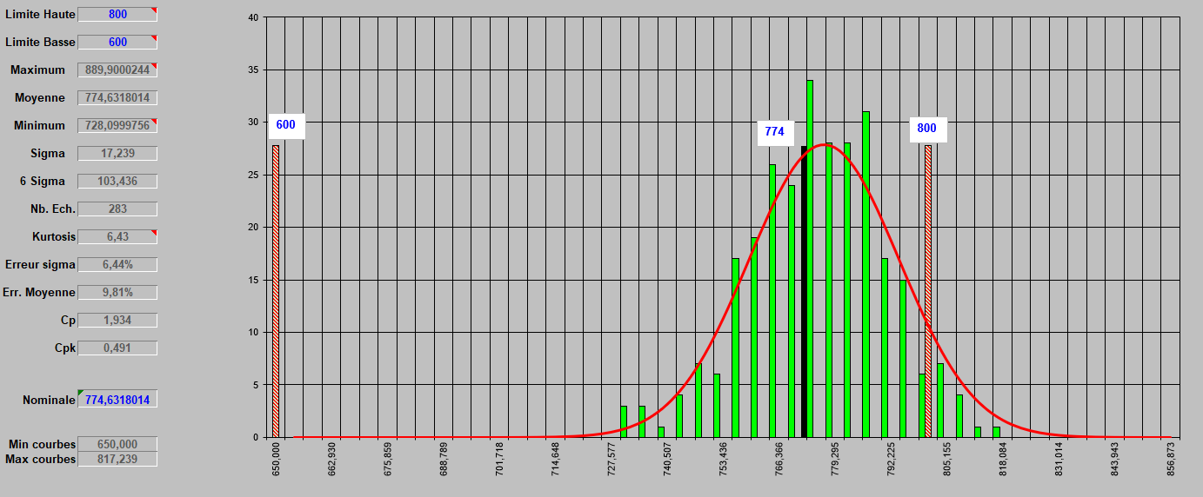
Icca measurements
M11 PM 6/6 Libya
Average: 774 out of 283 batteries tested, the dispersion is closer to the upper limit
=> Shift the upper limit to 900: To be confirmed with Evgeni

Slide 15
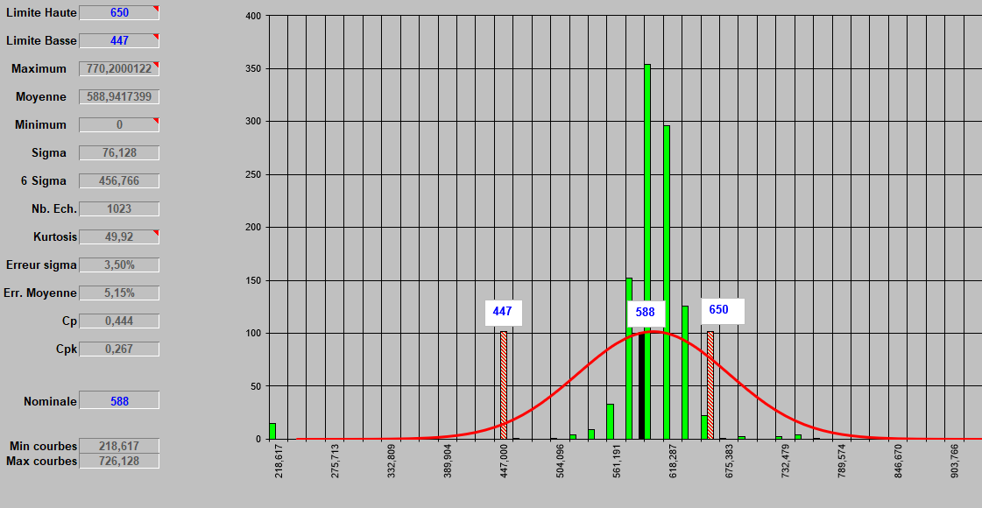
Icca measurements
L2 PB 5/5 Power/SMF
Average: 588 out of 1023 batteries tested, dispersion is closer to the upper limit
=> Shift the upper limit to 750 or 800: To be confirmed with Evgeni

Slide 16
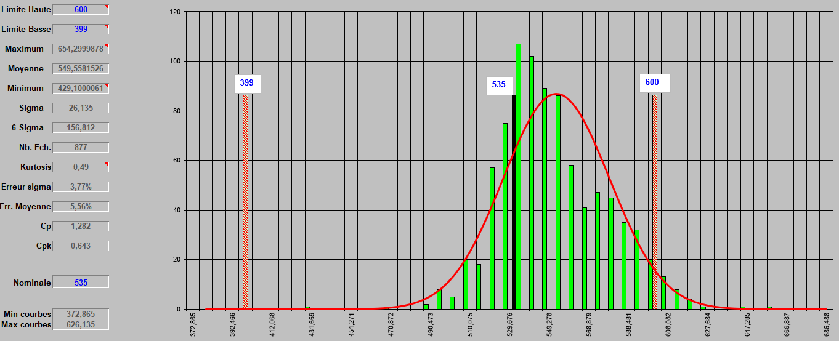
Icca measurements
L2 PB 4/5 Libye/SMF
Average: 549 out of 877 batteries tested, dispersion is closer to the upper limit
=> Shift the upper limit to 700 : To be confirmed with Evgeni

Slide 17
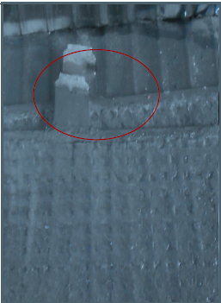
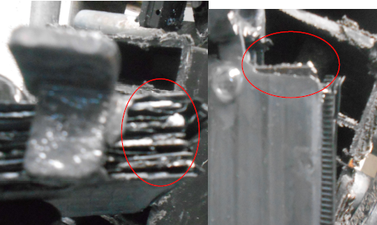
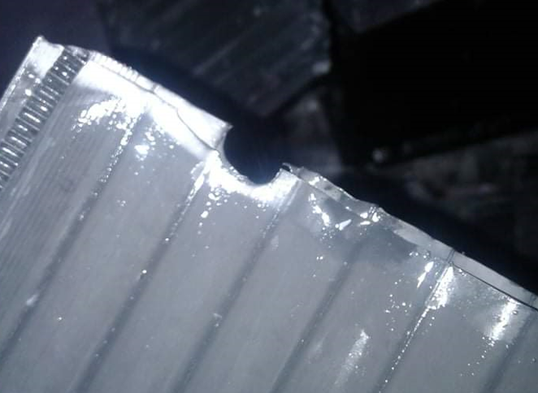
Défauts
Article | Code | Défaut | Cause défaut | Photo
L1 export R/N | 1046/152 |  | Plaque mal soudée (plaque positive et négative)
NS40 | 7 |  | Séparateur brulée

Slide 18
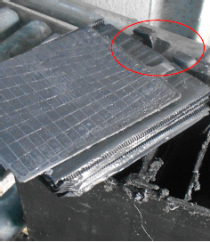
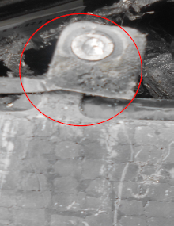
Défauts
Article | Code | Défaut | Cause défaut | Photo
NS40 | 45 |  | Plaque mal soudée
NS40 | 45 |  | Connexion mal soudée

Slide 19
MERCI

