Slide 1


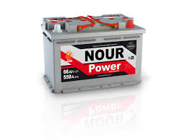
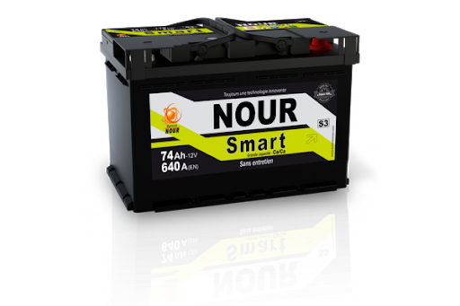
SNA NOUR
Rapport de test HRD
20-04-2022
Achref Riahi

Slide 2
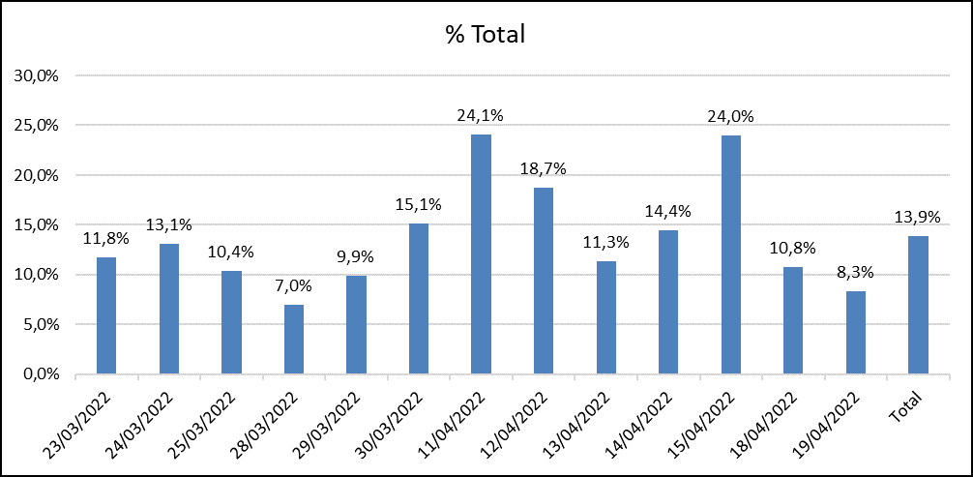
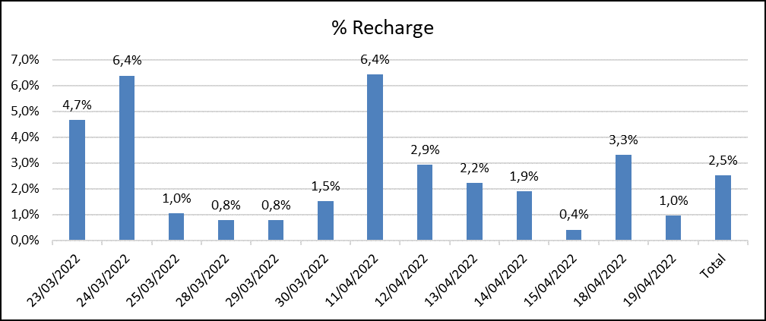
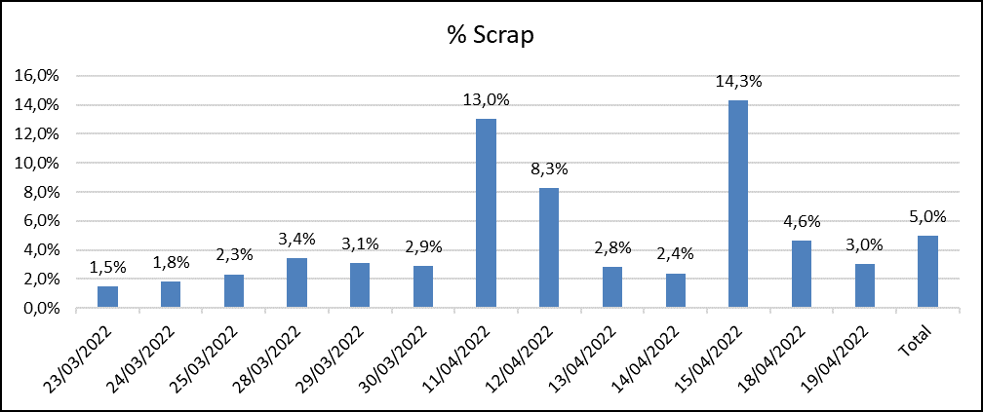
Taux de défauts Journalier
Date | Qté totale testée | Total Qté Nok | % Total | Recharge | Retest | Scrap | % Recharge | % Scrap
23/03/2022 | 1200 | 141 | 11,8% | 56 | 30 | 18 | 4,7% | 1,5%
24/03/2022 | 1206 | 158 | 13,1% | 77 | 22 | 22 | 6,4% | 1,8%
25/03/2022 | 1250 | 130 | 10,4% | 13 | 36 | 29 | 1,0% | 2,3%
28/03/2022 | 1135 | 79 | 7,0% | 9 | 19 | 39 | 0,8% | 3,4%
29/03/2022 | 1267 | 125 | 9,9% | 10 | 19 | 39 | 0,8% | 3,1%
30/03/2022 | 1176 | 178 | 15,1% | 18 | 13 | 34 | 1,5% | 2,9%
11/04/2022 | 1168 | 281 | 24,1% | 75 | 20 | 152 | 6,4% | 13,0%
12/04/2022 | 1436 | 269 | 18,7% | 42 | 67 | 119 | 2,9% | 8,3%
13/04/2022 | 1439 | 163 | 11,3% | 32 | 52 | 41 | 2,2% | 2,8%
14/04/2022 | 1256 | 181 | 14,4% | 24 | 31 | 30 | 1,9% | 2,4%
15/04/2022 | 1435 | 344 | 24,0% | 6 | 68 | 205 | 0,4% | 14,3%
18/04/2022 | 1422 | 153 | 10,8% | 47 | 17 | 66 | 3,3% | 4,6%
19/04/2022 | 1249 | 104 | 8,3% | 12 | 12 | 38 | 1,0% | 3,0%
Total | 16639 | 2306 | 13,9% | 421 | 406 | 832 | 2,5% | 5,0%

Slide 3
Typologies de défauts
Étiquettes de lignes | Nombre de Diagnostic Message
Error OCV min.!; | 628
ΔU bigger than setting; | 343
Error Icca min.;Error HRDV min.;ΔU bigger than setting;Error R internal Max.; | 191
Current out of limit!;Error HRDV min.; | 158
Error HRDV min.; | 148
Error Icca max.; | 142
Error Icca min.; | 132
Error Icca min.;Error HRDV min.; | 113
Error Icca min.;Error HRDV min.;ΔU bigger than setting; | 94
Error OCV max.!; | 78
Reverse polarity; | 67
 | 57
Error Icca min.;Error HRDV min.;Error R internal Max.; | 40
Error HRDV max.; | 25
Error Icca min.;ΔU bigger than setting; | 24
Error HRDV min.;ΔU bigger than setting; | 21
Error Icca max.;Error HRDV max.; | 19
Error R internal Max.; | 11
Error HRDV min.;Error R internal Max.; | 10
Error HRDV min.;ΔU bigger than setting;Error R internal Max.; | 6
Error Icca max.;ΔU bigger than setting; | 5
Error HRDV max.;ΔU bigger than setting; | 2
ΔU bigger than setting;Error R internal Max.; | 1
Error Icca max.;Error HRDV max.;ΔU bigger than setting; | 1
Current out of limit!; | 1
Error HRDV min.;Error R internal Min.; | 1
Error Icca max.;Error R internal Min.; | 1
Total général | 2319
Défaut | 11/04/2022 | 12/04/2022 | 13/04/2022 | 14/04/2022 | 15/04/2022 | 18/04/2022 | 19/04/2022
Error Icca min | 56 | 70 | 27 | 16 | 79 | 58 | 66
Error HRDV min | 145 | 89 | 46 | 30 | 124 | 81 | 55
ΔU bigger than setting | 64 | 111 | 22 | 49 | 112 | 55 | 37
Error OCV min | 81 | 58 | 62 | 45 | 55 | 58 | 14
Error R internal Max | 20 | 75 | 8 | 6 | 55 | 25 | 10
Current out of limit | 14 | 8 | 28 | 13 | 31 | 25 | 5
Reverse polarity | 4 | 7 | 6 | 6 | 7 | 5 | 5
Error Icca max |  | 3 | 15 | 55 | 18 | 3
Error OCV max |  | 41 | 4 |  | 6
Error HRDV max |  | 1 |  | 3 | 3

Slide 4
Moyenne des tensions

Slide 5
Bilan Production du 11/04 au 19/04/2022
Taux de défauts par type de batterie
Complément de charge
Date | Qté totale | Qté Recharge | % Recharge
32-M10 PM 5/5 Power | 505 | 44 | 9%
4-L1 PB 5/5 S1 | 606 | 22 | 4%
45-M15 PMSP 9/10 Jumbo | 62 | 20 | 32%
12-L3 PB 7/7 S3 /EUF | 657 | 19 | 3%
27-D26 PM 5/6 Premuim | 132 | 17 | 13%
9-L3 PB 5/6 Libye | 421 | 16 | 4%
22-NS40 E115 4/5 Premuim | 131 | 14 | 11%
2-L1 PB 4/4 Power | 624 | 13 | 2%
10-L3 PB 6/6 Power /MF | 480 | 12 | 3%
40-PR110 PM 8/9 | 49 | 9 | 18%
29-D31 PM 7/8 Premuim | 126 | 7 | 6%
38-M12 PM 7/7 Power | 74 | 7 | 9%
5-L2 PB 4/5 Libye /MF | 1490 | 5 | 0%
8-L2 PB 6/6 S2 | 639 | 5 | 1%
42-M14 PMSP 8/9 Jumbo | 33 | 4 | 12%
33-M10 PM SP 5/5 Premuim | 334 | 3 | 1%
48-M16 PMsp 12/13 Jumbo | 164 | 3 | 2%
16-L5 PB 7/8 Libye | 159 | 3 | 2%
36-M11 PM 7/8 Premuim | 77 | 3 | 4%
1-L1 PB 3/4 Libye | 1051 | 2 | 0%
6-L2 PB 5/5 Power/SMF | 110 | 2 | 2%
11-L3 PB 6/7 Premuim /SMF | 344 | 1 | 0%
35-M11 PM 6/6 Libye | 320 | 1 | 0%
7-L2 PB 5/6 Premuim /L2S | 189 | 1 | 1%
21-NS40 E115 4/4 Libye | 145 | 1 | 1%
31-HD10 PMT 5/6 HD | 114 | 1 | 1%
13-L3 PB 7/8 S3B | 39 | 1 | 3%
24-D23 PM 4/5 Libye | 13 | 1 | 8%
3-L1 PB 4/5 Premuim/SMF | 3 | 1 | 33%
Batterie | Qté totale | Qté Nok | %
21-NS40 E115 4/4 Libye | 145 | 105 | 72,4%
22-NS40 E115 4/5 Premuim | 131 | 83 | 63,4%
4-L1 PB 5/5 S1 | 606 | 73 | 12,0%
7-L2 PB 5/6 Premuim /L2S | 189 | 59 | 31,2%
8-L2 PB 6/6 S2 | 639 | 55 | 8,6%
2-L1 PB 4/4 Power | 624 | 48 | 7,7%
12-L3 PB 7/7 S3 /EUF | 657 | 35 | 5,3%
5-L2 PB 4/5 Libye /MF | 1490 | 29 | 1,9%
48-M16 PMsp 12/13 Jumbo | 164 | 28 | 17,1%
1-L1 PB 3/4 Libye | 1051 | 27 | 2,6%
32-M10 PM 5/5 Power | 505 | 25 | 5,0%
11-L3 PB 6/7 Premuim /SMF | 344 | 12 | 3,5%
35-M11 PM 6/6 Libye | 320 | 11 | 3,4%
10-L3 PB 6/6 Power /MF | 480 | 10 | 2,1%
13-L3 PB 7/8 S3B | 39 | 9 | 23,1%
33-M10 PM SP 5/5 Premuim | 334 | 7 | 2,1%
44-M15 PMSP 9/9 Libye | 74 | 6 | 8,1%
17-L5 PB 8/8 Power/MF | 126 | 4 | 3,2%
46-M15 PMSP 11/12 Jumbo S/MF | 15 | 4 | 26,7%
27-D26 PM 5/6 Premuim | 132 | 3 | 2,3%
19-L5 PB 9/9 S5 | 78 | 3 | 3,8%
40-PR110 PM 8/9 | 49 | 3 | 6,1%
29-D31 PM 7/8 Premuim | 126 | 2 | 1,6%
31-HD10 PMT 5/6 HD | 114 | 2 | 1,8%
45-M15 PMSP 9/10 Jumbo | 62 | 2 | 3,2%
42-M14 PMSP 8/9 Jumbo | 33 | 2 | 6,1%
9-L3 PB 5/6 Libye | 421 | 1 | 0,2%
36-M11 PM 7/8 Premuim | 77 | 1 | 1,3%
51-L6 PB 10/10 | 2 | 1 | 50,0%
50-MAR200 PM 13/14 MAR200 | 1 | 1 | 100,0%

Slide 6
Points d’amélioration produit process

Slide 7
OCV-Tension

Slide 8
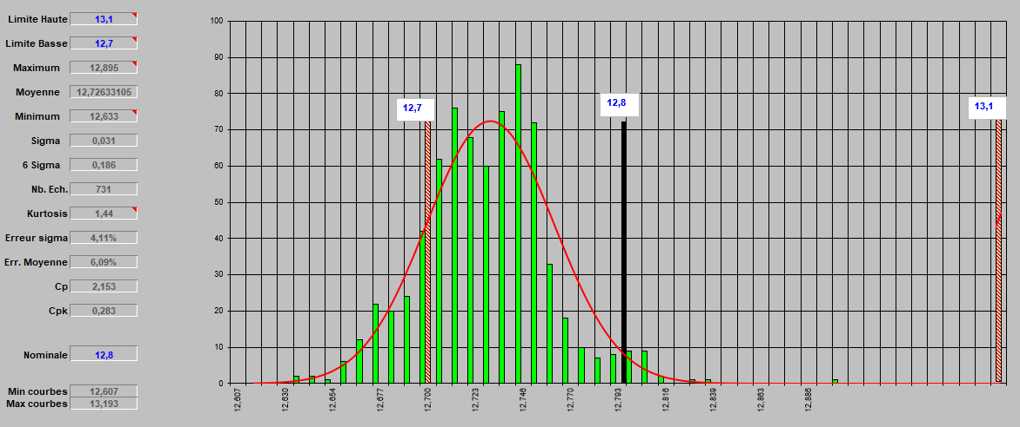
Voltage measurements
M10 PM 5/5 Power and
M10 PM SP 5/5 Premium
Average: 12.72 out of 731 batteries tested
=> The voltage must be increased to 12.80 minimum

Slide 9
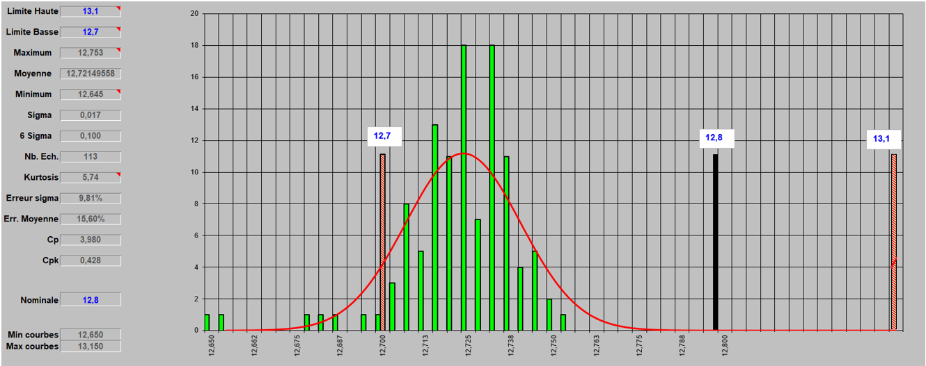
Voltage measurements
M12 PM 7/7 Power
Average: 12.72 out of 113 batteries tested
=> The voltage must be increased to 12.80 minimum

Slide 10
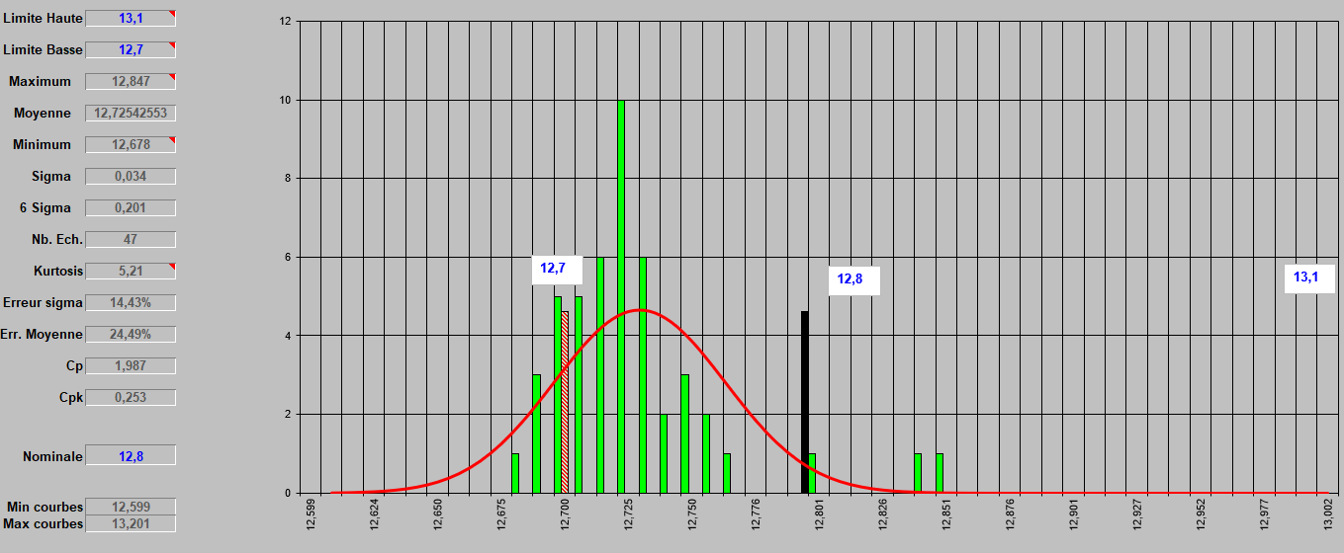
Voltage measurements
PR110 PM 8/9
Average: 12.72 out of 47 batteries tested
=> The voltage must be increased to 12.80 minimum

Slide 11
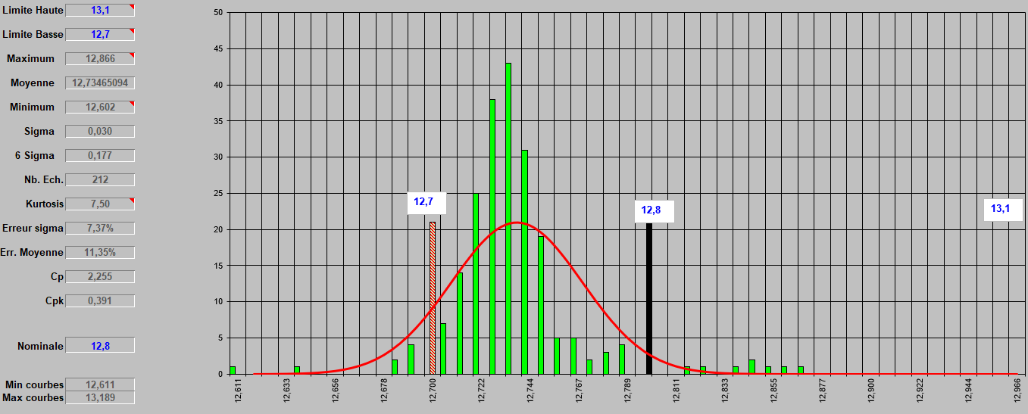
Voltage measurements
M14 PMSP 8/9 Jumbo
Average: 12.72 out of 47 batteries tested
=> The voltage must be increased to 12.80 minimum

Slide 12
Icca-Courent

Slide 13
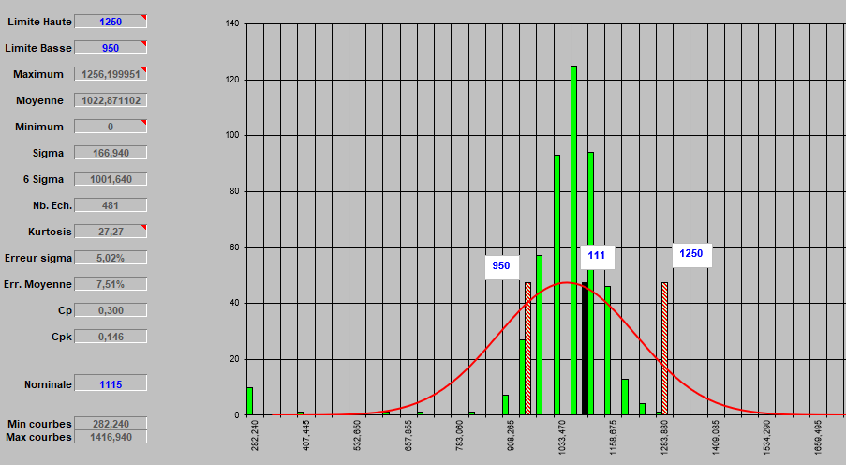
Icca measurements
M15 PMSP 9/10 Jumbo
Average: 1022 out of 481 batteries tested, the average is closer to the lower limit

Slide 14
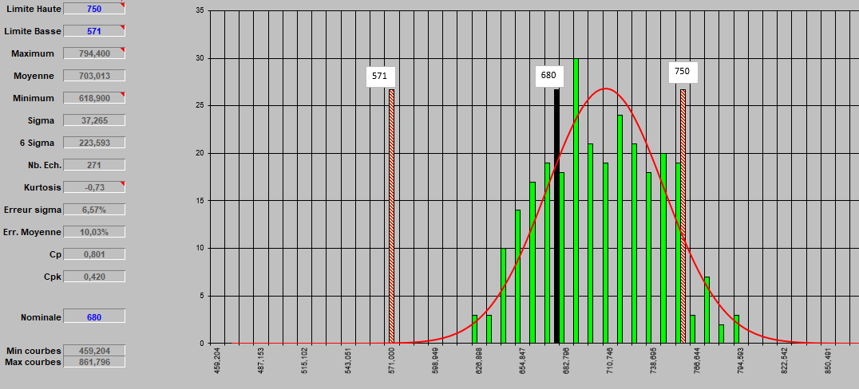
Icca measurements
D26 PM 5/6 Premium
Average: 703 out of 271 batteries tested, the dispersion is closer to the upper limit
=> Shift the upper limit to 850: recommendation from Evgeni

Slide 15
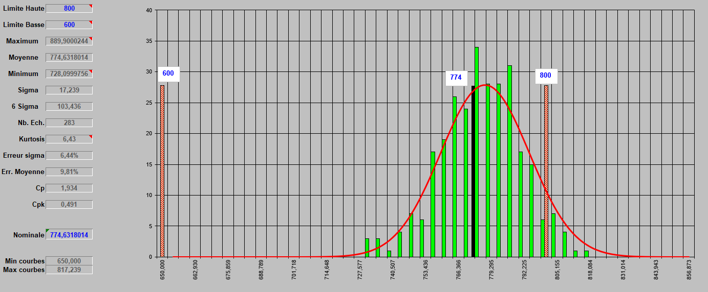
Icca measurements
M11 PM 6/6 Libya
Average: 774 out of 283 batteries tested, the dispersion is closer to the upper limit
=> Shift the upper limit to 900: To be confirmed with Evgeni

Slide 16
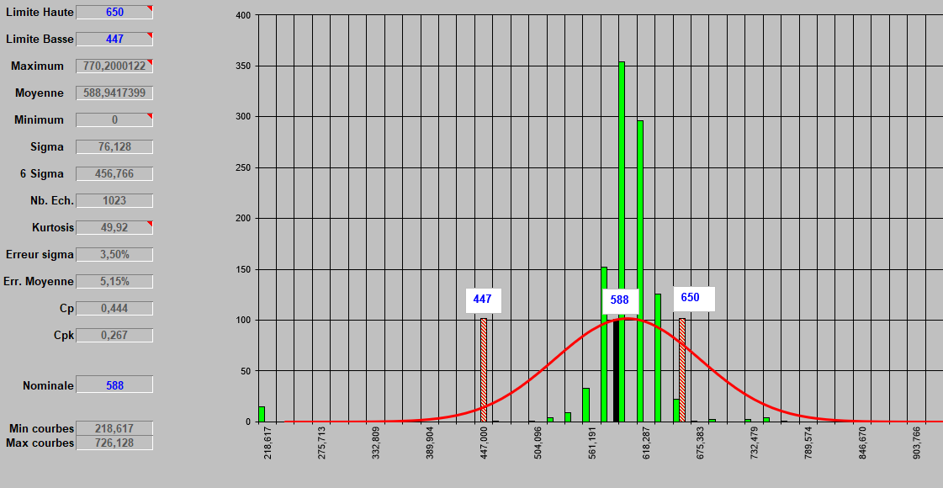
Icca measurements
L2 PB 5/5 Power/SMF
Average: 588 out of 1023 batteries tested, dispersion is closer to the upper limit
=> Shift the upper limit to 750 or 800: To be confirmed with Evgeni

Slide 17
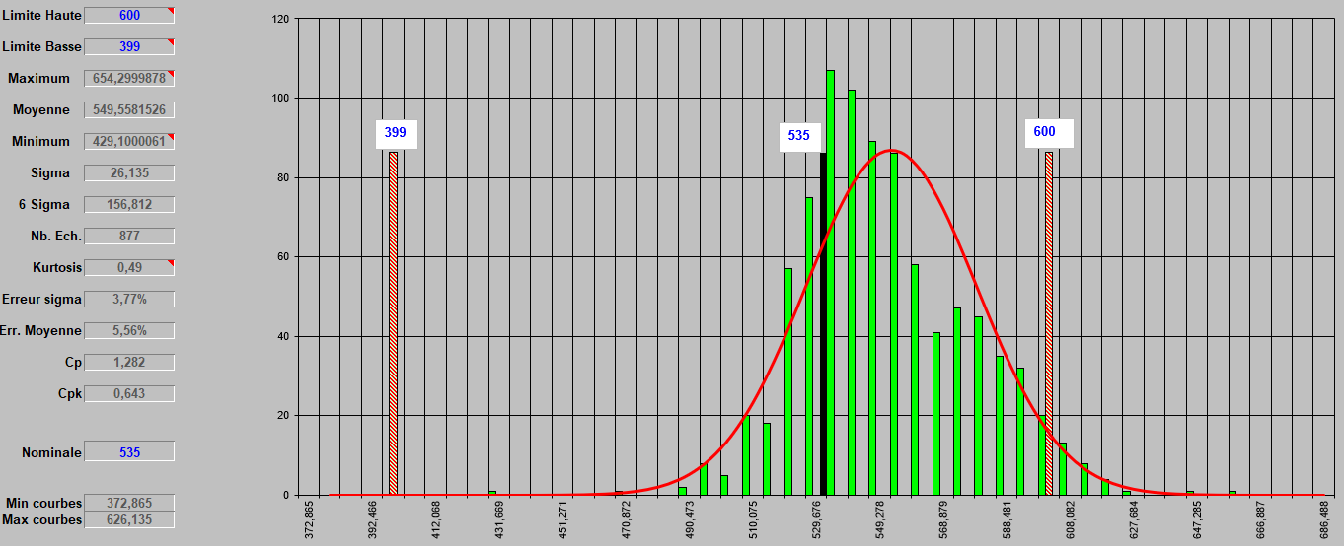
Icca measurements
L2 PB 4/5 Libye/SMF
Average: 549 out of 877 batteries tested, dispersion is closer to the upper limit
=> Shift the upper limit to 700 : To be confirmed with Evgeni

Slide 18
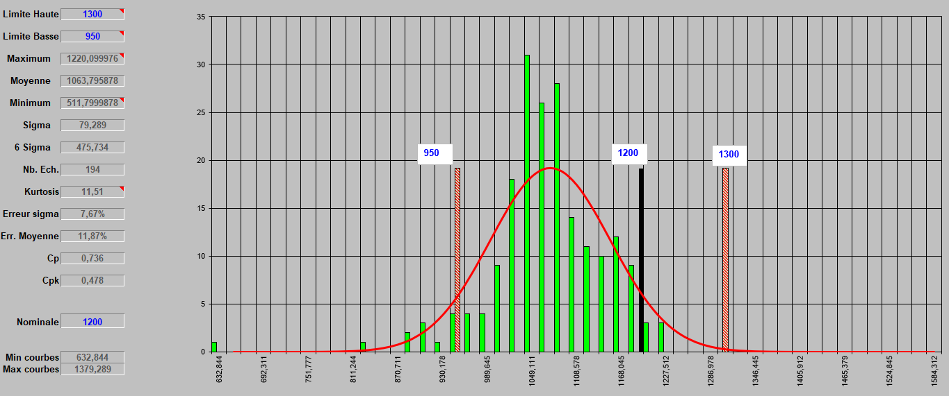
Icca measurements
M16 PMsp 12/13 Jumbo
Average: 1063 out of 194 batteries tested, measurements are closer to the lower limit
=> ????

Slide 19
Autopsie

Slide 20
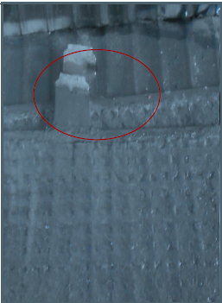
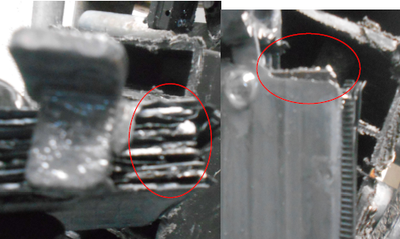
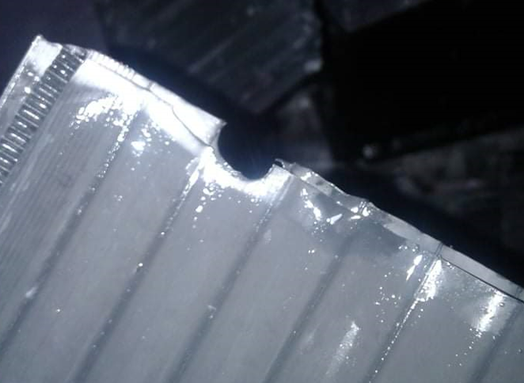
Défauts
Article | Code | Défaut | Photo
L1 export R/N | 1046/152 | Plaque mal soudée (plaque positive et négative)
NS40 | 7 | Séparateur brulée

Slide 21
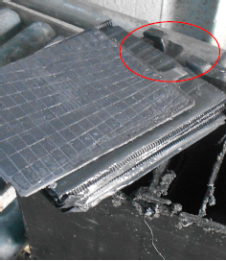
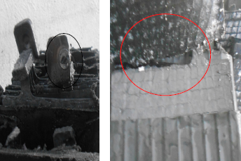
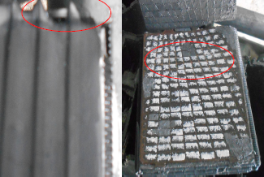
Défauts
Article | Code | Défaut | Photo
NS40 | 45 | Plaque mal soudée
NS40 | 45 | Séparateur brulé, connexion mal soudé, élément inversé et plaque positive non enveloppé

Slide 22
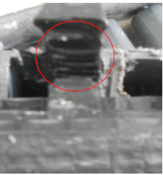
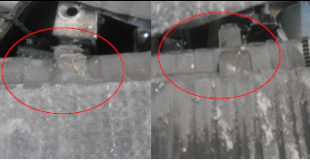
Défauts
Article | Code | Défaut | Photo
M10 | 1214/16 | Plaque positive mal soudé
S3 |  | Plaque positive et négative mal soudé

Slide 23
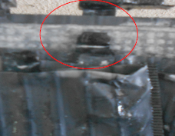
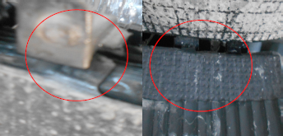
Défauts
Article | Code | Défaut | Photo
S1 |  | Plaque mal soudée
S2 | 1220/40 | Elément inversé, plaque mal soudée et connexion mal soudée

Slide 24
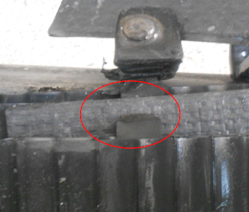
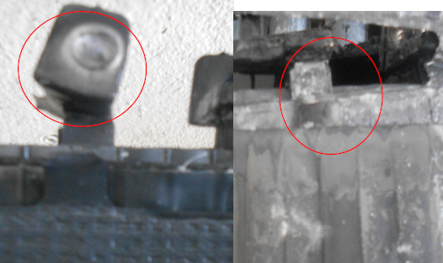
Défauts
Article | Code | Défaut | Photo
L3 | 1182/72 | Plaque positive mal soudée
S3 | 1183/11 1183/14 | Plaque mal soudée connexion mal soudée (aspect non conforme)

Slide 25
MERCI

