Slide 1


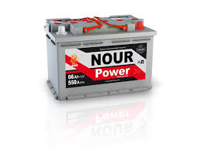
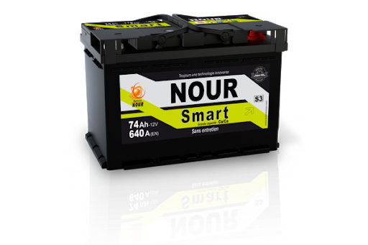
SNA NOUR
Rapport de test HRD
25-04-2022 Week 16
Achref Riahi

Slide 2
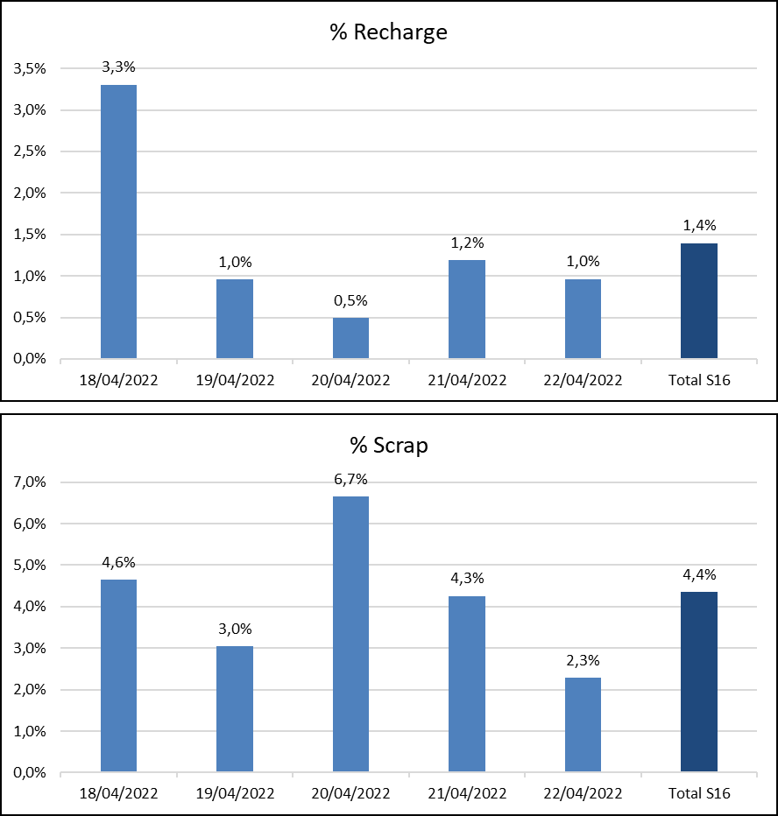
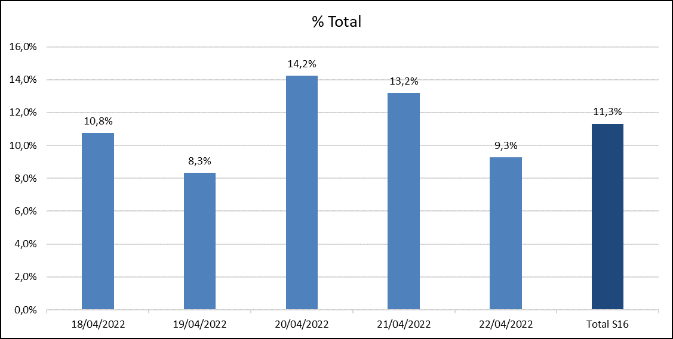
Taux de défauts Journalier
Date | Qté totale testée | Total Qté Nok | % Total | Recharge | Retest | Scrap | % Recharge | % Scrap
18/04/2022 | 1422 | 153 | 10,8% | 47 | 17 | 66 | 3,3% | 4,6%
19/04/2022 | 1249 | 104 | 8,3% | 12 | 12 | 38 | 1,0% | 3,0%
20/04/2022 | 1609 | 229 | 14,2% | 8 | 55 | 107 | 0,5% | 6,7%
21/04/2022 | 1174 | 155 | 13,2% | 14 | 50 | 50 | 1,2% | 4,3%
22/04/2022 | 1142 | 106 | 9,3% | 11 | 11 | 26 | 1,0% | 2,3%
Total S16 | 6596 | 747 | 11,3% | 92 | 145 | 287 | 1,4% | 4,4%

Slide 3
Typologies de défauts
Message d’erreur | Nombre de Diagnostic Message
Error OCV min.!; | 146
ΔU bigger than setting; | 128
Error Icca min.; | 75
Error Icca min.;Error HRDV min.;ΔU bigger than setting;Error R internal Max.; | 65
Error Icca max.; | 57
Reverse polarity; | 49
Error Icca min.;Error HRDV min.; | 46
Current out of limit!;Error HRDV min.; | 45
Error Icca min.;Error HRDV min.;ΔU bigger than setting; | 41
 | 22
Error HRDV min.; | 21
Error OCV max.!; | 18
Error Icca min.;ΔU bigger than setting; | 18
Error Icca min.;Error HRDV min.;Error R internal Max.; | 12
Error HRDV min.;ΔU bigger than setting; | 3
Error Icca max.;ΔU bigger than setting; | 1
Current out of limit!; | 1
Error HRDV min.;ΔU bigger than setting;Error R internal Max.; | 1
Total général | 749
Défaut | 11/04 | 12/04 | 13/04 | 14/04 | 15/04 | 18/04 | 19/04 | 20/04 | 21/04 | 22/04
Error Icca min | 56 | 70 | 27 | 16 | 79 | 58 | 66 | 55 | 73 | 47
Error HRDV min | 145 | 89 | 46 | 30 | 124 | 81 | 55 | 51 | 77 | 33
ΔU bigger than setting | 64 | 111 | 22 | 49 | 112 | 55 | 37 | 123 | 44 | 33
Error Icca max |  | 3 | 15 | 55 | 18 | 3 |  | 31 |  | 24
Error OCV min | 81 | 58 | 62 | 45 | 55 | 58 | 14 | 23 | 41 | 11
Reverse polarity | 4 | 7 | 6 | 6 | 7 | 5 | 5 | 22 | 8 | 10
Error R internal Max | 20 | 75 | 8 | 6 | 55 | 25 | 10 | 28 | 13 | 9
Current out of limit | 14 | 8 | 28 | 13 | 31 | 25 | 5 | 8 | 23 | 5
Error OCV max |  | 41 | 4 |  | 6 |  |  | 16 | 2
Error HRDV max |  | 1 |  | 3 | 3

Slide 4
Moyenne des tensions
 | Moyenne du 23/03 au 26/03 | Moyenne du 28/03 au 19/04 | Moyenne du 20/04 au 22/04
Moyenne par référence | 12,75 | 12,78 | 12,80
1-L1 PB 3/4 Libye |  | 12,78
2-L1 PB 4/4 Power | 12,76 | 12,78 | 12,84
3-L1 PB 4/5 Premuim/SMF | 12,78 | 12,72 | 12,85
5-L2 PB 4/5 Libye /MF |  | 12,76 | 12,79
6-L2 PB 5/5 Power/SMF | 12,78 | 12,77 | 12,80
7-L2 PB 5/6 Premuim /L2s |  | 12,77 | 12,84
8-L2 PB 6/6 S2 |  | 12,79 | 12,85
9-L3 PB 5/6 Libye | 12,74 | 12,75
10-L3 PB 6/6 Power /MF | 12,77 | 12,78 | 12,79
11-L3 PB 6/7 Premuim /SMF |  | 12,79 | 12,80
12-L3 PB 7/7 S3 /EUF | 12,75 | 12,80 | 12,81
13-L3 PB 7/8 S3B |  | 12,78 | 12,80
16-L5 PB 7/8 Libye |  | 12,79
17-L5 PB 8/8 Power/MF | 12,73 | 12,80
19-L5 PB 9/9 S5 | 12,75 | 12,80
21-NS40 E115 4/4 Libye |  | 12,86 | 12,86
22-NS40 E115 4/5 PREMUIM |  | 12,86 | 12,89
23-NS60 E115 5/6 PREMUIM |  |  | 12,89
24-D23 PM 4/5 LIBYE |  | 12,78
26-D26 PM 5/5 LIBYE |  |  | 12,82
27-D26 PM 5/6 PREMUIM | 12,78 | 12,78 | 12,74
28-D31 PM 6/7 LIBYE |  |  | 12,78
29-D31 PM 7/8 PREMUIM |  | 12,73 | 12,80
30-M10 PM 4/4 LIBYE |  |  | 12,81
31-HD10 PMT 5/6 HD |  | 12,74
32-M10 PM 5/5 Power | 12,72 | 12,75 | 12,78
33-M10 PM SP 5/5 Premuim | 12,74 | 12,77 | 12,78
34-M11 PM 7/7 Power | 12,80 | 12,80
35-M11 PM 6/6 Libye |  | 12,76 | 12,79
36-M11 PM 7/8 Premuim | 12,78 | 12,78 | 12,78
38-M12 PM 7/7 POWER | 12,73 | 12,71 | 12,76
39-M12 PM 8/8 PRMUIM |  | 12,89 | 12,76
40-PR110 PM 8/9 |  | 12,73 | 12,78
42-M14 PMSP 8/9 Jumbo | 12,75 | 12,75 | 12,75
44-M15 PMSP 9/9 LIBYE | 12,68 | 12,80
45-M15 PMSP 9/10 JUMBO | 12,75 | 12,77 | 12,78
46-M15 PMSP 11/12 Jumbo S/MF | 12,76 | 12,80 | 12,77
48-M16 PMSP 12/13 JUMBO | 12,76 | 12,78 | 12,76
50-MAR200 PM 13/14 MAR200 |  | 12,76 | 12,75
51-L6 PB 10/10 | 12,75 | 12,73

Slide 5
Bilan Production du 18/04 au 22/04/2022
Taux de défauts par type de batterie
Complément de charge
Batterie | Qté totale | Qté Nok | %
21-NS40 E115 4/4 Libye | 91 | 56 | 61,5%
12-L3 PB 7/7 S3 /EUF | 793 | 43 | 5,4%
4-L1 PB 5/5 S1 | 473 | 25 | 5,3%
11-L3 PB 6/7 Premuim /SMF | 178 | 18 | 10,1%
22-NS40 E115 4/5 Premuim | 41 | 17 | 41,5%
33-M10 PM SP 5/5 Premuim | 556 | 14 | 2,5%
32-M10 PM 5/5 Power | 773 | 12 | 1,6%
5-L2 PB 4/5 Libye /MF | 307 | 12 | 3,9%
48-M16 PMsp 12/13 Jumbo | 196 | 12 | 6,1%
10-L3 PB 6/6 Power /MF | 714 | 11 | 1,5%
50-MAR200 PM 13/14 MAR200 | 33 | 10 | 30,3%
8-L2 PB 6/6 S2 | 469 | 8 | 1,7%
29-D31 PM 7/8 Premuim | 125 | 5 | 4,0%
13-L3 PB 7/8 S3B | 105 | 5 | 4,8%
45-M15 PMSP 9/10 Jumbo | 201 | 4 | 2,0%
36-M11 PM 7/8 Premuim | 144 | 4 | 2,8%
3-L1 PB 4/5 Premuim/SMF | 105 | 3 | 2,9%
2-L1 PB 4/4 Power | 95 | 3 | 3,2%
35-M11 PM 6/6 Libye | 87 | 3 | 3,4%
46-M15 PMSP 11/12 Jumbo S/MF | 66 | 3 | 4,5%
31-HD10 PMT 5/6 HD | 114 | 2 | 1,8%
7-L2 PB 5/6 Premuim /L2S | 106 | 2 | 1,9%
19-L5 PB 9/9 S5 | 75 | 2 | 2,7%
40-PR110 PM 8/9 | 66 | 2 | 3,0%
25-D23 PM 5/5 Premuim | 38 | 2 | 5,3%
17-L5 PB 8/8 Power/MF | 37 | 2 | 5,4%
38-M12 PM 7/7 Power | 112 | 1 | 0,9%
23-NS60 E115 5/6 Premuim | 40 | 1 | 2,5%
28-D31 PM 6/7 Libye | 37 | 1 | 2,7%
26-D26 PM 5/5 Libye | 19 | 1 | 5,3%
Date | Qté totale | Qté Recharge | % Recharge
12-L3 PB 7/7 S3 /EUF | 793 | 20 | 3%
4-L1 PB 5/5 S1 | 473 | 20 | 4%
45-M15 PMSP 9/10 Jumbo | 201 | 14 | 7%
10-L3 PB 6/6 Power /MF | 714 | 12 | 2%
48-M16 PMsp 12/13 Jumbo | 196 | 4 | 2%
36-M11 PM 7/8 Premuim | 144 | 4 | 3%
5-L2 PB 4/5 Libye /MF | 307 | 3 | 1%
27-D26 PM 5/6 Premuim | 141 | 2 | 1%
38-M12 PM 7/7 Power | 112 | 2 | 2%
13-L3 PB 7/8 S3B | 105 | 2 | 2%
26-D26 PM 5/5 Libye | 19 | 2 | 11%
32-M10 PM 5/5 Power | 773 | 1 | 0%
33-M10 PM SP 5/5 Premuim | 556 | 1 | 0%
39-M12 PM 8/8 Prmuim | 121 | 1 | 1%
31-HD10 PMT 5/6 HD | 114 | 1 | 1%
2-L1 PB 4/4 Power | 95 | 1 | 1%
21-NS40 E115 4/4 Libye | 91 | 1 | 1%
42-M14 PMSP 8/9 Jumbo | 3 | 1 | 33%

Slide 6
Points d’amélioration produit process

Slide 7
OCV-Tension

Slide 8
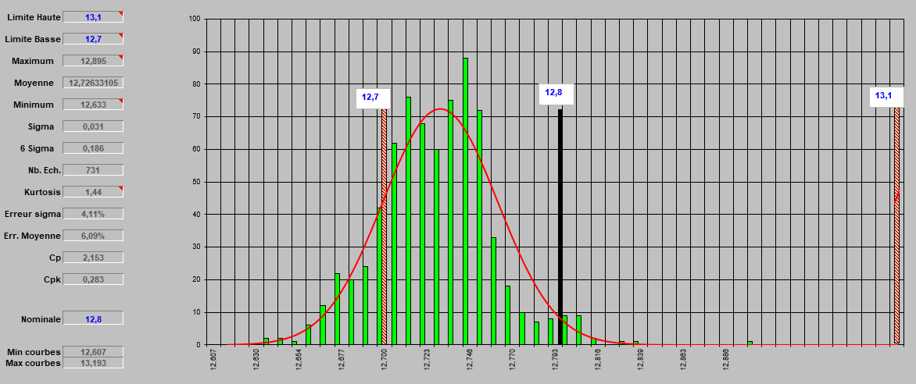
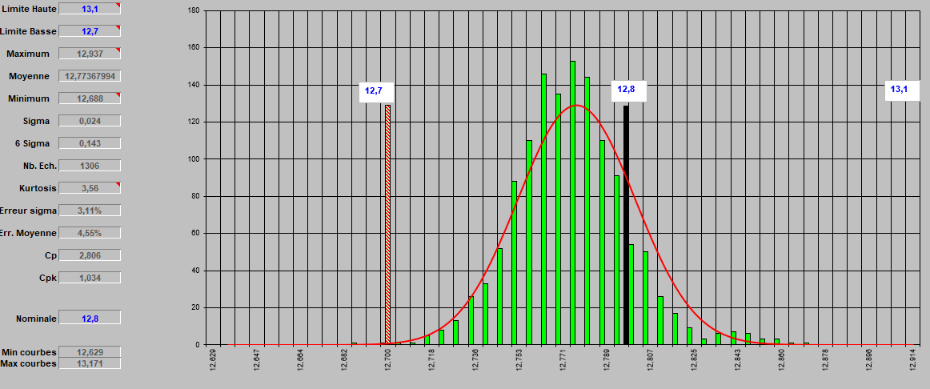
Voltage measurements
M10 PM 5/5 Power and
M10 PM SP 5/5 Premium
Period from: 23/03 to 15/04
Period from: 18/04 to 22/04
Average: From 12.72 to 12,77 : Good

Slide 9
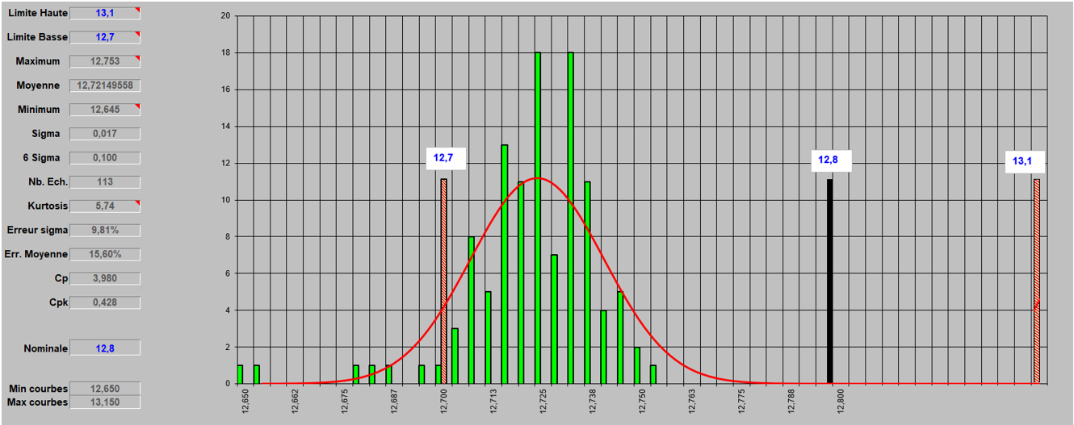
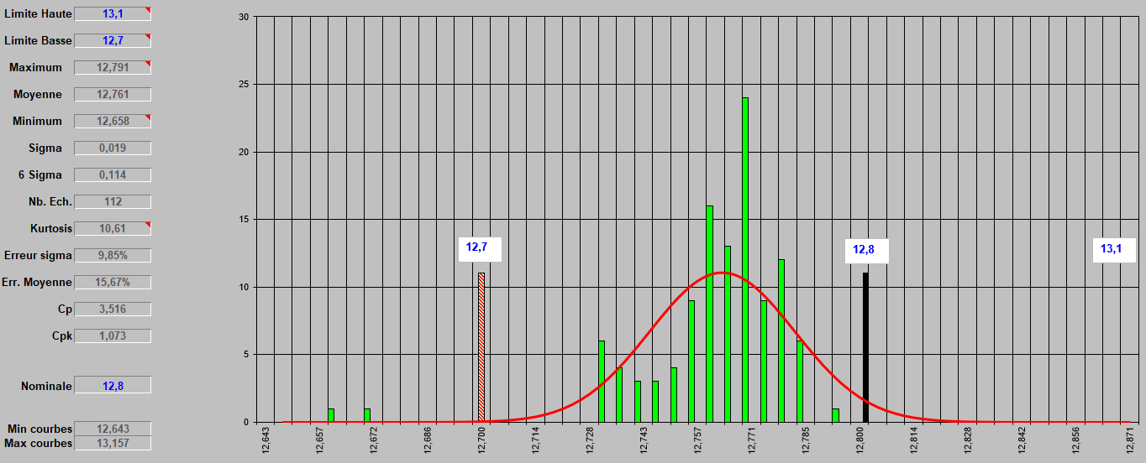
Voltage measurements
M12 PM 7/7 Power
Period from: 23/03 to 15/04
Period from: 18/04 to 22/04
Average: From 12.72 to 12,76 : Good

Slide 10
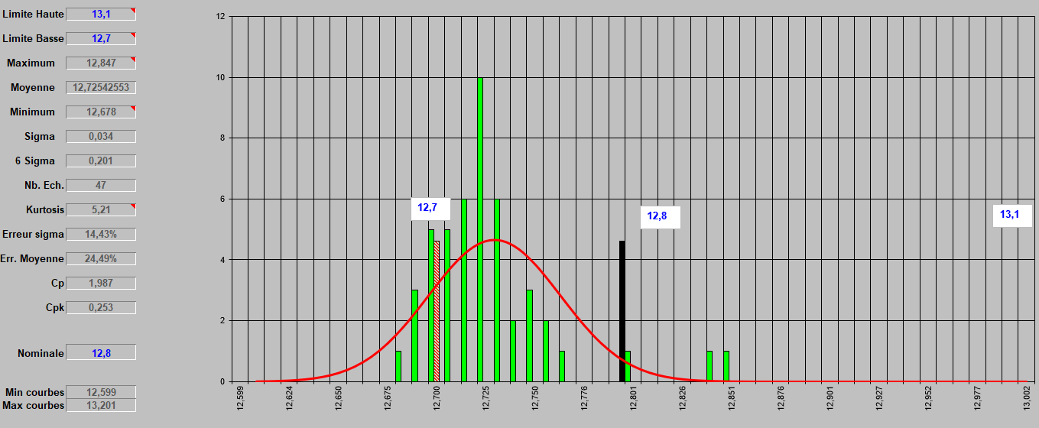
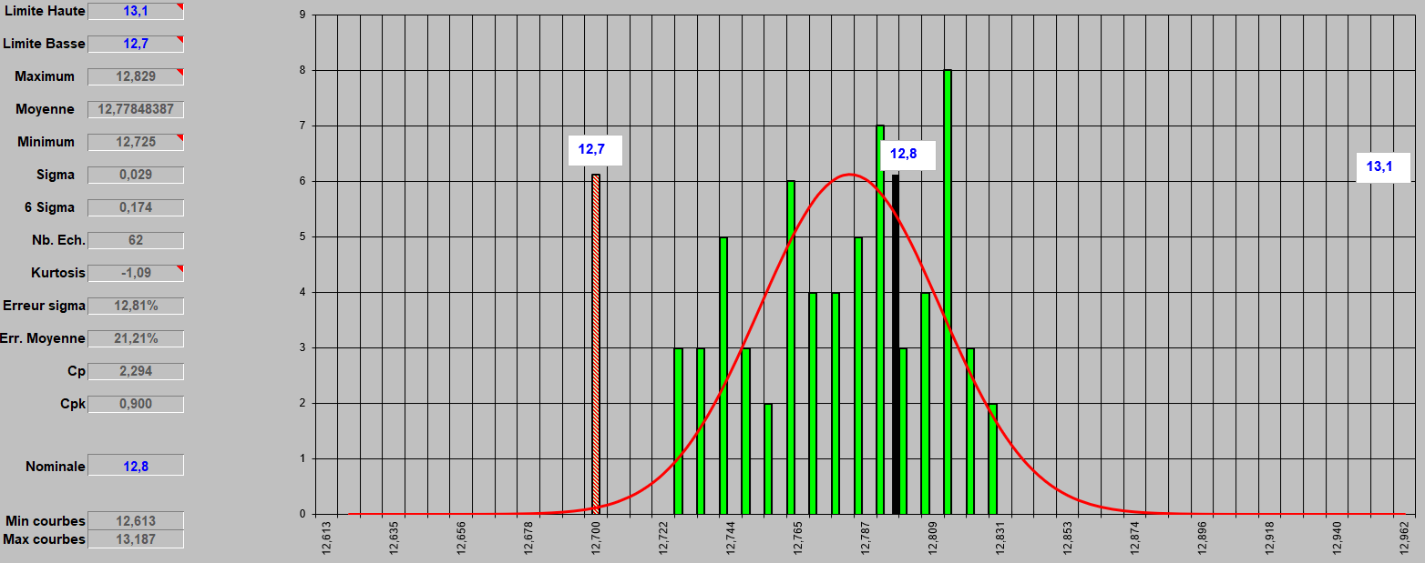
Voltage measurements
PR110 PM 8/9
Period from: 23/03 to 15/04
Period from: 18/04 to 22/04
Average: From 12.72 to 12,77 : Good

Slide 11
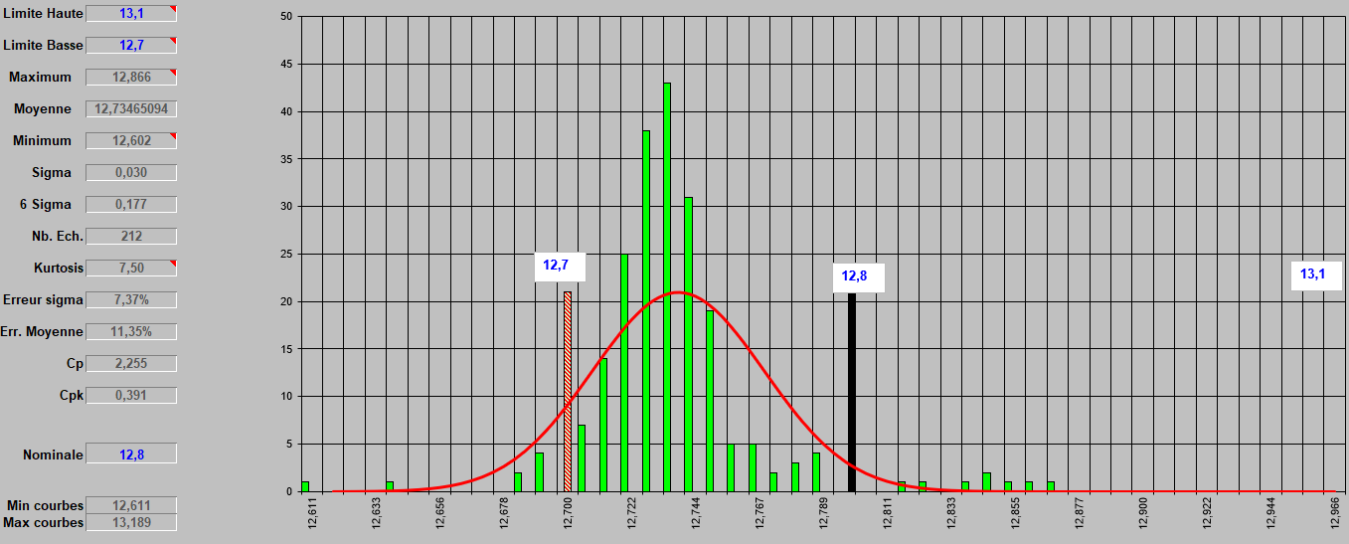
Voltage measurements
M14 PMSP 8/9 Jumbo
Period from: 23/03 to 15/04
Period from: 18/04 to 22/04
Average: From 12.73 to 12,77 : Good

Slide 12
Icca-Courent

Slide 13
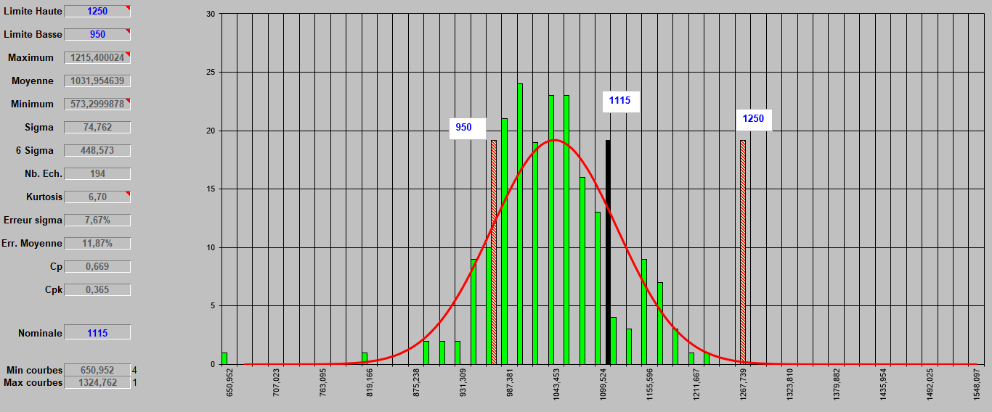
Icca measurements
45-M15 PMSP 9/10 Jumbo
Period from: 18/04 to 22/04
Average: 1031 out of 194 batteries tested, the average still closer to the lower limit

Slide 14
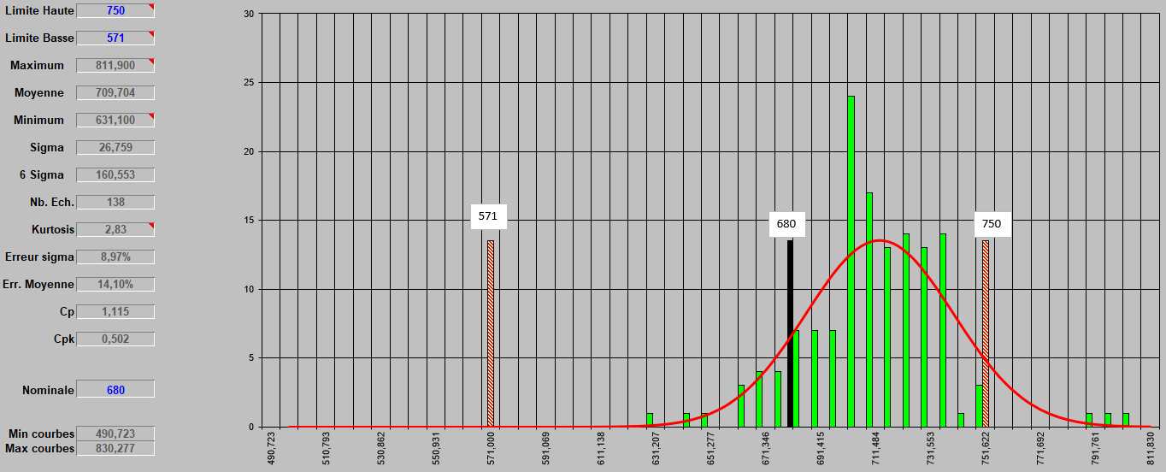
Icca measurements
27-D26 PM 5/6 Premium
Period from: 18/04 to 22/04
Average: 709 out of 138 batteries tested, the average still closer to the upper limit

Slide 15
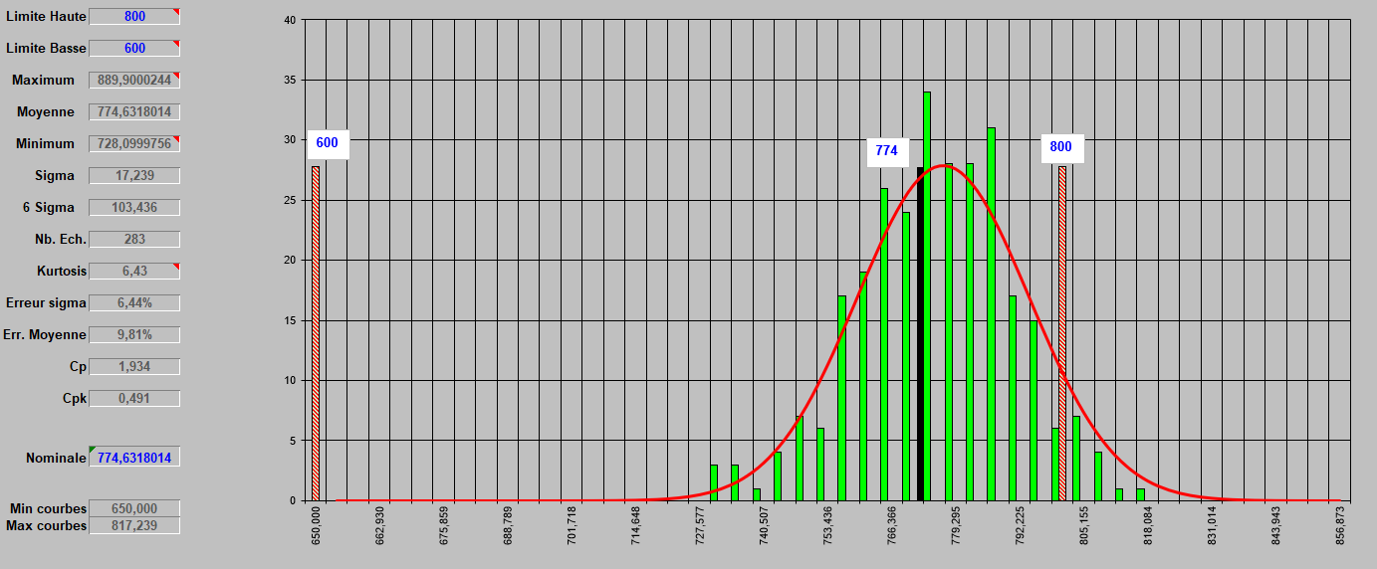
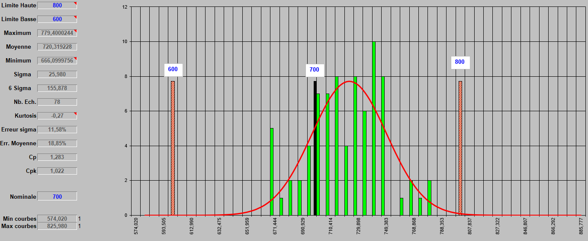
Icca measurements
35-M11 PM 6/6 Libya
Period from: 23/03 to 15/04
Period from: 18/04 to 22/04
Average: From 774 to 720

Slide 16
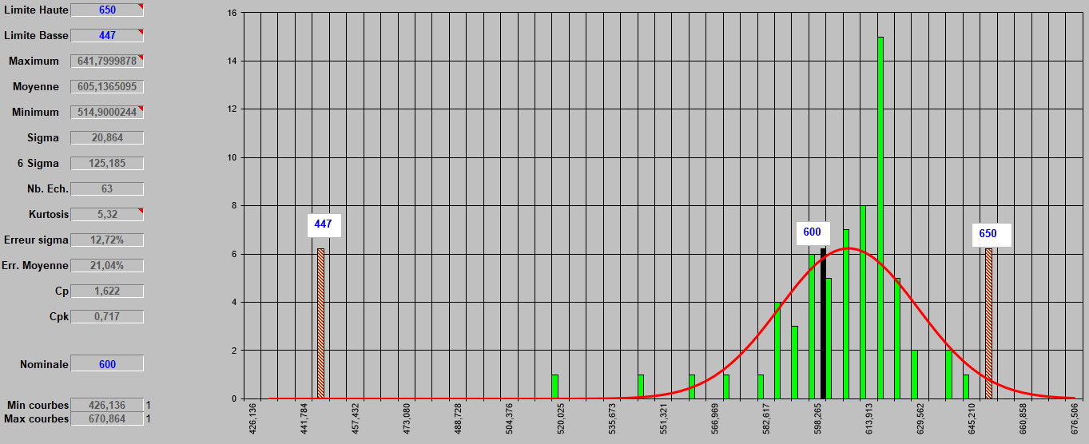
Icca measurements
6-L2 PB 5/5 Power/SMF
Period from: 18/04 to 22/04
Average: 605 out of 63 batteries tested, Average still closer to the upper limit

Slide 17
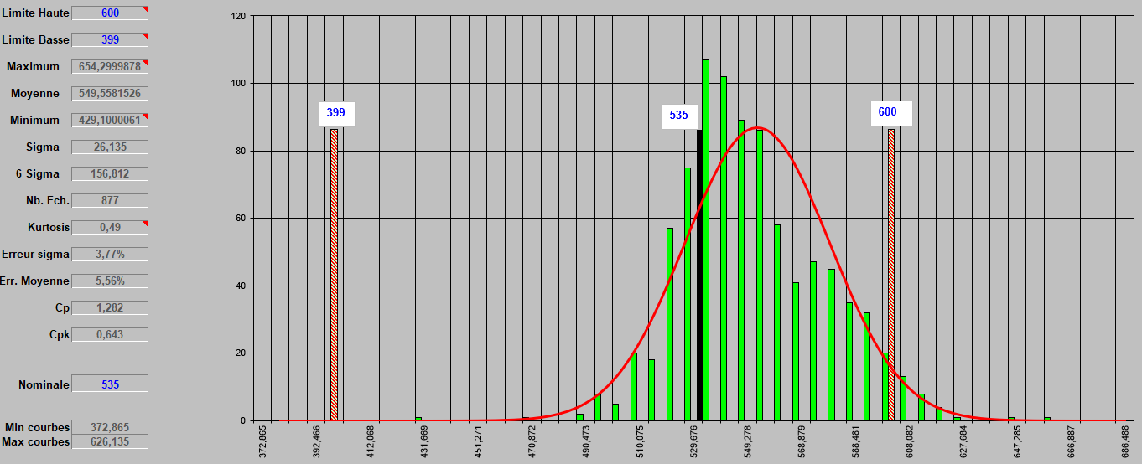
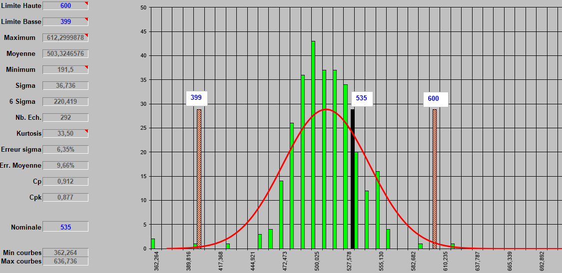
Icca measurements
5-L2 PB 4/5 Libye/SMF
Period from: 23/03 to 15/04
Period from: 18/04 to 22/04
Average: From 549 to 503

Slide 18
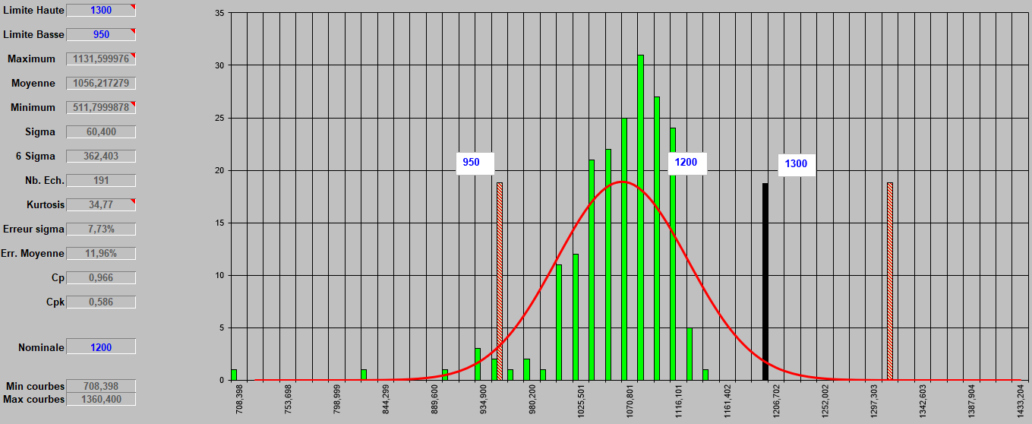
Icca measurements
48-M16 PMsp 12/13 Jumbo
Period from: 18/04 to 22/04
Average: 1056 out of 191 batteries tested, measurements still closer to the lower limit

Slide 19

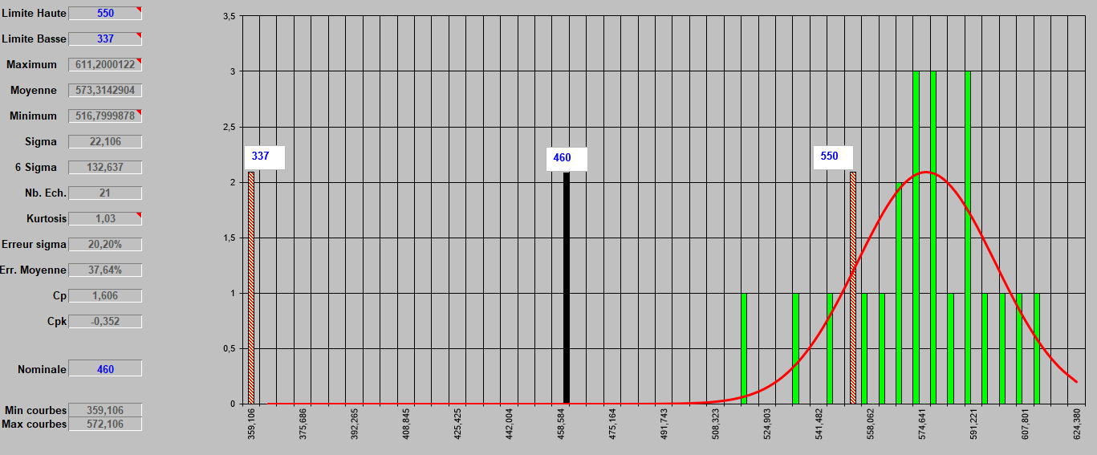
Icca measurements
23-NS60 E115 5/6 Premuim
Average: 573 out of 21 batteries tested, measurements are not between limits at all
=> ????

Slide 20
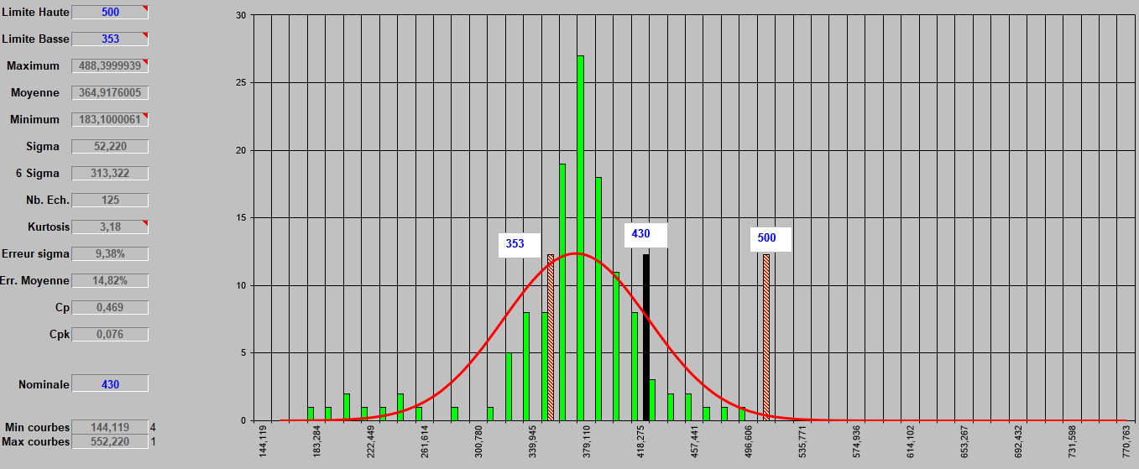
Icca measurements
22-NS40 E115 4/5 Premuim
Average: 364 out of 125 batteries tested, measurements are closer to lower limits
=> ????

Slide 21
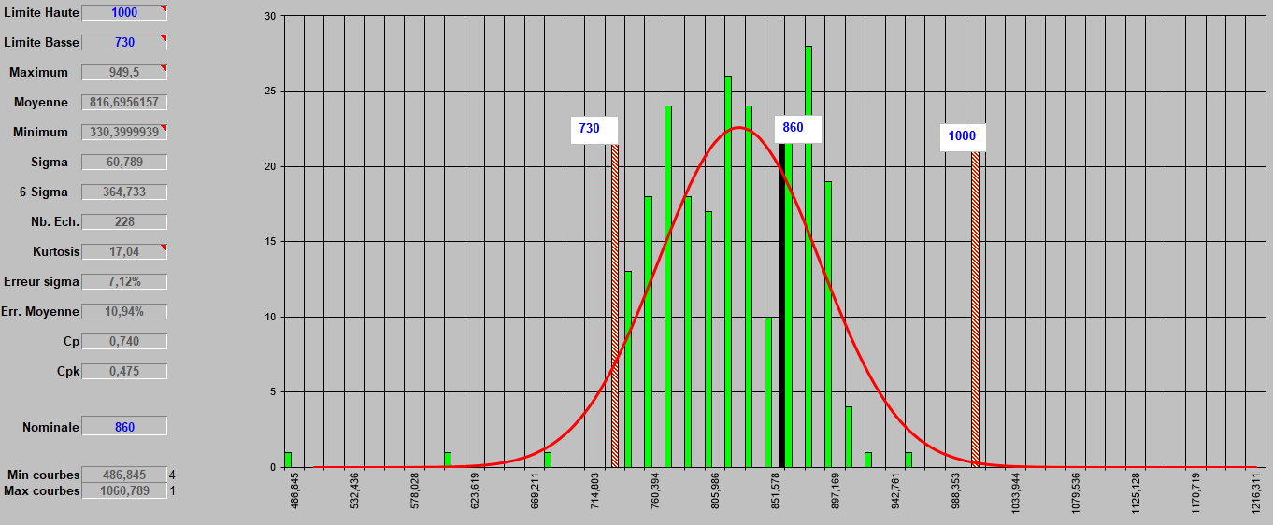
Icca measurements
29-D31 PM 7/8 Premuim
Average: 816 out of 228 batteries tested, measurements are closer to lower limits
=> ????

Slide 22
MERCI

