Slide 1


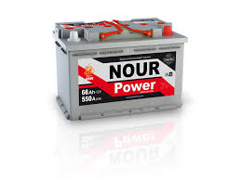
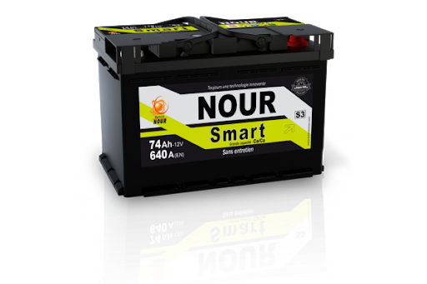
SNA NOUR
Rapport de test HRD
04-05-2022 Week 17
Achref Riahi

Slide 2
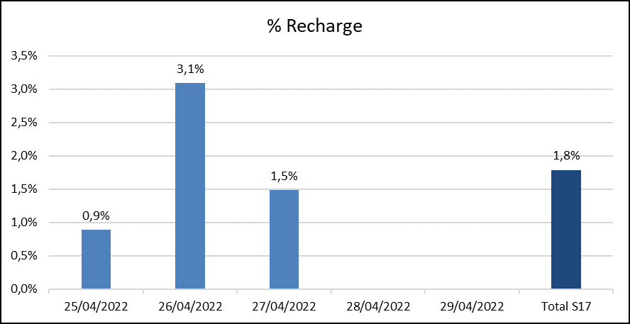
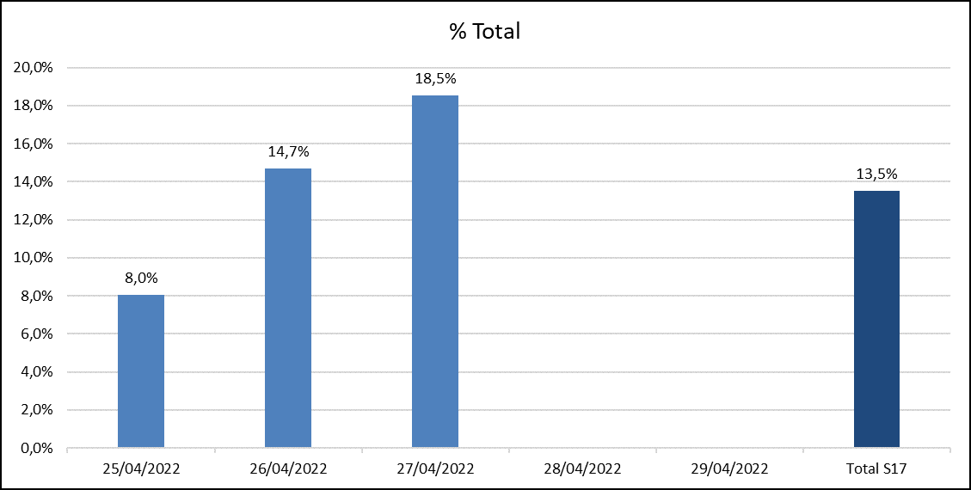
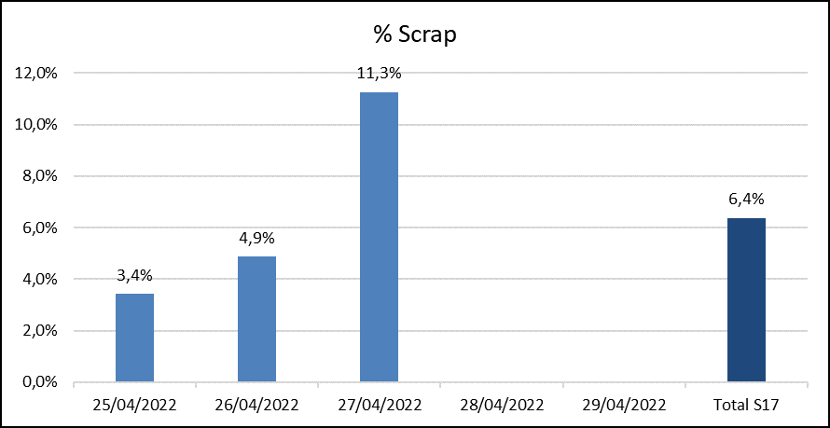
Daily Scrap Rate
Date | Qté totale testée | Total Qté Nok | % Total | Recharge | Retest | Scrap | % Recharge | % Scrap
25/04/2022 | 1456 | 117 | 8,0% | 13 | 9 | 50 | 0,9% | 3,4%
26/04/2022 | 1294 | 190 | 14,7% | 40 | 19 | 63 | 3,1% | 4,9%
27/04/2022 | 1278 | 237 | 18,5% | 19 | 48 | 144 | 1,5% | 11,3%
28/04/2022
29/04/2022
Total S17 | 4028 | 544 | 13,5% | 72 | 76 | 257 | 1,8% | 6,4%

Slide 3
Production report from 25/04 to 27/04/2022
Defect rate by battery type
Additional charge rate
Batterie | Qté totale | Qté Nok | %
22-NS40 E115 4/5 Premuim | 114 | 97 | 85,1%
4-L1 PB 5/5 S1 | 592 | 68 | 11,5%
10-L3 PB 6/6 Power /MF | 402 | 15 | 3,7%
12-L3 PB 7/7 S3 /EUF | 325 | 12 | 3,7%
42-M14 PMSP 8/9 Jumbo | 370 | 10 | 2,7%
21-NS40 E115 4/4 Libye | 41 | 10 | 24,4%
33-M10 PM SP 5/5 Premuim | 327 | 8 | 2,4%
45-M15 PMSP 9/10 Jumbo | 35 | 6 | 17,1%
6-L2 PB 5/5 Power/SMF | 31 | 6 | 19,4%
29-D31 PM 7/8 Premuim | 198 | 5 | 2,5%
11-L3 PB 6/7 Premuim /SMF | 104 | 4 | 3,8%
51-L6 PB 10/10 | 74 | 3 | 4,1%
5-L2 PB 4/5 Libye /MF | 10 | 3 | 30,0%
25-D23 PM 5/5 Premuim | 6 | 3 | 50,0%
38-M12 PM 7/7 Power | 280 | 2 | 0,7%
31-HD10 PMT 5/6 HD | 64 | 2 | 3,1%
32-M10 PM 5/5 Power | 23 | 2 | 8,7%
36-M11 PM 7/8 Premuim | 228 | 1 | 0,4%
2-L1 PB 4/4 Power | 139 | 1 | 0,7%
40-PR110 PM 8/9 | 64 | 1 | 1,6%
7-L2 PB 5/6 Premuim /L2S | 58 | 1 | 1,7%
27-D26 PM 5/6 Premuim | 33 | 1 | 3,0%
Date | Qté totale | Qté Recharge | % Recharge
42-M14 PMSP 8/9 Jumbo | 370 | 18 | 5%
4-L1 PB 5/5 S1 | 592 | 9 | 2%
10-L3 PB 6/6 Power /MF | 402 | 6 | 1%
38-M12 PM 7/7 Power | 280 | 6 | 2%
36-M11 PM 7/8 Premuim | 228 | 6 | 3%
45-M15 PMSP 9/10 Jumbo | 35 | 6 | 17%
19-L5 PB 9/9 S5 | 176 | 5 | 3%
2-L1 PB 4/4 Power | 139 | 5 | 4%
51-L6 PB 10/10 | 74 | 3 | 4%
29-D31 PM 7/8 Premuim | 198 | 2 | 1%
11-L3 PB 6/7 Premuim /SMF | 104 | 2 | 2%
27-D26 PM 5/6 Premuim | 33 | 2 | 6%
7-L2 PB 5/6 Premuim /L2S | 58 | 1 | 2%
9-L3 PB 5/6 Libye | 5 | 1 | 20%

Slide 4
Types of defects
Message d’erreur | Nombre de Message
ΔU bigger than setting; | 165
Error OCV min.!; | 93
Error Icca min.;Error HRDV min.;ΔU bigger than setting;Error R internal Max.; | 60
Error Icca min.; | 53
Error Icca min.;Error HRDV min.;ΔU bigger than setting; | 46
Reverse polarity; | 24
Error Icca min.;Error HRDV min.; | 23
Current out of limit!;Error HRDV min.; | 18
Error Icca min.;ΔU bigger than setting; | 13
Error Icca min.;Error HRDV min.;Error R internal Max.; | 11
 | 11
Error OCV max.!; | 10
Error HRDV min.; | 6
Error HRDV min.;ΔU bigger than setting; | 6
Error Icca max.; | 2
Error HRDV min.;Error R internal Max.; | 1
Total général | 542
Défaut | 11/4 | 12/4 | 13/4 | 14/4 | 15/4 | 18/4 | 19/4 | 20/4 | 21/4 | 22/4 | 25/4 | 26/4 | 27/4
ΔU bigger than setting | 64 | 111 | 22 | 49 | 112 | 55 | 37 | 123 | 44 | 33 | 65 | 103 | 138
Error HRDV min | 145 | 89 | 46 | 30 | 124 | 81 | 55 | 51 | 77 | 33 | 60 | 102 | 44
Error Icca min | 56 | 70 | 27 | 16 | 79 | 58 | 66 | 55 | 73 | 47 | 71 | 116 | 40
Error OCV min | 81 | 58 | 62 | 45 | 55 | 58 | 14 | 23 | 41 | 11 | 17 | 40 | 36
Reverse polarity | 4 | 7 | 6 | 6 | 7 | 5 | 5 | 22 | 8 | 10 | 3 | 1 | 20
Error R internal Max | 20 | 75 | 8 | 6 | 55 | 25 | 10 | 28 | 13 | 9 | 35 | 41 | 13
Current out of limit | 14 | 8 | 28 | 13 | 31 | 25 | 5 | 8 | 23 | 5 | 3 | 14 | 10
Error OCV max |  | 41 | 4 |  | 6 |  |  | 16 | 2 |  |  | 2 | 8
Error Icca max |  | 3 | 15 | 55 | 18 | 3 |  | 31 |  | 24 |  | 1 | 1
Error HRDV max |  | 1 |  | 3 | 3

Slide 5
Voltages Average
 | Average from 23/03 to 26/03 | Average from 28/03 to 19/04 | Average from 20/04 to 22/04 | Average from 25/04 to 29/04
Average per type | 12,75 | 12,78 | 12,80 | 12,79
1-L1 PB 3/4 Libye |  | 12,78
2-L1 PB 4/4 Power | 12,76 | 12,78 | 12,84 | 12,81
3-L1 PB 4/5 Premuim/SMF | 12,78 | 12,72 | 12,85 | 12,85
5-L2 PB 4/5 Libye /MF |  | 12,76 | 12,79 | 12,79
6-L2 PB 5/5 Power/SMF | 12,78 | 12,77 | 12,80 | 12,81
7-L2 PB 5/6 Premuim /L2s |  | 12,77 | 12,84 | 12,83
8-L2 PB 6/6 S2 |  | 12,79 | 12,85 | 12,81
9-L3 PB 5/6 Libye | 12,74 | 12,75 |  | 12,78
10-L3 PB 6/6 Power /MF | 12,77 | 12,78 | 12,79 | 12,78
11-L3 PB 6/7 Premuim /SMF |  | 12,79 | 12,80 | 12,78
12-L3 PB 7/7 S3 /EUF | 12,75 | 12,80 | 12,81 | 12,79
13-L3 PB 7/8 S3B |  | 12,78 | 12,80
16-L5 PB 7/8 Libye |  | 12,79
17-L5 PB 8/8 Power/MF | 12,73 | 12,80 |  | 12,82
19-L5 PB 9/9 S5 | 12,75 | 12,80 |  | 12,80
21-NS40 E115 4/4 Libye |  | 12,86 | 12,86 | 12,89
22-NS40 E115 4/5 PREMUIM |  | 12,86 | 12,89 | 12,84
23-NS60 E115 5/6 PREMUIM |  |  | 12,89
24-D23 PM 4/5 LIBYE |  | 12,78
26-D26 PM 5/5 LIBYE |  |  | 12,82
27-D26 PM 5/6 PREMUIM | 12,78 | 12,78 | 12,74 | 12,77
28-D31 PM 6/7 LIBYE |  |  | 12,78 | 12,82
29-D31 PM 7/8 PREMUIM |  | 12,73 | 12,80 | 12,79
30-M10 PM 4/4 LIBYE |  |  | 12,81
31-HD10 PMT 5/6 HD |  | 12,74 |  | 12,78
32-M10 PM 5/5 Power | 12,72 | 12,75 | 12,78 | 12,78
33-M10 PM SP 5/5 Premuim | 12,74 | 12,77 | 12,78 | 12,77
34-M11 PM 7/7 Power | 12,80 | 12,80 |  | 12,80
35-M11 PM 6/6 Libye |  | 12,76 | 12,79
36-M11 PM 7/8 Premuim | 12,78 | 12,78 | 12,78 | 12,78
38-M12 PM 7/7 POWER | 12,73 | 12,71 | 12,76 | 12,74
39-M12 PM 8/8 PRMUIM |  | 12,89 | 12,76 | 12,79
40-PR110 PM 8/9 |  | 12,73 | 12,78 | 12,78
42-M14 PMSP 8/9 Jumbo | 12,75 | 12,75 | 12,75 | 12,76
44-M15 PMSP 9/9 LIBYE | 12,68 | 12,80
45-M15 PMSP 9/10 JUMBO | 12,75 | 12,77 | 12,78 | 12,78
46-M15 PMSP 11/12 Jumbo S/MF | 12,76 | 12,80 | 12,77
48-M16 PMSP 12/13 JUMBO | 12,76 | 12,78 | 12,76 | 12,77
50-MAR200 PM 13/14 MAR200 |  | 12,76 | 12,75 | 12,77
51-L6 PB 10/10 | 12,75 | 12,73 |  | 12,76

Slide 6
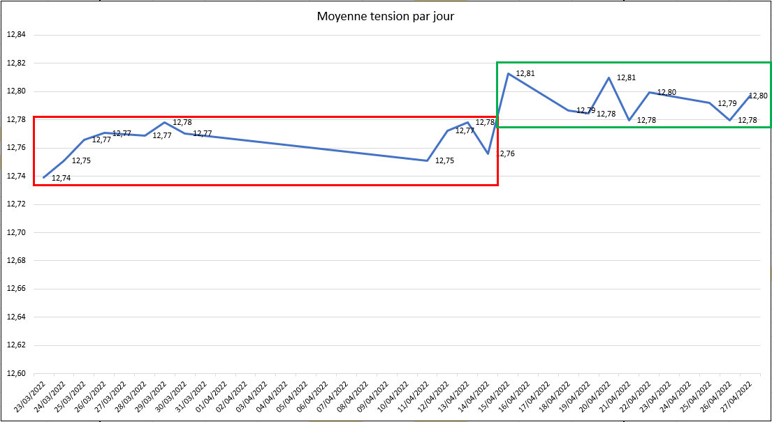

Voltages Average
Voltages Daily Average

Slide 7
Product & process improvement points

Slide 8
OCV-Voltage

Slide 9
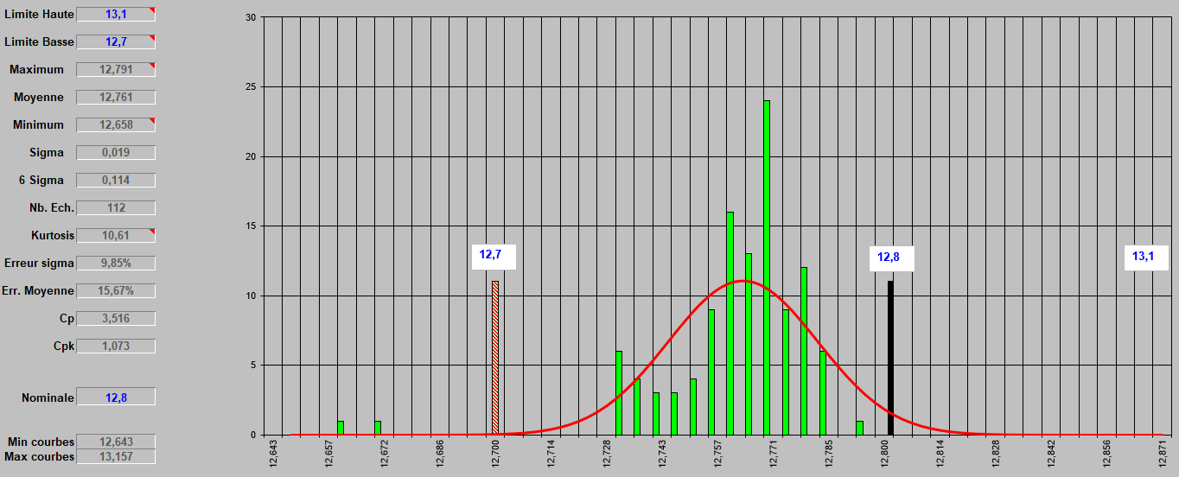
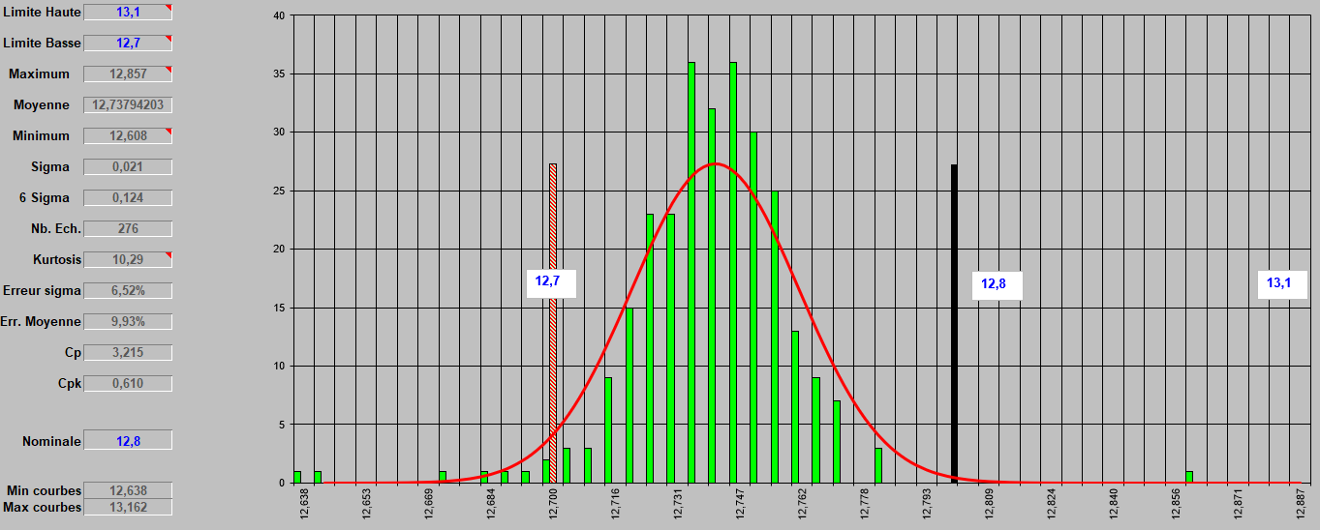
Voltage measurements
38-M12 PM 7/7 Power
Period from: 18/04 to 22/04
Period from: 25/04 to 29/04
Average: From 12.76 to 12,73 : ???

Slide 10
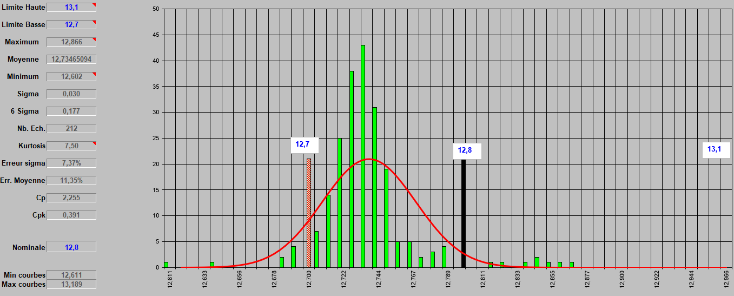
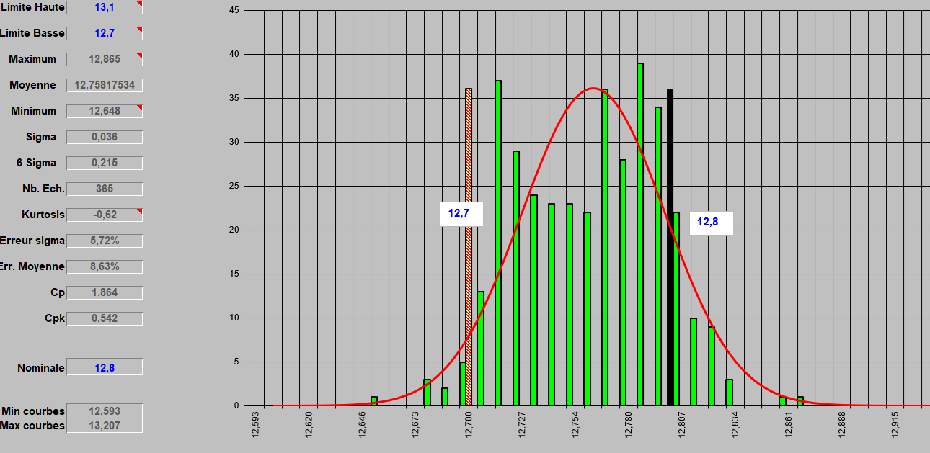
Voltage measurements
42-M14 PMSP 8/9 Jumbo
Period from: 23/03 to 15/04
Period from: 25/04 to 29/04
Average: From 12.73 to 12,75 : still need improvement

Slide 11
Icca-Current

Slide 12
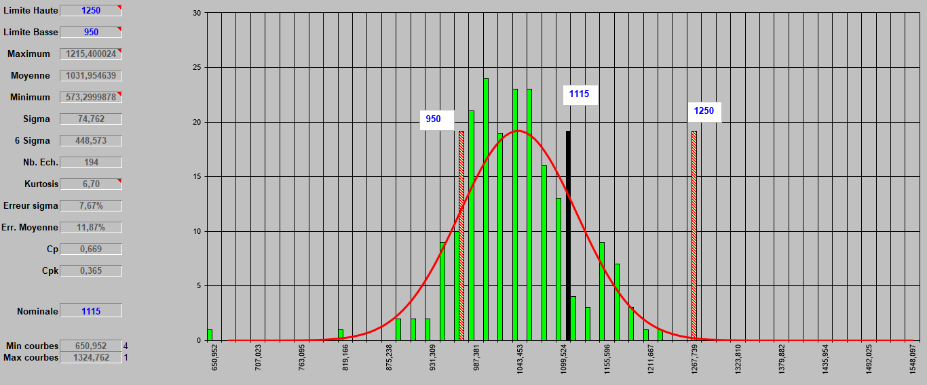
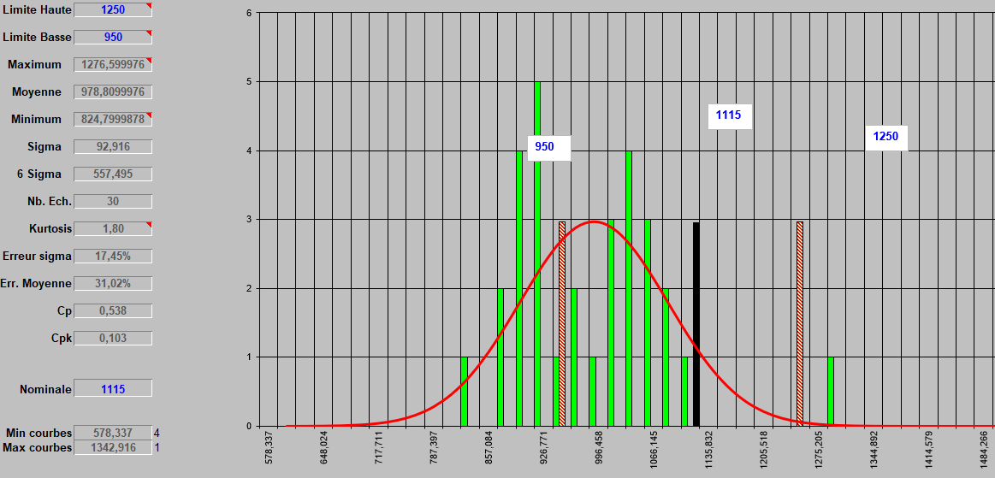
Icca measurements
45-M15 PMSP 9/10 Jumbo
Period from: 18/04 to 22/04
Period from: 25/04 to 29/04
Average: 1031 out of 194 batteries tested
Average: 978 out of 30 batteries tested

Slide 13
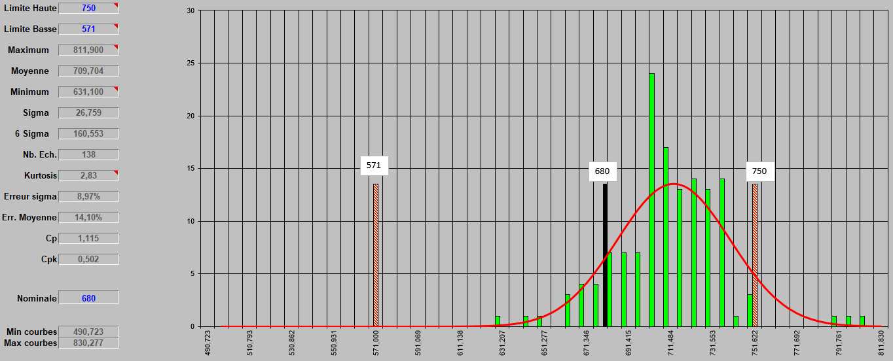
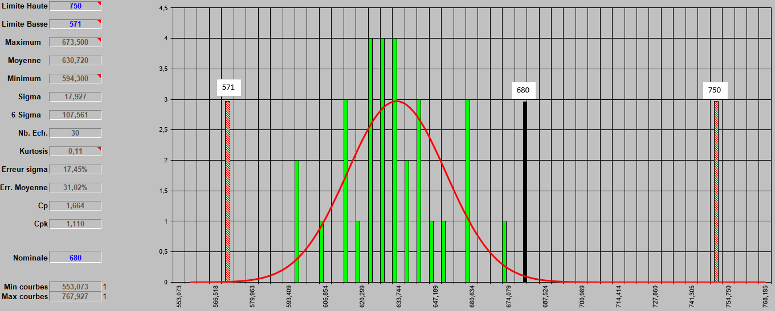
Icca measurements
27-D26 PM 5/6 Premium
Period from: 18/04 to 22/04
Period from: 25/04 to 29/04
Average: 709 out of 138 batteries tested
Average: 630 out of 30 batteries tested

Slide 14
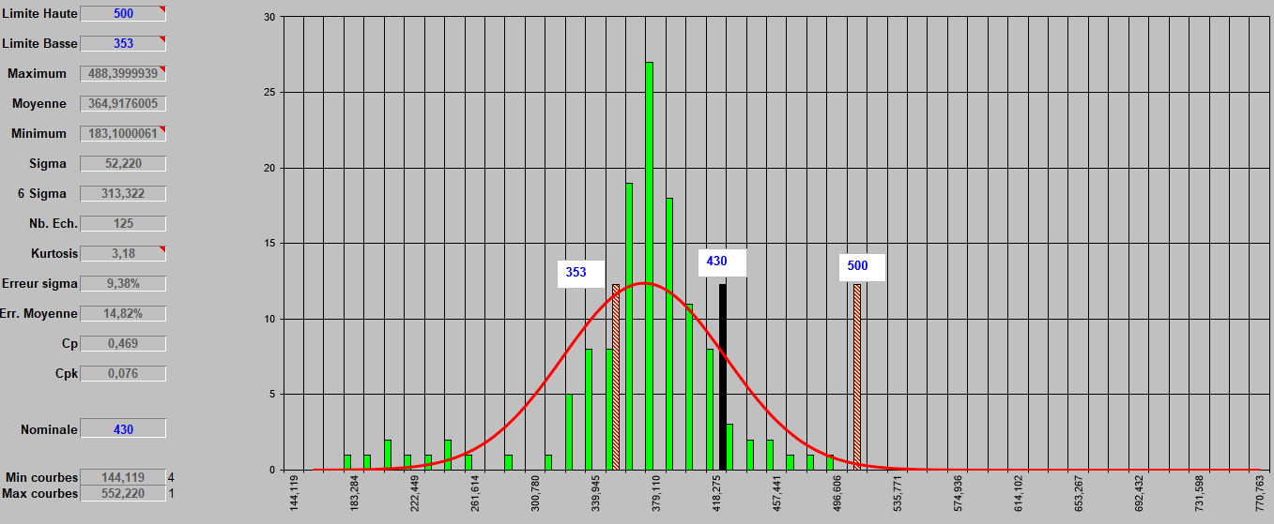
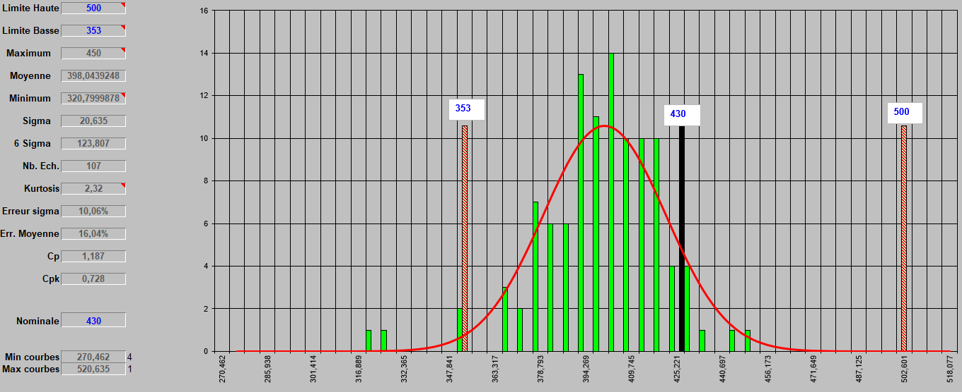
Icca measurements
22-NS40 E115 4/5 Premuim
Period from: 12/04 to 20/04
Period from: 25/04 to 27/04
Average: 364 out of 125 batteries tested
Average: 398 out of 107 batteries tested

Slide 15

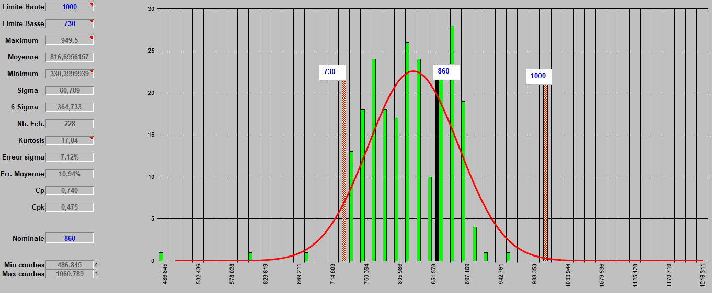
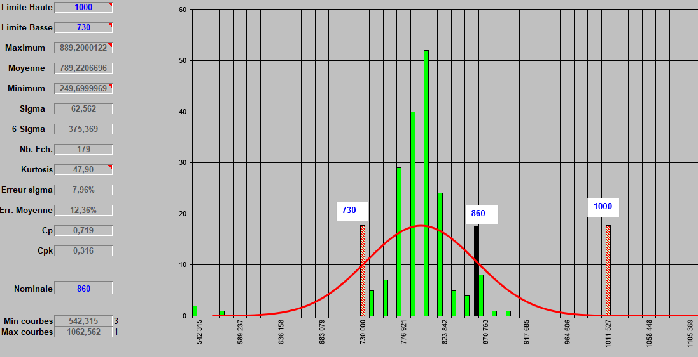
Icca measurements
29-D31 PM 7/8 Premuim
Period from: 12/04 to 22/04
Period from: 25/04 to 27/04
Average: 816 out of 228 batteries tested
Average: 789 out of 179 batteries tested

Slide 16
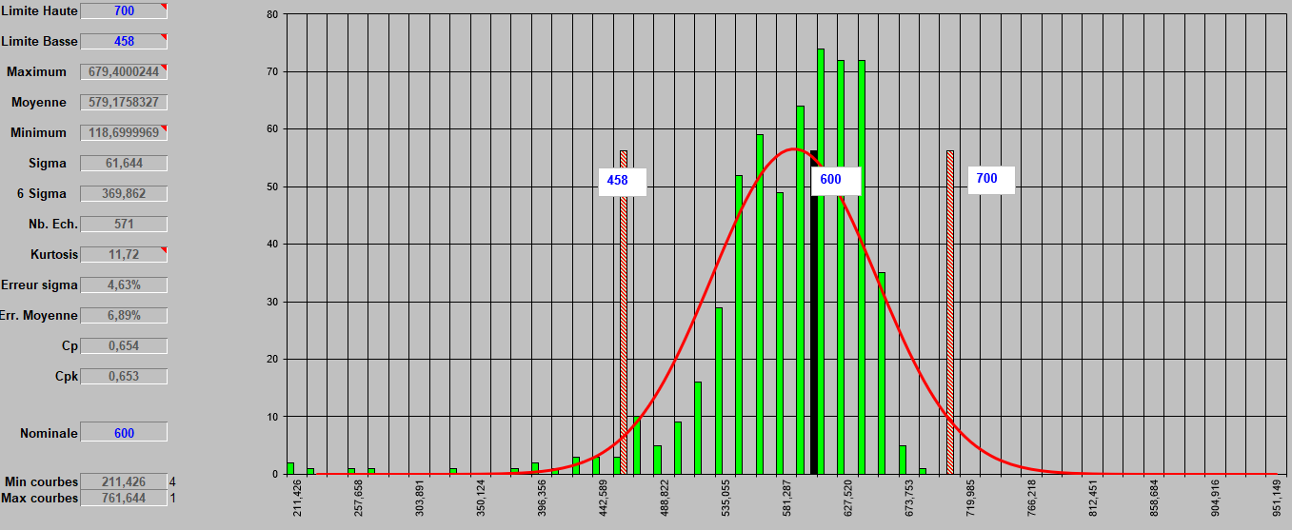
Icca measurements
4-L1 PB 5/5 S1
Maybe Limits should be reviewed

Slide 17
MERCI

