Slide 1


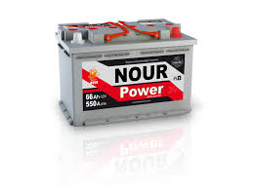
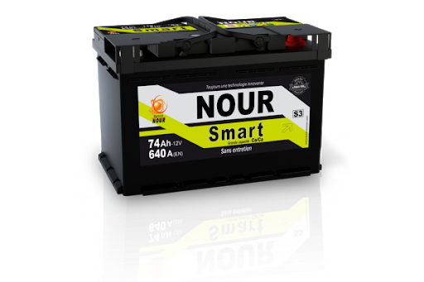
SNA NOUR
Rapport de test HRD
23-05-2022 Week 20
Achref Riahi

Slide 2
Weekly Scrap Rate

Slide 3
Production report Week 20
Defect rate by battery type
Additional charge rate
Batterie | Qté totale | Qté Nok | %
12-L3 PB 7/7 S3 /EUF | 876 | 47 | 5,4%
32-M10 PM 5/5 Power | 805 | 36 | 4,5%
10-L3 PB 6/6 Power /MF | 72 | 21 | 29,2%
27-D26 PM 5/6 Premuim | 112 | 11 | 9,8%
8-L2 PB 6/6 S2 | 464 | 9 | 1,9%
6-L2 PB 5/5 Power/SMF | 88 | 5 | 5,7%
11-L3 PB 6/7 Premuim /SMF | 66 | 4 | 6,1%
2-L1 PB 4/4 Power | 263 | 4 | 1,5%
50-MAR200 PM 13/14 MAR200 | 56 | 3 | 5,4%
26-D26 PM 5/5 Libye | 3 | 2 | 66,7%
Batterie | Qté totale | Qté Nok | %
12-L3 PB 7/7 S3 /EUF | 876 | 38 | 4,3%
8-L2 PB 6/6 S2 | 464 | 32 | 6,9%
3-L1 PB 4/5 Premuim/SMF | 233 | 23 | 9,9%
7-L2 PB 5/6 Premuim /L2S | 359 | 17 | 4,7%
2-L1 PB 4/4 Power | 263 | 17 | 6,5%
38-M12 PM 7/7 Power | 181 | 15 | 8,3%
11-L3 PB 6/7 Premuim /SMF | 66 | 14 | 21,2%
50-MAR200 PM 13/14 MAR200 | 56 | 10 | 17,9%
32-M10 PM 5/5 Power | 805 | 10 | 1,2%
4-L1 PB 5/5 S1 | 71 | 9 | 12,7%

Slide 4
Types of defects
Message d’erreur | Nombre de Message
Error OCV min.!; | 226
ΔU bigger than setting; | 95
Error Icca min.;Error HRDV min.;ΔU bigger than setting;Error R internal Max.; | 56
Current out of limit!;Error HRDV min.; | 55
Error Icca max.; | 38
Error Icca min.;Error HRDV min.; | 38
Error Icca min.; | 35
Error Icca min.;Error HRDV min.;Error R internal Max.; | 28
Error HRDV min.; | 26
Error Icca min.;Error HRDV min.;ΔU bigger than setting; | 26
Error Icca min.;ΔU bigger than setting; | 12
Reverse polarity; | 10
 | 9
Error OCV max.!; | 9
Error HRDV min.;ΔU bigger than setting; | 8
Current out of limit!; | 2
Error Icca min.;ΔU bigger than setting;Error R internal Max.; | 1
Error Icca min.;Error R internal Max.; | 1
Total général | 675
Défaut | S20
Error HRDV min | 237
Error OCV min | 226
ΔU bigger than setting | 198
Error Icca min | 197
Error R internal Max | 86
Current out of limit | 57
Error Icca max | 38
Reverse polarity | 10
Error OCV max | 9
Error HRDV max

Slide 5
Voltages Average
 | Moyenne | Moyenne par semaine
 |  | S12 | S13 | S15 | S16 | S17 | S19 | S20 | S21
Moyenne par référence | 12,78 | 12,75 | 12,77 | 12,78 | 12,80 | 12,79 | 12,79 | 12,78 | 12,80
1-L1 PB 3/4 Libye | 12,79 |  |  | 12,79 | 12,78 |  | 12,79
2-L1 PB 4/4 Power | 12,80 | 12,76 | 12,78 | 12,77 | 12,82 | 12,81 | 12,84 | 12,80
3-L1 PB 4/5 Premuim/SMF | 12,79 | 12,78 | 12,75 | 12,70 | 12,85 | 12,85 | 12,80 | 12,84
5-L2 PB 4/5 Libye /MF | 12,79 |  |  | 12,78 | 12,75 | 12,79 | 12,78 | 12,84
6-L2 PB 5/5 Power/SMF | 12,79 | 12,78 | 12,78 | 12,76 | 12,81 | 12,81 | 12,83 | 12,79
7-L2 PB 5/6 Premuim /L2s | 12,81 |  | 12,77 | 12,79 | 12,84 | 12,83 | 12,82 | 12,79 | 12,85
8-L2 PB 6/6 S2 | 12,81 |  | 12,77 | 12,78 | 12,83 | 12,81 | 12,85 | 12,78 | 12,83
9-L3 PB 5/6 Libye | 12,76 | 12,74 | 12,77 | 12,75 |  | 12,78
10-L3 PB 6/6 Power /MF | 12,76 | 12,76 | 12,80 | 12,77 | 12,76 | 12,78 | 12,73 | 12,71
11-L3 PB 6/7 Premuim /SMF | 12,78 |  | 12,79 | 12,79 | 12,82 | 12,78 | 12,75 | 12,76
12-L3 PB 7/7 S3 /EUF | 12,79 | 12,75 | 12,77 | 12,82 | 12,79 | 12,80 | 12,83 | 12,79
13-L3 PB 7/8 S3B | 12,81 |  |  | 12,82 | 12,80
14-L4 PB 7/7 Power | 12,68 |  |  |  |  |  | 12,68
16-L5 PB 7/8 Libye | 12,77 |  |  | 12,79 | 12,79 |  | 12,73
17-L5 PB 8/8 Power/MF | 12,80 | 12,73 |  | 12,84 | 12,82 | 12,82 | 12,81 | 12,80
19-L5 PB 9/9 S5 | 12,79 | 12,75 |  | 12,75 | 12,85 | 12,80 | 12,80 | 12,80
21-NS40 E115 4/4 Libye | 12,94 |  |  | 12,86 | 12,86 | 12,89 | 13,15
22-NS40 E115 4/5 PREMUIM | 12,85 |  |  | 12,81 | 12,89 | 12,84 | 12,85
23-NS60 E115 5/6 PREMUIM | 12,85 |  |  |  | 12,89 |  | 12,82
24-D23 PM 4/5 LIBYE | 12,82 |  |  | 12,78 |  |  | 12,84 | 12,84
26-D26 PM 5/5 LIBYE | 12,77 |  |  |  | 12,82 |  | 12,79 | 12,70
27-D26 PM 5/6 PREMUIM | 12,76 | 12,78 | 12,80 | 12,74 | 12,74 | 12,77 |  | 12,76
28-D31 PM 6/7 LIBYE | 12,78 |  |  |  | 12,78 | 12,82 |  | 12,74
29-D31 PM 7/8 PREMUIM | 12,78 |  |  | 12,75 | 12,80 | 12,78 | 12,77
30-M10 PM 4/4 LIBYE | 12,81 |  |  |  | 12,81
31-HD10 PMT 5/6 HD | 12,76 |  | 12,74 |  | 12,73 | 12,80 |  | 12,77
32-M10 PM 5/5 Power | 12,75 | 12,72 | 12,74 | 12,73 | 12,78 | 12,78 | 12,77 | 12,77
33-M10 PM SP 5/5 Premuim | 12,76 | 12,74 | 12,75 | 12,74 | 12,77 | 12,77 | 12,81 | 12,78
34-M11 PM 7/7 Power | 12,80 | 12,81 | 12,78 | 12,82 |  | 12,80 | 12,82 | 12,80
35-M11 PM 6/6 Libye | 12,76 |  | 12,72 | 12,78 | 12,79 |  | 12,77 | 12,75
36-M11 PM 7/8 Premuim | 12,78 | 12,78 | 12,82 | 12,77 | 12,78 | 12,78 | 12,74
38-M12 PM 7/7 POWER | 12,74 | 12,73 |  | 12,71 | 12,76 | 12,74 | 12,72 | 12,77
39-M12 PM 8/8 PRMUIM | 12,79 |  |  | 12,89 | 12,76 | 12,79 | 12,76 | 12,75
40-PR110 PM 8/9 | 12,76 |  |  | 12,73 | 12,78 | 12,78 | 12,75 | 12,79
42-M14 PMSP 8/9 Jumbo | 12,77 | 12,73 | 12,77 | 12,75 | 12,75 | 12,76 | 12,76 | 12,81 | 12,81
44-M15 PMSP 9/9 LIBYE | 12,74 | 12,68 |  | 12,79 |  |  | 12,74
45-M15 PMSP 9/10 JUMBO | 12,78 | 12,75 | 12,78 | 12,76 | 12,78 | 12,78 | 12,79 | 12,82 | 12,79
46-M15 PMSP 11/12 Jumbo S/MF | 12,79 | 12,76 | 12,79 | 12,81 | 12,77 |  | 12,74 | 12,85
48-M16 PMSP 12/13 JUMBO | 12,77 | 12,76 | 12,75 | 12,78 | 12,77 | 12,77 | 12,75 | 12,79 | 12,75
50-MAR200 PM 13/14 MAR200 | 12,76 |  |  |  | 12,75 | 12,77 | 12,79 | 12,75 | 12,76
51-L6 PB 10/10 | 12,74 | 12,75 |  | 12,73 |  | 12,76 | 12,72

Slide 6
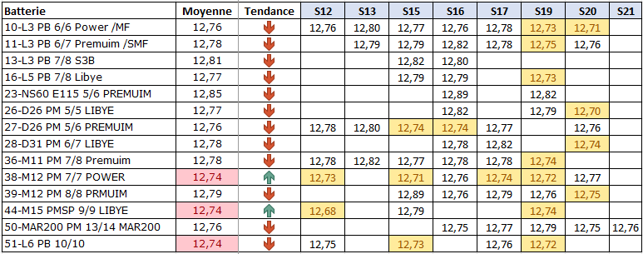
Voltages Average
Voltages Average: Batteries with not stable voltages average

Slide 7
MERCI

